Slide 1

35th TF online meeting of the ICP-Vegetation, February 2022
Analysis of heavy metal and POP pollution trends in the EMEP region basing on results
of atmospheric modelling and moss surveys
Ilyin I, Gusev A., Travnikov O., Batrakova N., Rozovskaya O., Strizhkina I.
EMEP/MSC-E

Slide 2
Objective: to examine long-term changes of HM and POP pollution levels in the EMEP region using results of atmospheric modelling, monitoring and moss surveys.
Outline
Motivation
Approach
Long-term changes of Pb, Cd and Hg
Long-term changes of second priority metals (Cu)
Levels and changes of POPs

Slide 3
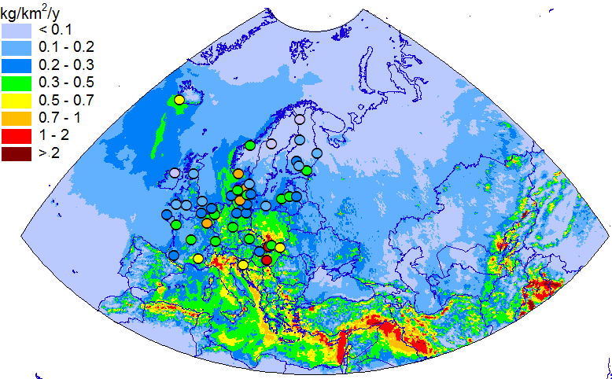
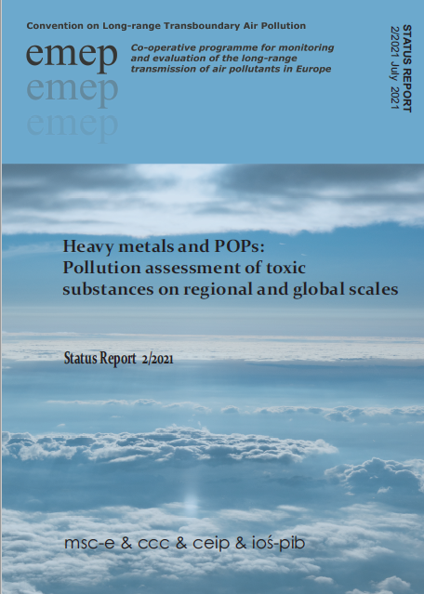
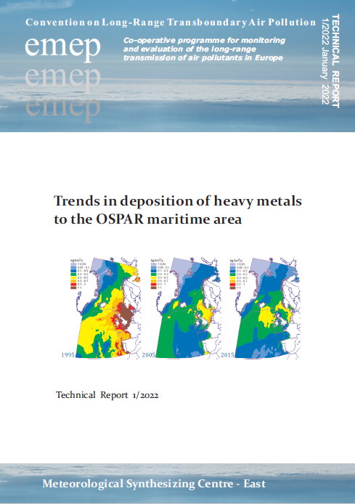
Modelling of heavy metal transport and deposition
for EMEP countries
Model output information for EMEP countries:
Pb wet deposition in 2019
Deposition and concentration levels
Transboundary fluxes
Deposition to marginal seas, Arctic etc..
Long-term trends
Evaluation against measurements

Slide 4
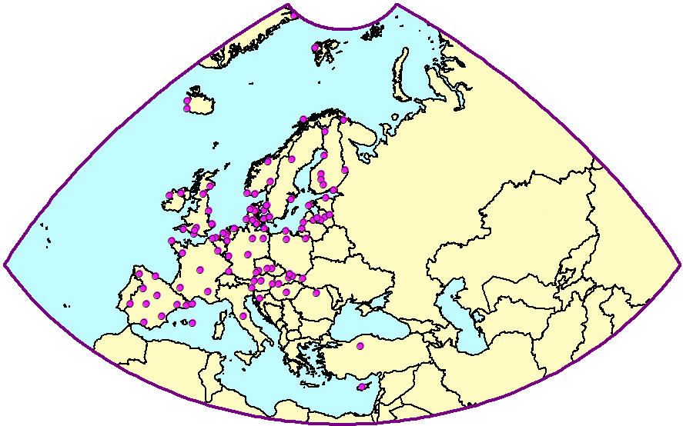
EMEP monitoring network (heavy metals)
Pro:
High temporal resolution
Quality is controlled and documented
Contra:
Few stations per country (1 – 6)
No available data from east Europe and Central Asia
EMEP monitoring stations (heavy metals)

Slide 5
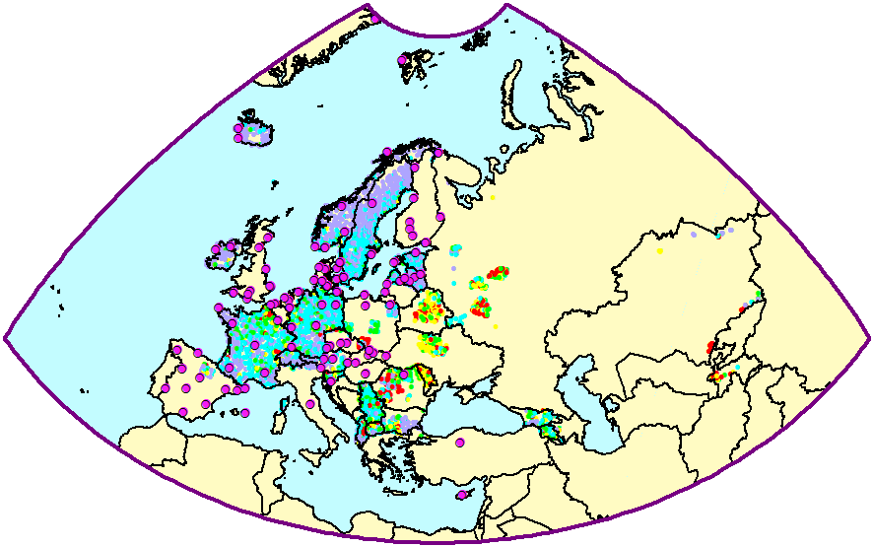
Moss sampling plots (survey 2015)
μg/g
< 0.1
Pro:
Dense spatial coverage within countries
Availability in East Europe and Central Asia
Contra:
Coarse temporal resolution
(~ 3 years accumulation)
Observed values depends on deposition and other factors (not easy to interpret the results)
0.1 – 0.2
0.2 – 0.3
0.3 – 0.5
> 0.5
Cd in mosses and EMEP stations
Combination of station-based measurements and results of biomonitoring can be useful for evaluation of long-term trends in the EMEP region

Slide 6
Approach
Data used:
HMs (Pb, Cd, Hg, Cu) in mosses (surveys of 1990, 1995, 2000, 2005, 2010, 2015);
provided by ICP-Vegetation
POPs (BaP, HCB, PCB-153, BDE-99) in 2010 and 2015 (from ICP-Vegetation)
Modelled deposition of HMs and POPs for 1990 – 2015 (lat-lon grid)
EMEP monitoring data
Studied parameters:
Long-term changes in countries
Long-term changes in locations of the EMEP stations
Data processing:
Deposition fluxes averaged over 3-year periods
Outliers of moss measurements are filtered out if measured value lies outside limits
of C_{mean} ± 3σ
Concentrations in mosses are averaged over grid cells in the EMEP domain
Deposition and concentrations in mosses are in dimensionless form
Notes:
Произошел переход на новую сетку.
Результаты расчетов на новой и старой сетках ЕМЕП сопоставимы.
Различия в пространственном распределении обусловлены разными данными по землепользованию.
6

Slide 7
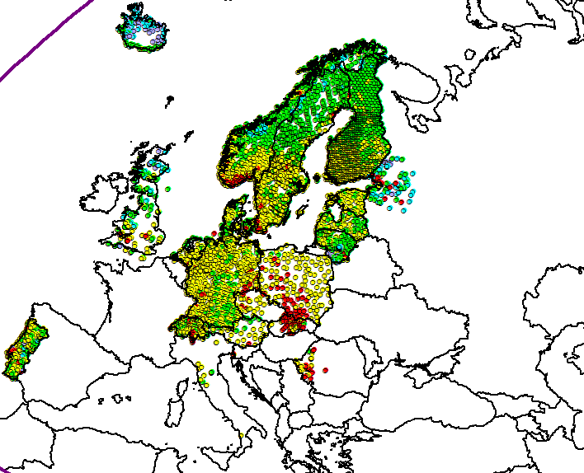
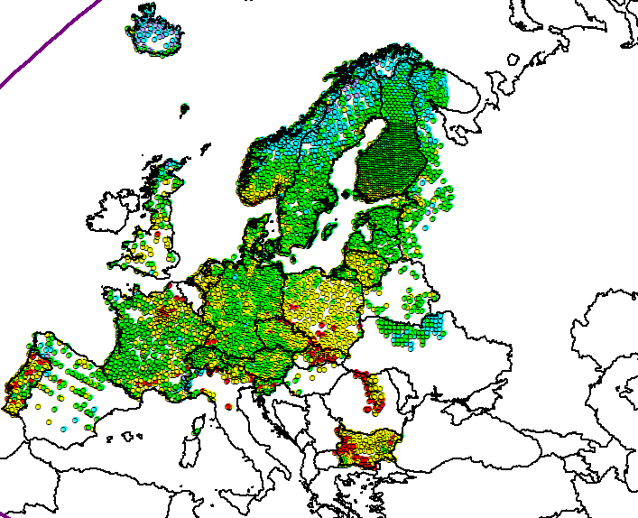
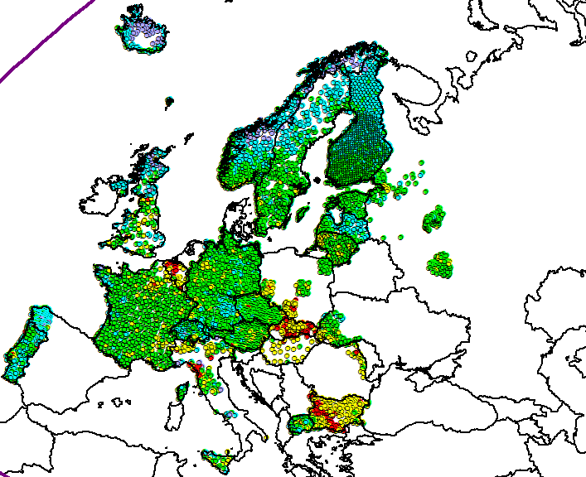
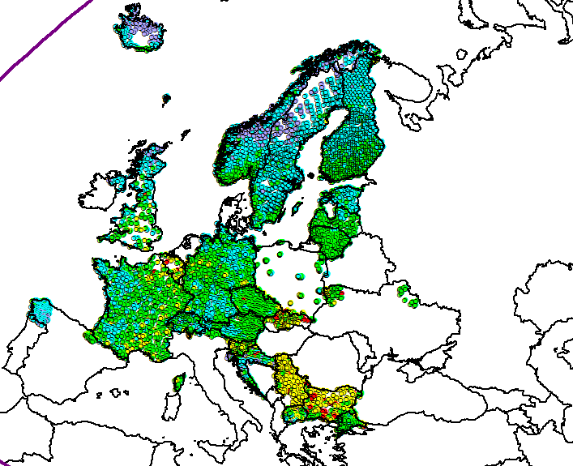
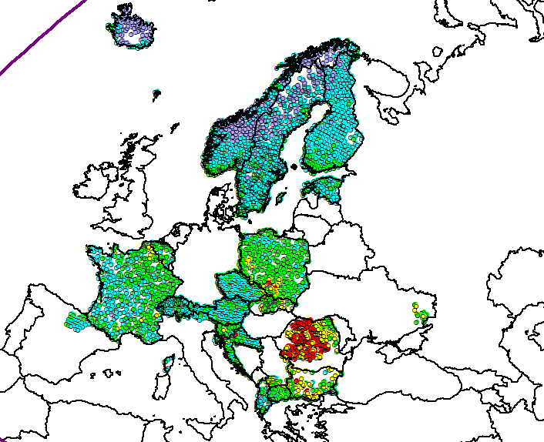
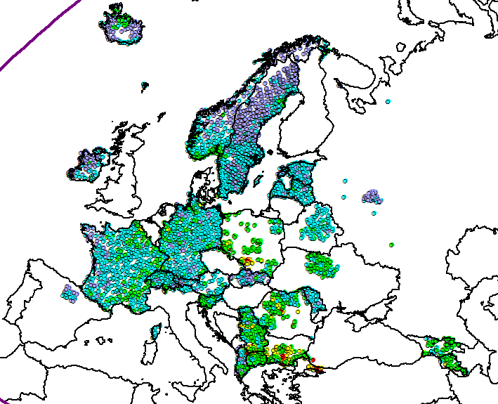
Concentrations of Pb in mosses (surveys 1990 - 2015)
1990
1995
2000
2005
2010
2015
< 1
1-3
3-10
10-30
> 30
μg/g

Slide 8
Long-term changes of deposition and concentrations
in mosses (1990 - 2015)
Pb concentrations in mosses, 2015
2015
Deposition flux
Conc. in mosses
Fraction of a country’s area covered by moss surveys

Slide 9
Average reduction rate (% per year) of deposition and concentrations in mosses
Pb
Cd
Hg
Concentrations in mosses
Deposition flux
The highest decline for Pb, the lowest for Hg

Slide 10
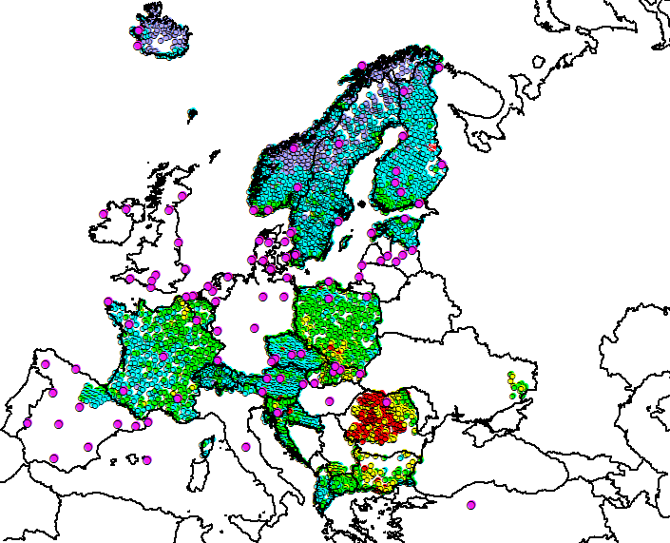
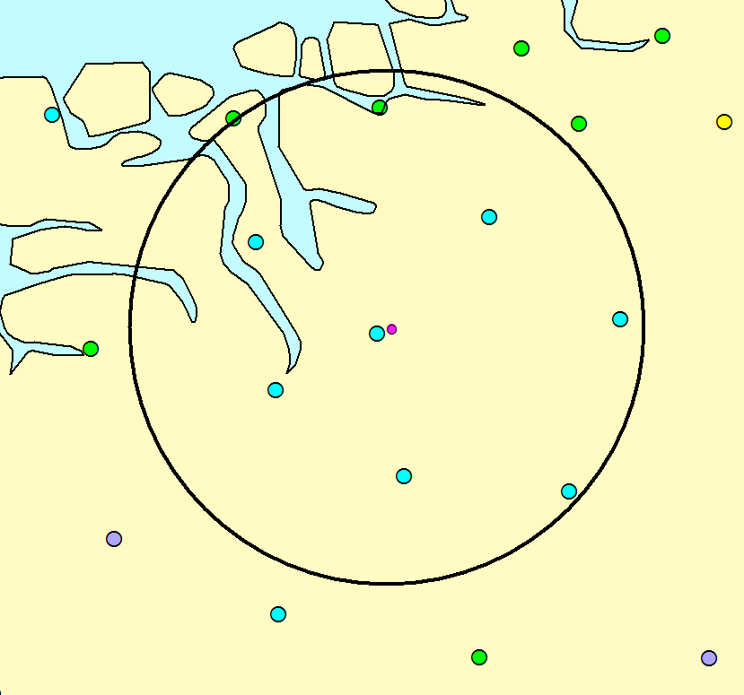
Comparison of modelled deposition changes
with moss data and EMEP measurements
Pb, 2010
NO39
50 km radius
EMEP station
Moss sampling plots
Modelled deposition: 3-year mean total deposition flux
Observed deposition: 3-year mean wet deposition flux
Concentration in moss: median for plots within the circle

Slide 11
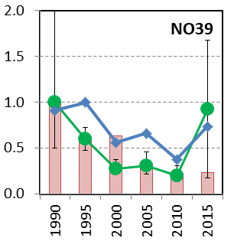
Pb deposition and concentrations in mosses
at the EMEP stations
Pb, 2010
Obs. wet deposition (EMEP stations)
Conc. in mosses
Modelled deposition flux
Long-term changes at local scale are revealed by modelling, observations at EMEP sites and biomonitoring

Slide 12
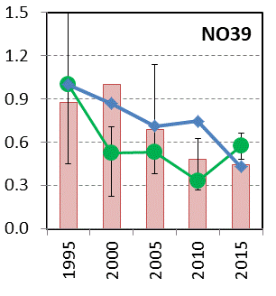
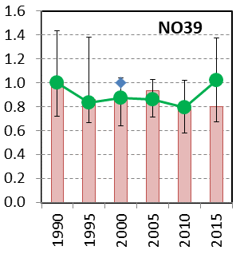
Modelled and observed levels at station NO39
(Kårvatn, Norway)
Pb
Cd
Cu
Obs. wet deposition
Conc. in mosses
Modelled deposition flux
Pb

Slide 13
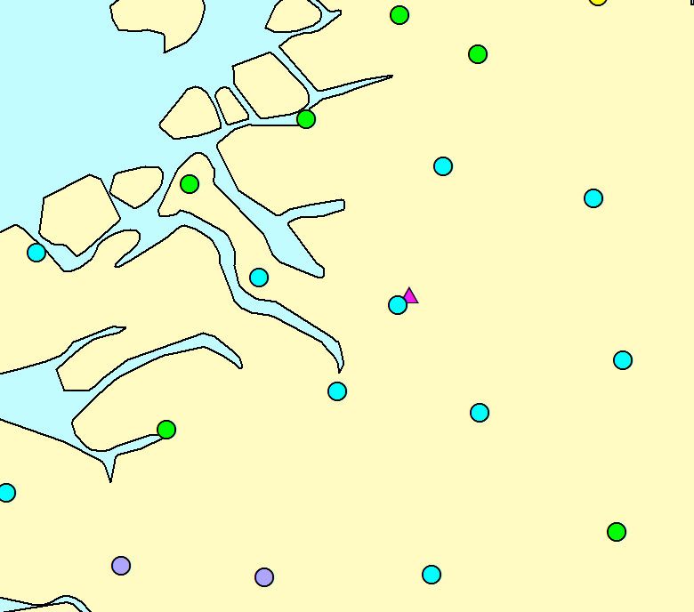
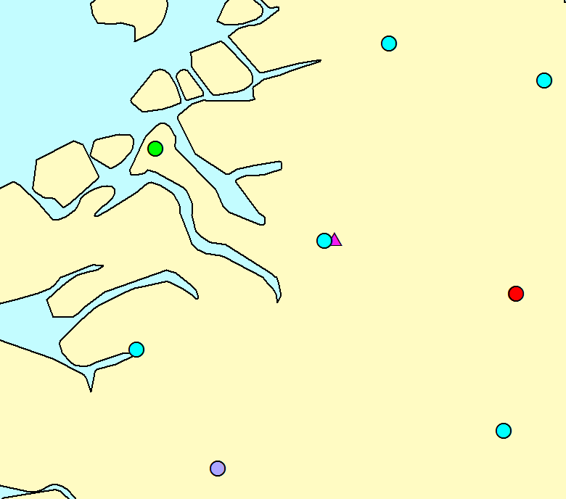
Concentrations of Pb in moss near EMEP station NO39
2010
2015
NO39
NO39
2 plots
8 plots
< 0.5
0.5-0.7
0.7-1
1-3
> 3
μg/g
Dense moss sampling network provides more reliable estimate of long-term changes
What is the effect of local environmental factors (e.g., meteorological conditions) on concentrations of heavy metals in moss?

Slide 14
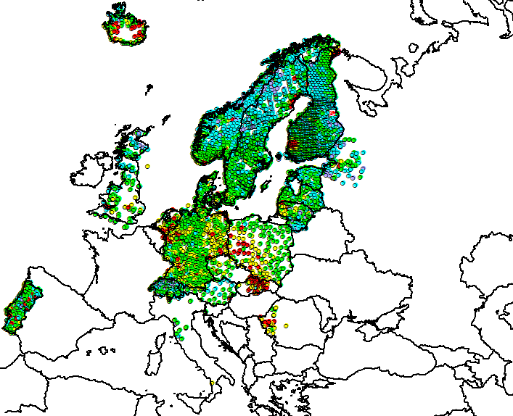
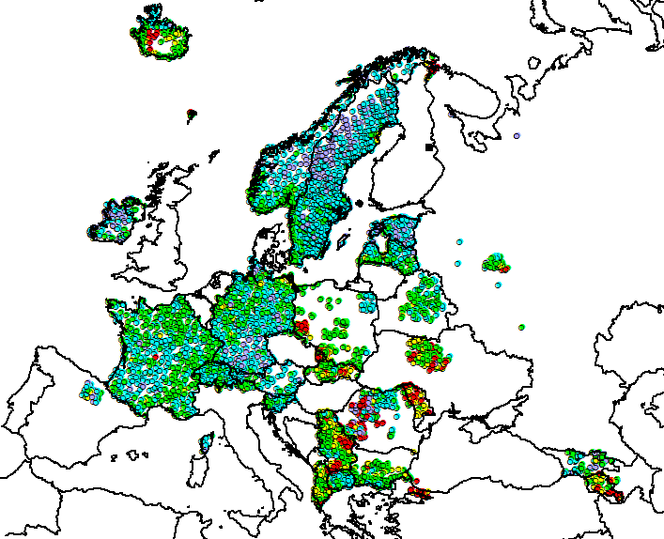
Heavy metals of the second priority: Cu
Cu official emission in the EMEP region
Low emission reduction over the last decades
High contribution to emission from Road Transport (brake/tire wear)
Road transport: 45– 65%
Cu concentrations in mosses
1990
2015
μg/g
< 3
3 - 5
5 -10
10 - 15
> 15

Slide 15
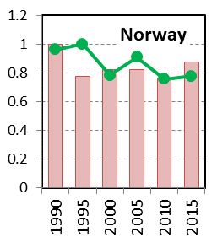
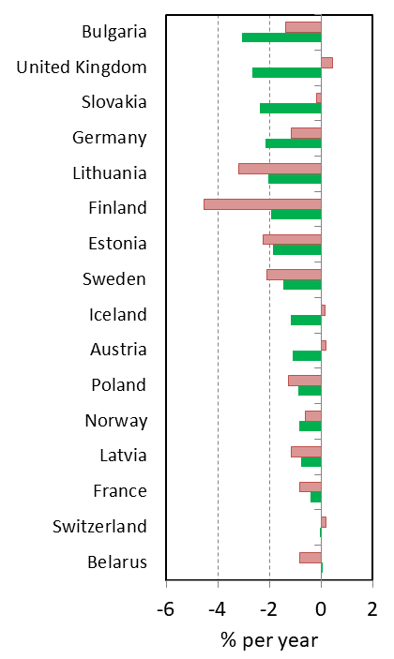

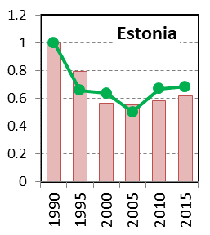

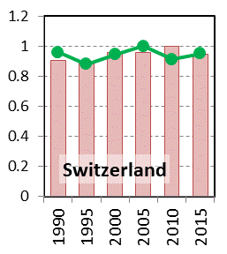
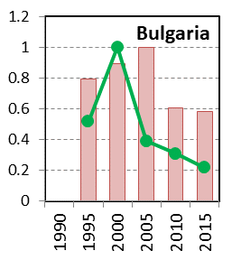


Long-term changes of Cu deposition and concentrations
in mosses (1990 - 2015)
Average reduction rate, %/yr
2015
Conc. in mosses
Deposition flux
Fraction of a country’s area

Slide 16
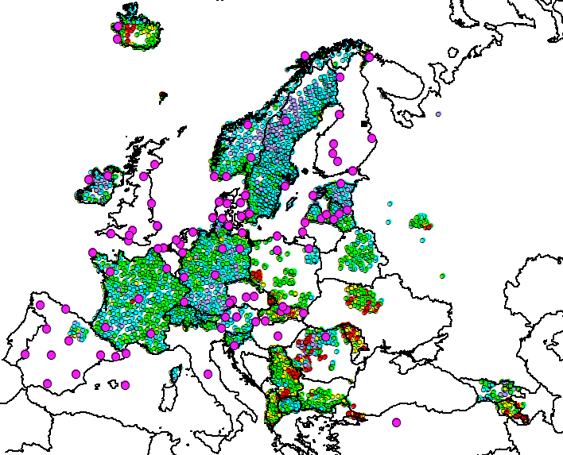
Cu deposition and concentrations in mosses
at the EMEP stations
2015
Obs. wet deposition
Conc. in mosses
Modelled deposition flux
Measurements in mosses can complement analysis of long-term changes where EMEP measurements are lacking
High temporal variability of the EMEP measurements of Cu. Quality issues?
Anything specific about Cu in mosses?

Slide 17
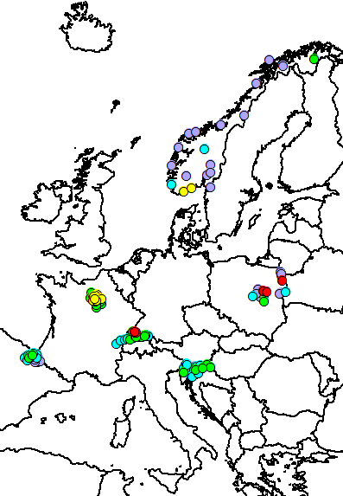
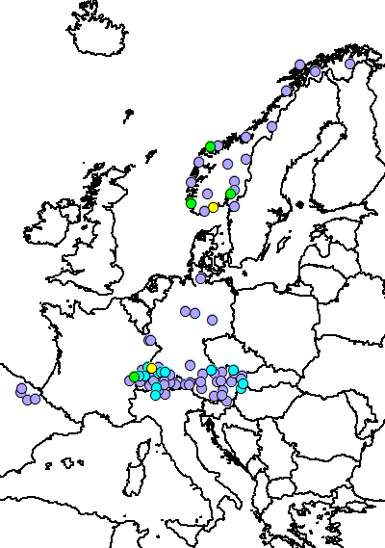
Comparison of POP deposition with concentrations in mosses
Considered species: B(a)P, PCB-153, HCB, BDE-99
Measured concentrations of B(a)P in mosses
Changes between 2010 and 2015 (%)
2010
2015
Norway
Switzerland
Concentrations in mosses
< 3
3-5
5-10
10-20
> 20
ng/g
Modelled deposition flux

Slide 18
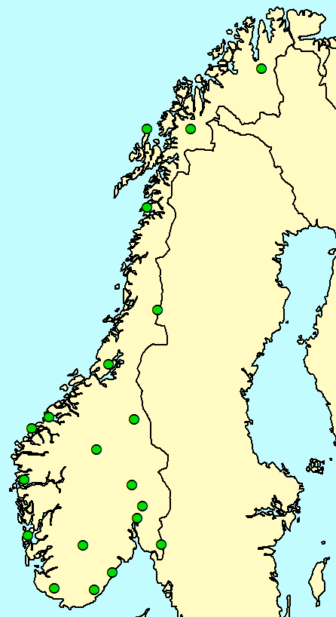
Modelled and observed B(a)P and PCB-153 air concentrations vs. concentrations in mosses at the EMEP stations Birkenes (Norway)
POP sampling plots in mosses
B(a)P
PCB-153
Obs. air conc.
Mod. air conc.
Conc. in moss
B(a)P: no changes in modelled concentrations, strong decline of observed concentration in air and in mosses. Unaccounted local emissions?
PCB-153: low changes of the modelled and observed values
Birkenes

Slide 19
Modelled and observed HCB air concentrations vs. concentrations in mosses at the EMEP stations Birkenes and Andoya (Norway)
POP sampling plots in mosses
HCB (Birkenes)
HCB (Andoya)
Andoya
Obs. air conc.
Mod. air conc.
Conc. in moss
Decrease of modelled air concentrations due to gradual degradation of HCB in soils and consequent declining of re-emission
Increase of the measured parameters until 2016 - 2017.
Birkenes

Slide 20
Modelled and observed BDE-99 air concentrations vs. concentrations in mosses at the EMEP stations Birkenes and Andoya (Norway)
POP sampling plots in mosses
BDE-99 (Birkenes)
BDE-99 (Andoya)
Andoya
Obs. air conc.
Mod. air conc.
Conc. in moss
Distinct decline of modelled and observed values in accord with emission reduction
Birkenes

Slide 21
Conclusions
Combined usage of the results of biomonitoring, atmospheric modelling and EMEP monitoring allows to identify and investigate long-term HM and POP pollution changes in particular countries as well as at local scale
Results of modelling and biomonitoring demonstrate similar rates of Pb, Cd and Hg reduction in most of EMEP countries. The highest reduction is noted for Pb, and the lowest for Hg.
Measurements in mosses, observations at the EMEP monitoring stations and modelling results demonstrate declining trend for BDE-99 and minor changes for PCB-153. For B(a)P and HCB the changes between modelled and the observed values are contrasting.
High density of moss sampling favours more reliable indication of long-term tendencies at local spatial scale.
Results of moss surveys are very useful for evaluation of long-term trends of HMs and POPs in the EMEP region. Further cooperation between EMEP and ICP-Vegetation is highly appreciated.

