Slide 1




Assessment of heavy metal pollution within EMEP
I.Ilyin, O.Travnikov, O. Rozovskaya (MSC-E)
W. Aas (CCC),
K. Mareckova, S. Poupa, C. Sosa, M. Tista, R. Wankmueller (CEIP)

Slide 2
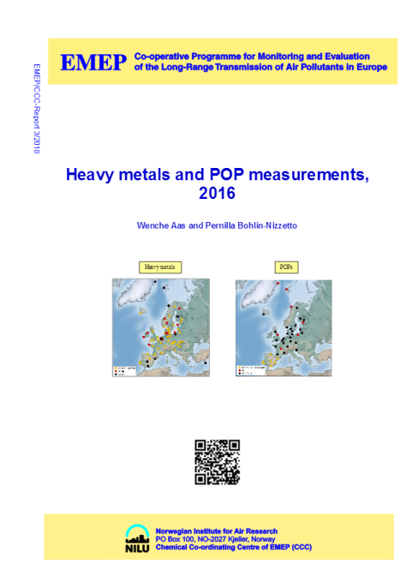
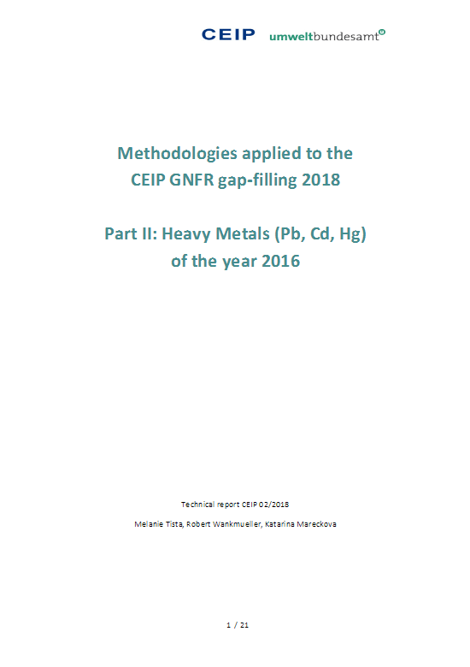
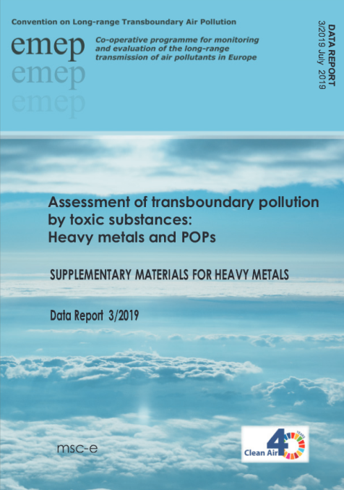
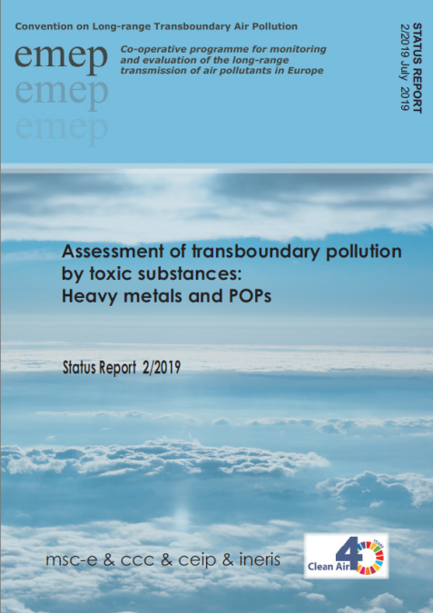
Outline
Assessment of pollution in 2017
  Emissions (CEIP)
  Monitoring (CCC)
  Operational modelling (MSC-E)
New model output (toxicity)
Research activities
  Case Study for Germany
  Hg atmospheric chemistry
  Hg multi-media modelling
Outreach
Future work
Notes:
Чётче про работу именно трех центров.

Slide 3
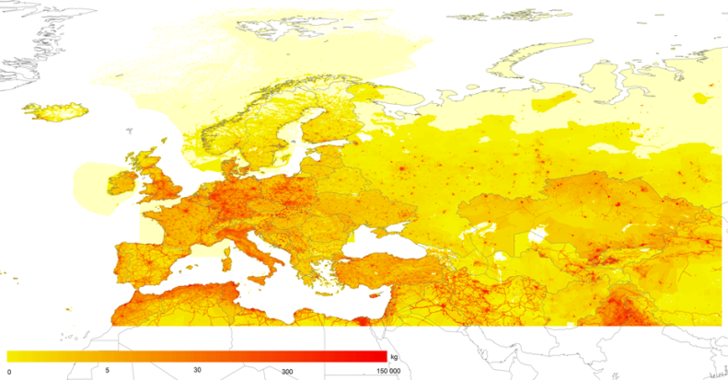
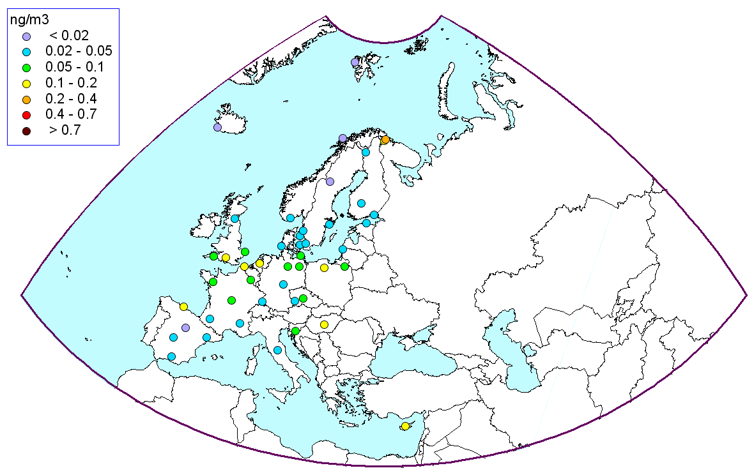
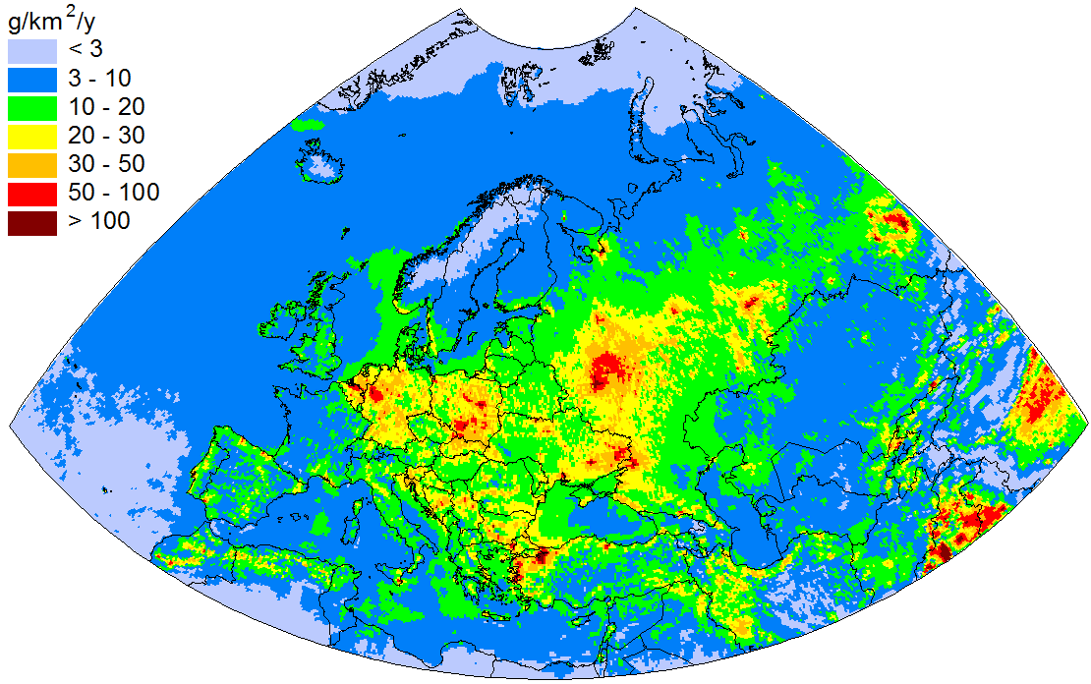
Assessment of heavy metal pollution (2017)
Gridded emission (Pb)
Regular information:
Emission data (CEIP)
Monitoring results (CCC)
Operational modelling (MSC-E)
  Pollution maps
  Transboundary transport
  Pollution of marginal seas
  Ecosystem-specific deposition
  Evaluation vs. measurements
  Country’s pollution (on the web)
Observed Cd in air
Cd deposition
Notes:
3
Мониторинг – не только сравнения. А вообще оценка.

Slide 4
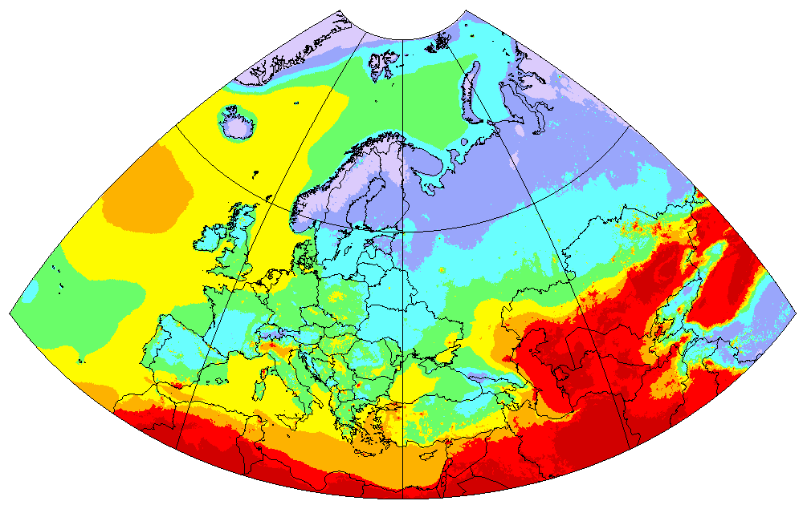
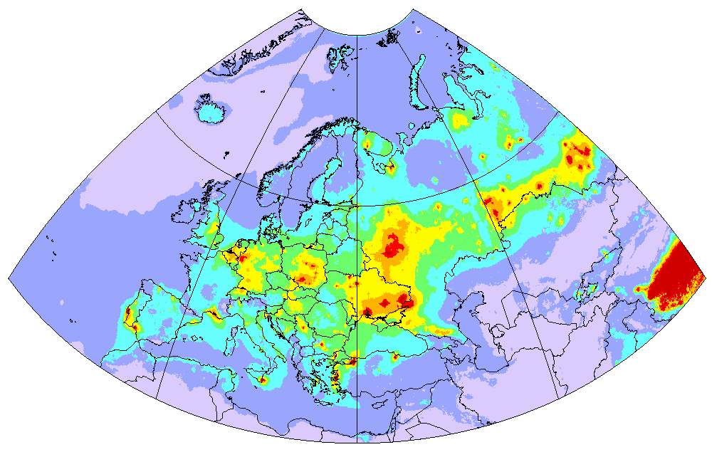
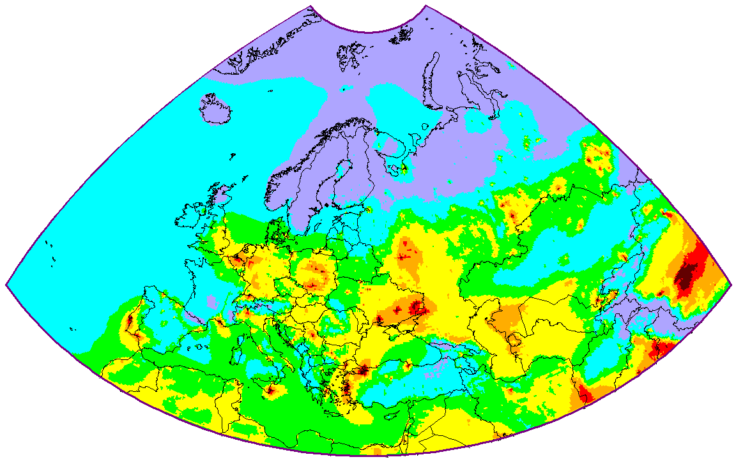







New output: Toxicity of atmospheric particulate matter
Estimates of toxic components in PM2.5
PM2.5 concentration in 2016 (MSC-W)
Cd content in PM2.5 (mg/kg)
Cd concentration in 2016 (MSC-E)
Toxicity of particles could be important to evaluate health effects
0.02
0.05
0.1
0.2
0.04
0.07
ng/m³
Notes:
Про МСЦ-З – они проводят ассессмент ВЧ, не просто «карта».

Slide 5
Toxic effects of heavy metals (European Chemical Agency)
Classification of heavy metals as toxic substances in EU REACH *
Substance | Toxicity for humans | Toxicity for aquatic organisms
 |  | Effects | Threshold levels (NOEC) in freshwater **
Cd | Carcinogenic, mutagenic, reprotoxic |  | 0.19 µg/L
Pb | Reprotoxic | Acute and chronic | 2.4 µg/L
Hg | Reprotoxic |  | 0.057 µg/L
* EU regulation “Registration, Evaluation, Authorisation and Restriction of Chemicals” (REACH)
** The REGULATION (EC) No 1272/2008 on Classification, Labelling and Packaging of Substances and Mixtures, commonly known as CLP Regulation, entered into force on 20 January 2009
Notes:
5

Slide 6
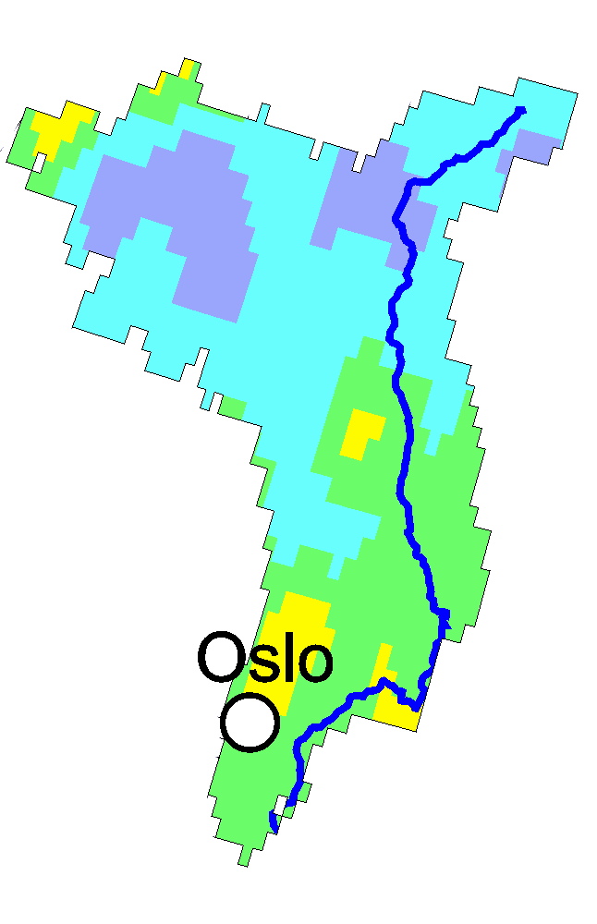
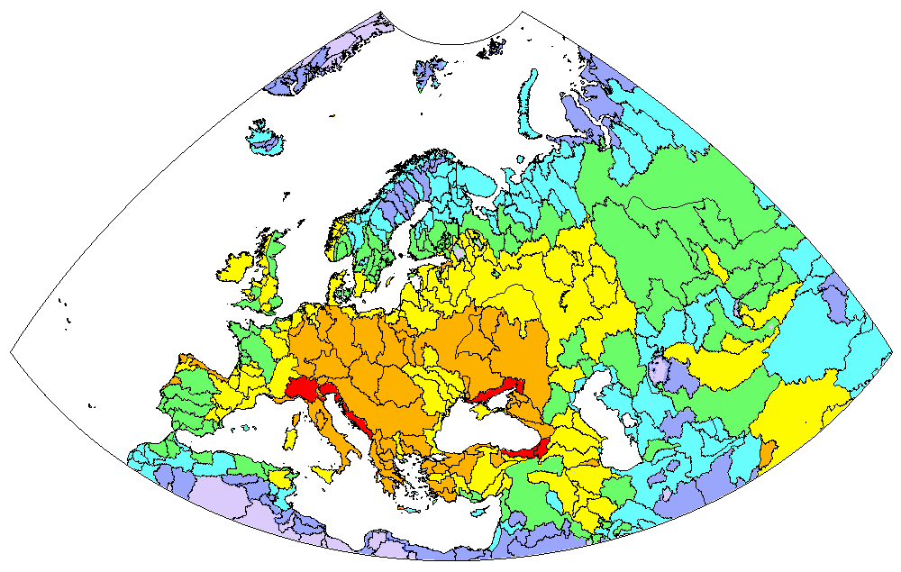
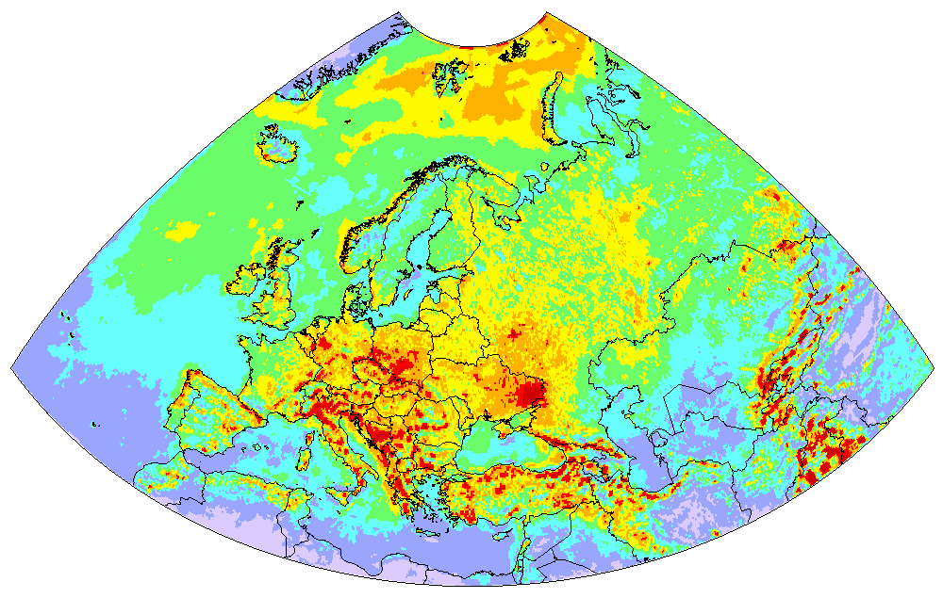
New output: Atmospheric loads to various ecosystems
Model estimates of HM and POP deposition to watersheds
Glåma watershed
Hg deposition in 2016
Hg deposition to land cover categories of Glåma watershed
Mixed forest
4%
Other
8%
Wooden grassland
8%
Coniferous forests
46%
Grassland
8%
Shrubs
26%
Feedback from WGE is needed
Notes:
6

Slide 7
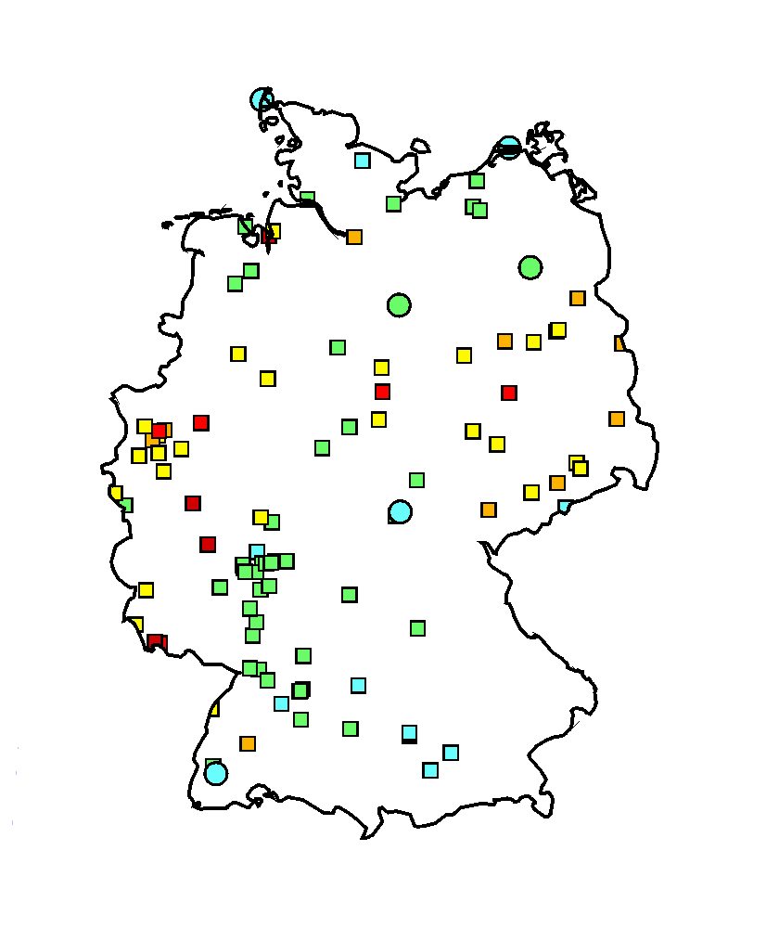
Country-scale assessment of pollution levels
Case study on heavy metal pollution in Germany
Research program (2019-2020):
Collection of national input information (emissions, monitoring, etc.)
Detailed assessment of Hg, Pb and Cd
pollution in Germany in 2014-2016
Evaluation of modelling results vs. national and EMEP measurements
Analysis of model-to-measurement deviations, recommendations for improvement of monitoring and modelling
Pb measurements in Germany (2016)
The project is funded by the country (Germany, UBA) and by EMEP
Notes:
Не исследования. Более глубокий, более детальный ассессмент.

Slide 8
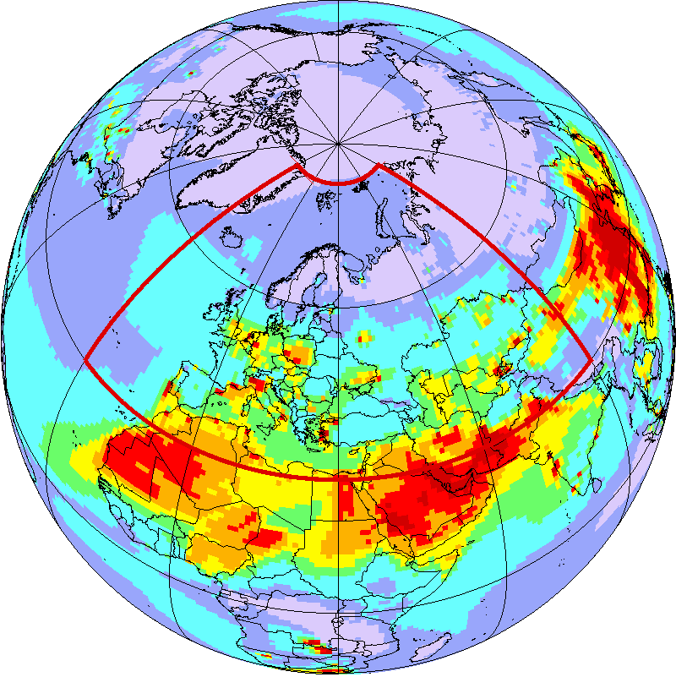
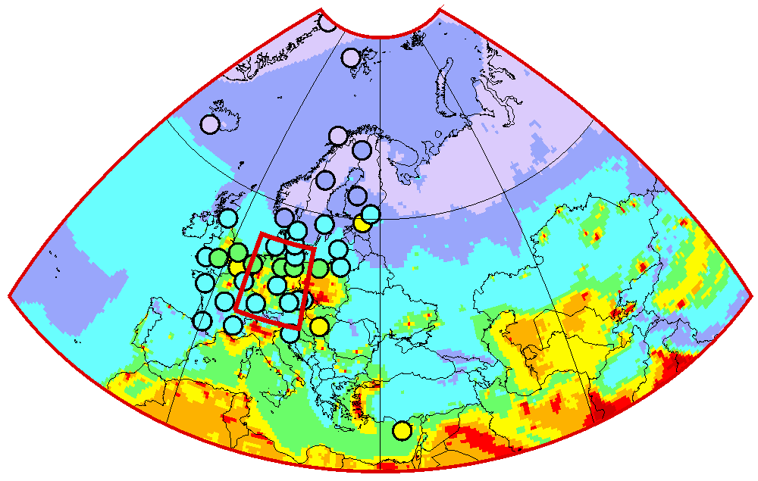
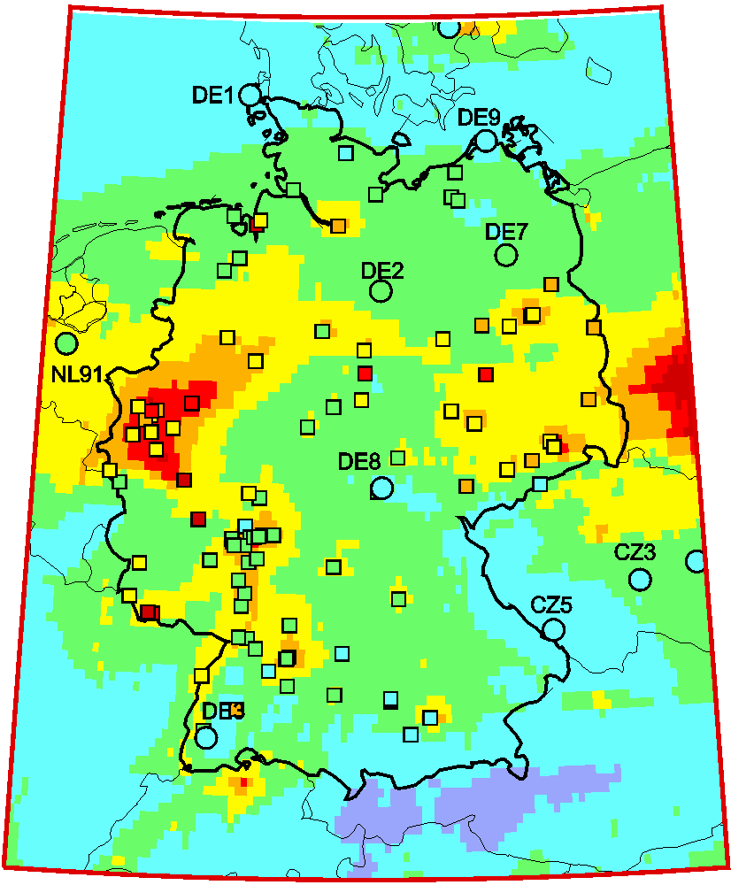
Country-scale assessment: Nested modelling
Pb concentration in air, 2015 (pilot results)
Global scale
EMEP region
Germany
Deposition (Pb)
Deposition (Hg)
Non-EMEP
Regional (EMEP)
National (DE)
Notes:
Про ртуть – не подробно. Сказать, что просто есть различия для разных металлов.

Slide 9
Country-scale assessment: Model vs. observations (Germany)
Main outcome: improvement of model assessment in the entire EMEP region, basing on the study for Germany
Further steps:
Pb concentration in air in 2015
Joint analysis of the results with national experts
Recommendations for improvement of the assessment quality both on national and regional (EMEP) scales
Notes:
Сравнения – для большого колитчества станций, ЕМЕП и национальных.

Slide 10
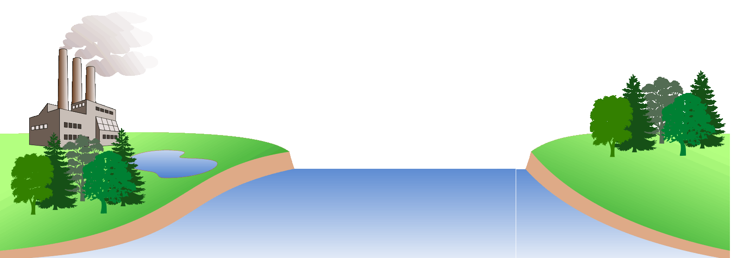

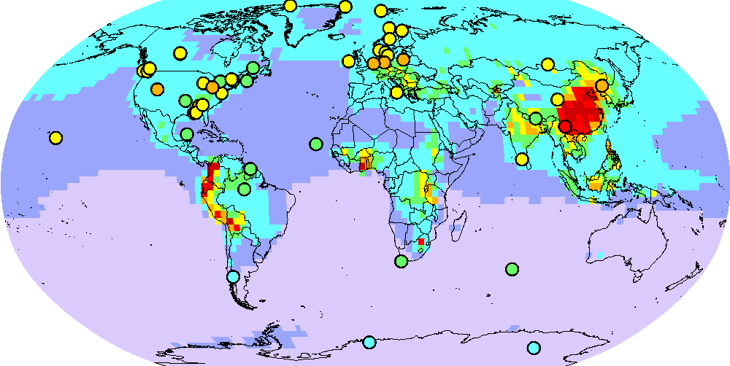
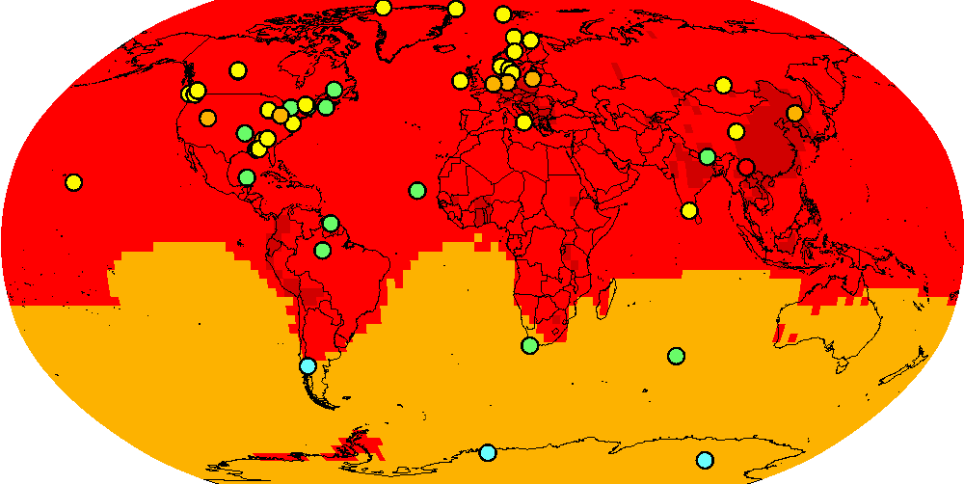
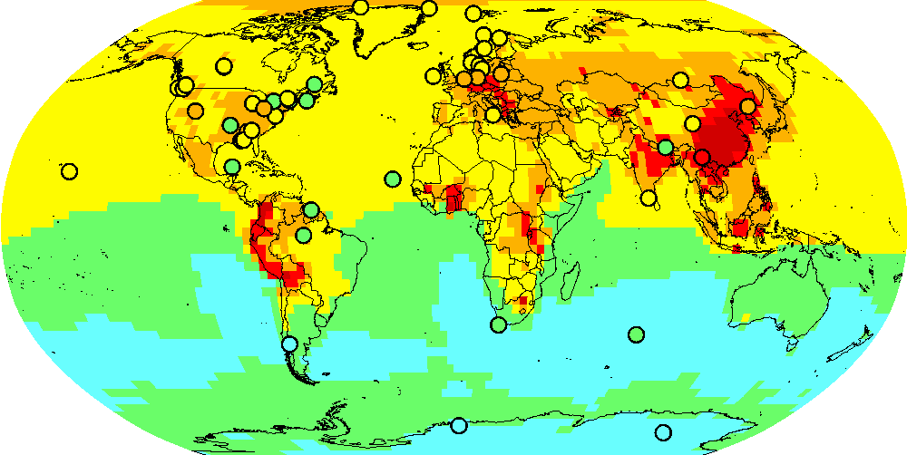
Research: Model study of Hg atmospheric chemistry
Motivation:
Chemistry is critical for Hg atmospheric cycle
Important role of Br-initiated oxidation of Hg in the atmosphere (but still uncertain)
New photo-reduction mechanisms
Br, OH, HO₂, NO₂, …
Br
oxidation
Hg^{II}
Hg⁰
Hg^{I}Br
hν
emission
deposition
Results published in Nature Communications (Saiz-Lopez et al., 2018)
Ongoing activity:
Study by international research group (EMEP/MSC-E, Spain, France, Canada, USA, UK)
MSC-E performed model evaluation (GLEMOS) of the new mechanisms
Test #1
Test #2
Test #3
Hg in air, ng/m³
Notes:
10
Про исследования и роль ТФММ – здесь сказать.

Slide 11
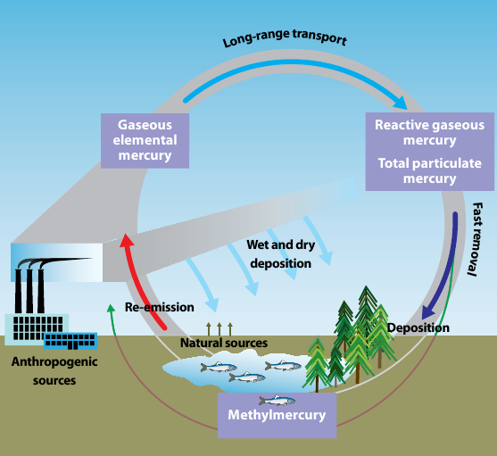
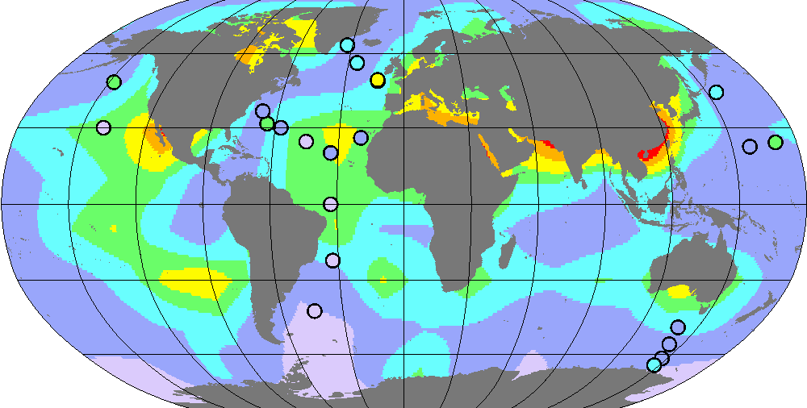
Research: Mercury multi-media modelling
Initial development of multi-media modelling approach for Hg
Hg cycling in the environment
Motivation:
Mercury easily cycles between the atmosphere and water/soil/vegetation
Legacy/natural sources make up 65% of Hg deposition within EMEP
UNEP/AMAP, 2008
On-going work:
Development of Hg media modules for GLEMOS (ocean, soil, vegetation)
Assessment of long-term Hg accumulation in media since pre-industrial times (1800 - present)
Evaluation against observations
Notes:
11
11
11
Важно для уточнения конц. в воздухе.

Slide 12
Outreach
Minamata Convention (MC)
  Information exchange with Ad-Hoc Technical Expert Group
Arctic Monitoring and Assessment Programme (AMAP)
  Participation in AMAP Mercury Assessment 2021; workshop in Copenhagen, October, 2019
European Commission (Marie Skłodowska-Curie Actions, Innovative Training Networks, ITN)
  Participation in project “Global Mercury Observation and Training network in support to the Minamata Convention” (starting in 2020)
Helsinki Commission (HELCOM)
  Assessment of atmospheric load of heavy metals to the Baltic Sea
International Conference on Mercury as a Global Pollutant (ICMGP 2019), Krakow, 8-13 September, 2019
  Presentation of new scientific findings on Hg within EMEP
Notes:
Можно поподробнее рассказать.

Slide 13
Further research activities (2020/2021)
Research and model development
  Evaluation of new mechanisms of Hg oxidation and reduction in the atmosphere
  Assessment of the role of regional, global, and secondary sources in long-term changes of Hg pollution in the EMEP region (in coop. with TF HTAP).
  Complex analysis of problem areas of Pb and Cd pollution in the EMEP region involving modelling and variety of measurement data
Country-specific Case Studies (Germany)
  Evaluation of modelling results vs. measurements and analysis of discrepancies
  Detailed assessment of Pb, Cd and Hg pollution in Germany in 2014-2016
Co-operation with Working Group on Effects
  Joint analysis of HM measurements in moss in co-operation with ICP-Vegetation
  Data exchange with ICP-Integrated Monitoring, ICP-Forests and ICP-Waters on heavy metal concentration and deposition
Notes:
Посмотреть то , что отправили Лоренс.

