Slide 1



Heavy metal pollution assessment within EMEP: Progress and plans
O. Travnikov, I. Ilyin, M. Kleimenov, O. Rozovskaya, I. Strizhkina (MSC-E)
W. Aas, K. Breivik, P.B. Nizzetto, K.A. Pfaffhuber (CCC)
S. Poupa, R. Wankmueller, B. Ullrich (CEIP)

Slide 2
Heavy metal research and assessment in 2022
  Operational assessment of HM (Cd, Pb, Hg) pollution in 2020
    Collection and analysis of monitoring data (CCC)
    Compiling, gap-filling and gridding of emissions data (CEIP)
    Model assessment of transboundary pollution (MSC-E)
  Country-scale study of Hg pollution in Norway (national experts, TFMM)
  Scientific co-operation on Hg assessment (national experts, AMAP, TF HTAP)
    Assessment of Hg pollution in the Arctic
    Co-operative activities within TF HTAP
  A pilot study of HM pollution from wildfires (TF HTAP)
  Co-operation with WGE: Trend analysis (ICP-Vegetation)
  Outreach: Marine pollution assessment (OSPAR, HELCOM)
  GLEMOS model open source distribution

Slide 3
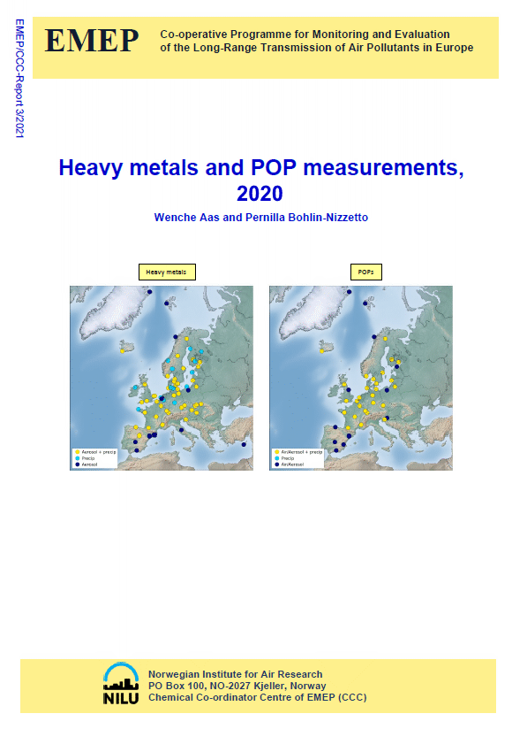
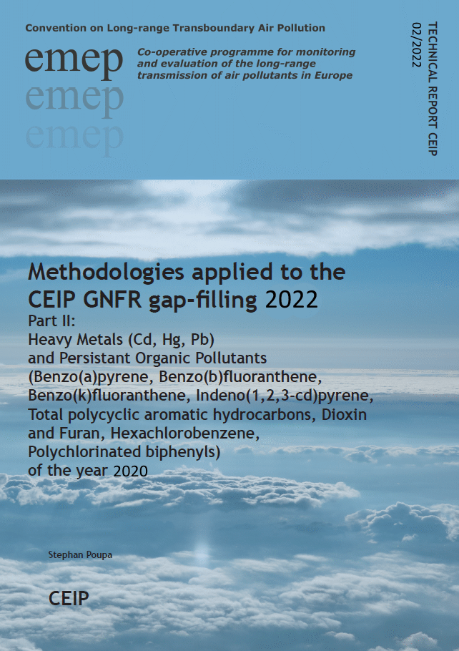
Heavy metal research and assessment in 2022
  Operational assessment of HM pollution in 2020
    Collection and analysis of monitoring data (CCC)
    Compiling, gap-filling and gridding of emissions data (CEIP)
    Model assessment of transboundary pollution (MSC-E)
  Country-scale study of Hg pollution in Norway (national experts, TFMM)
  Scientific co-operation on Hg assessment (national experts, AMAP, TF HTAP)
    Assessment of Hg pollution in the Arctic
    Co-operative activities within TF HTAP
  A pilot study of HM pollution from wildfires (TF HTAP)
  Co-operation with WGE: Trend analysis (ICP-Vegetation)
  Outreach: Marine pollution assessment (OSPAR, HELCOM)
  GLEMOS model open source distribution

Slide 4
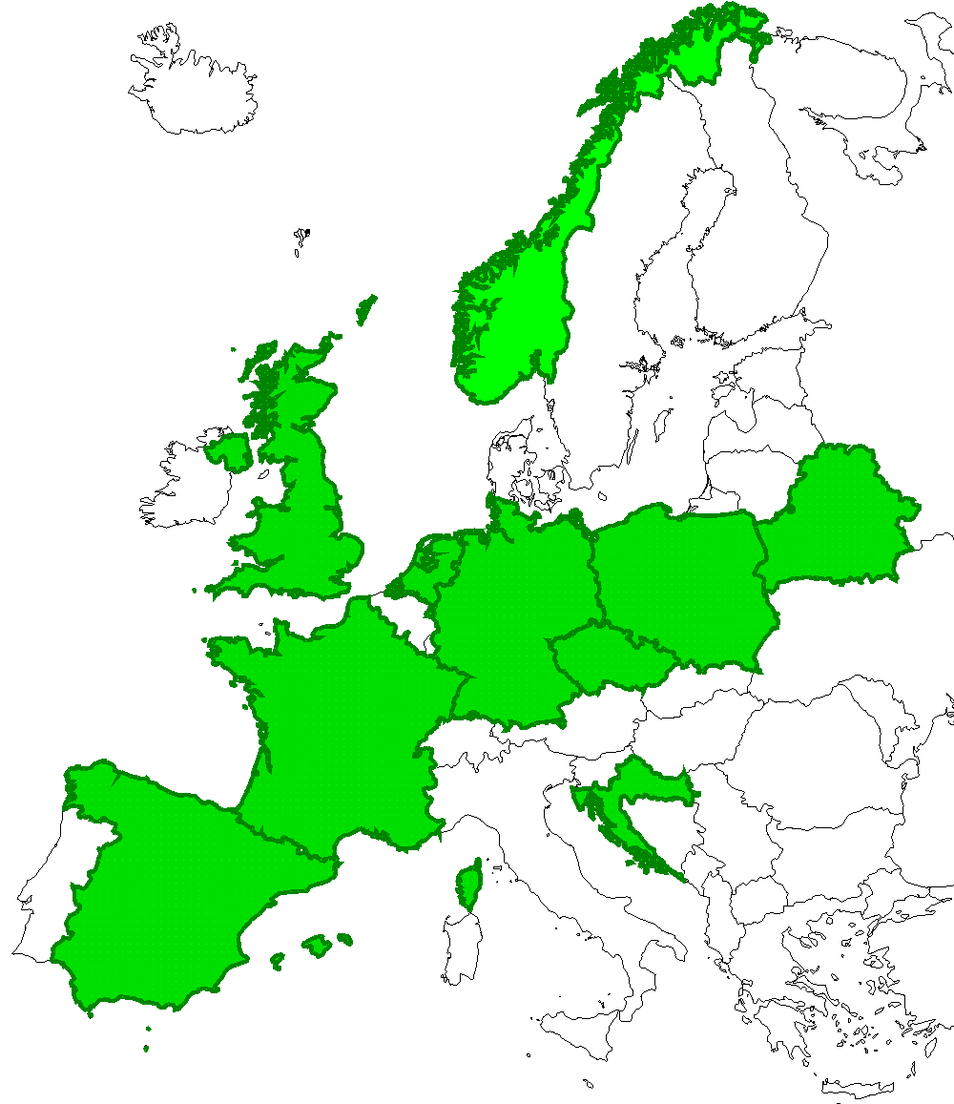
Co-operation with national experts workplan item 1.2.1
Country-scale studies for the EMEP countries (2010-2022)
In co-operation with Task Force on Measurements and Modelling (TFMM)
Objective:
Assessment of HM and POP pollution on a country scale involving national experts and variety of national data
Countries involved:
Czech Republic, Croatia, Netherlands, Belarus, UK, Poland, Spain, France, Germany, Norway
Main outcomes:
Refined information on pollution levels
Analysis of national emissions
Improvement of modelling approaches
Participating countries

Slide 5
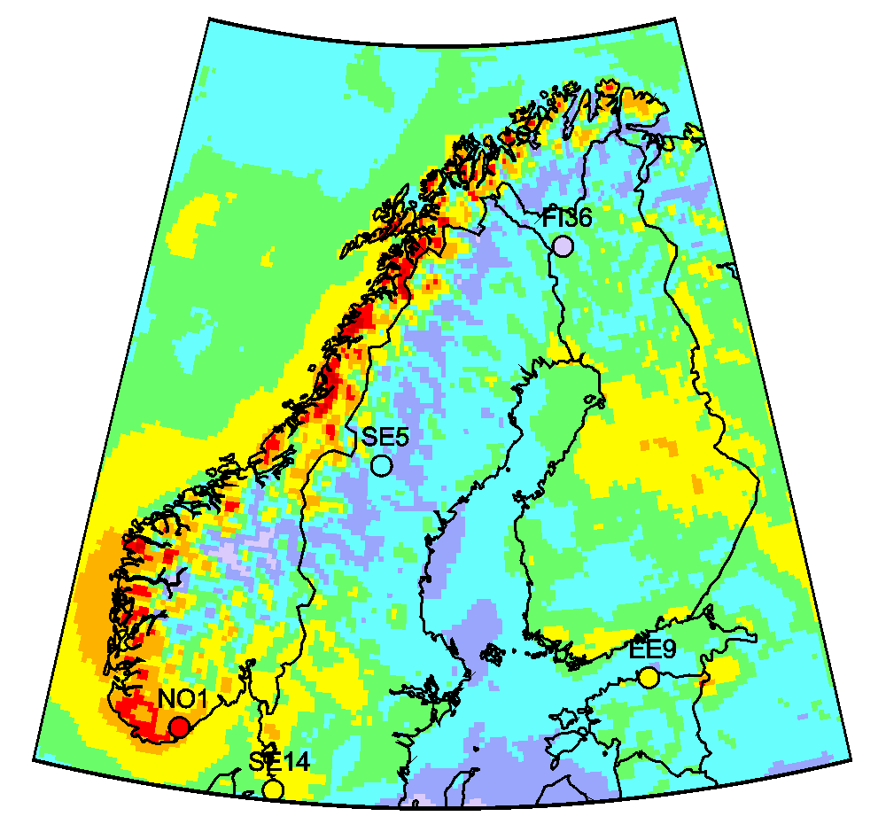
Co-operation with TFMM workplan item 1.2.1
Case study: Hg pollution in Norway
EMEP/MSC-E contribution to the Norwegian Mercury Assessment 2022
Hg wet deposition (2015)
Contributors:
Norway: NILU, NIVA, NP, IMR, NEA, NIPH EMEP: MSC-E
Provided data and analysis:
Modelled spatial patterns of Hg loads to Norway and adjacent seas
Long-term trends (1990-2020) of Hg emissions, air concentration and deposition
Contribution to analysis of Hg levels and trends in biota (fish, bears, foxes)

Slide 6
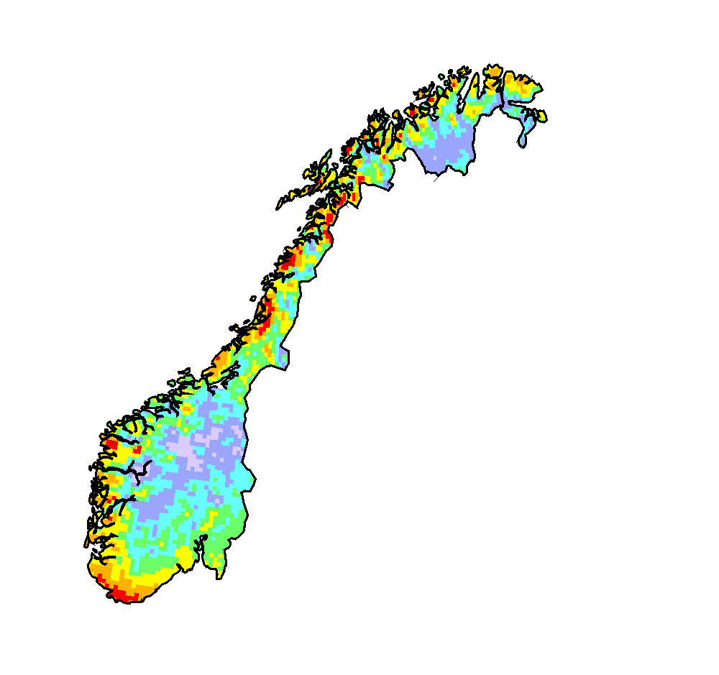
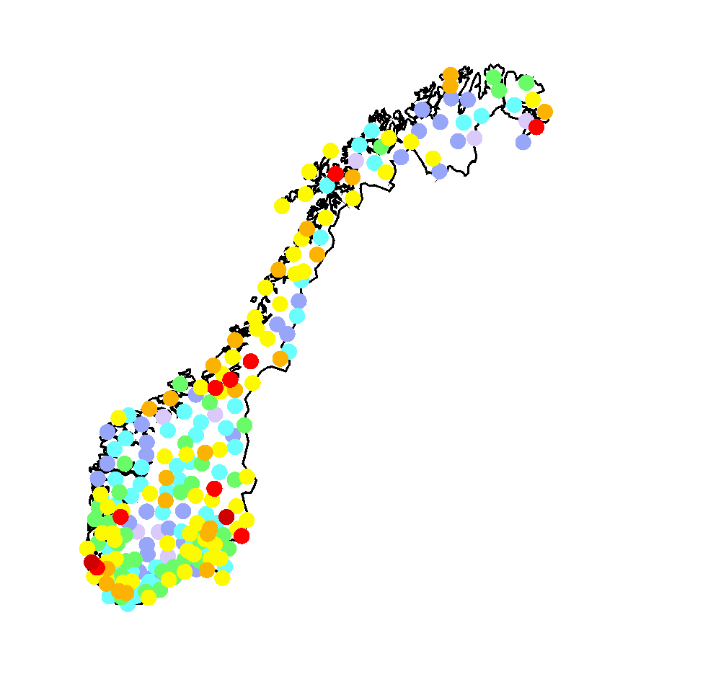
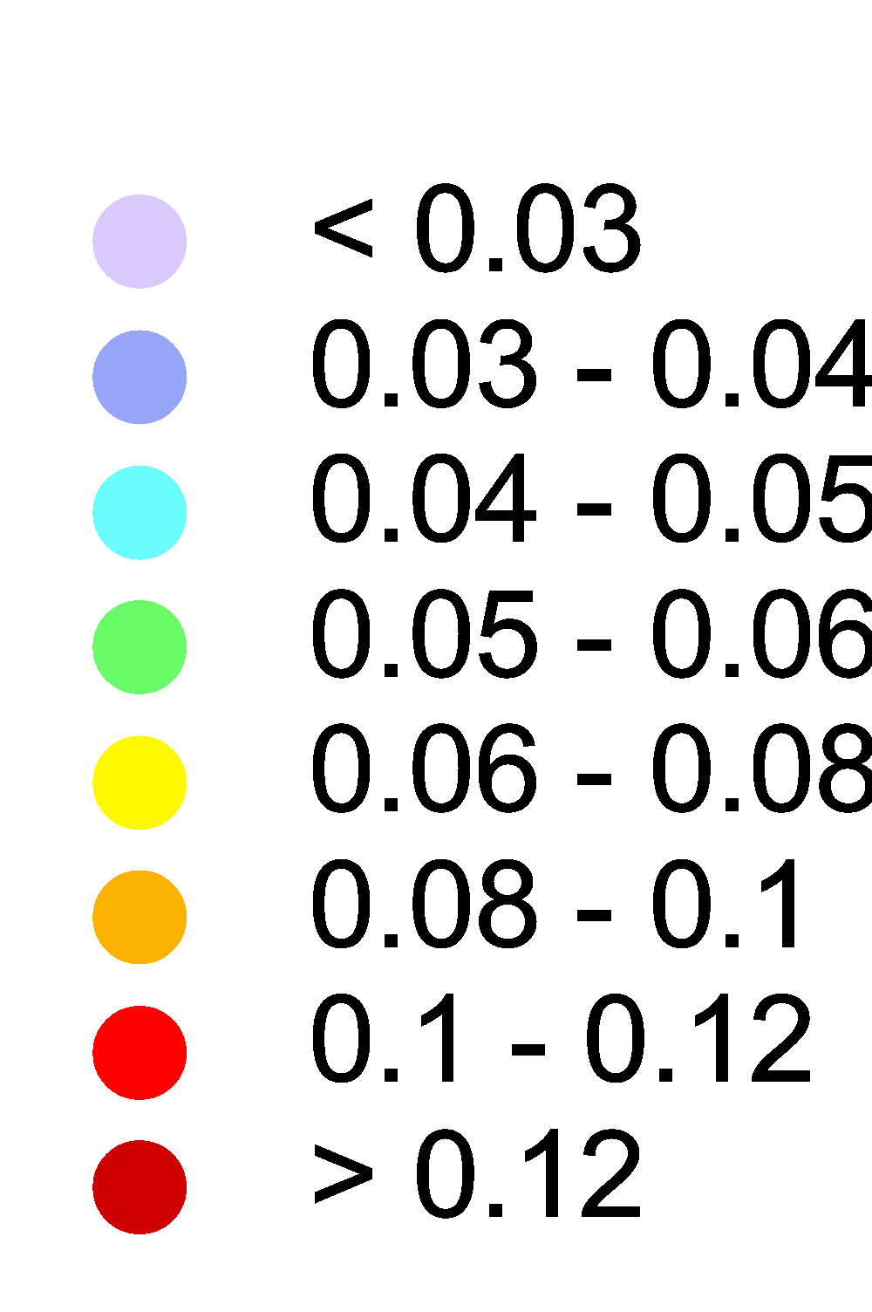
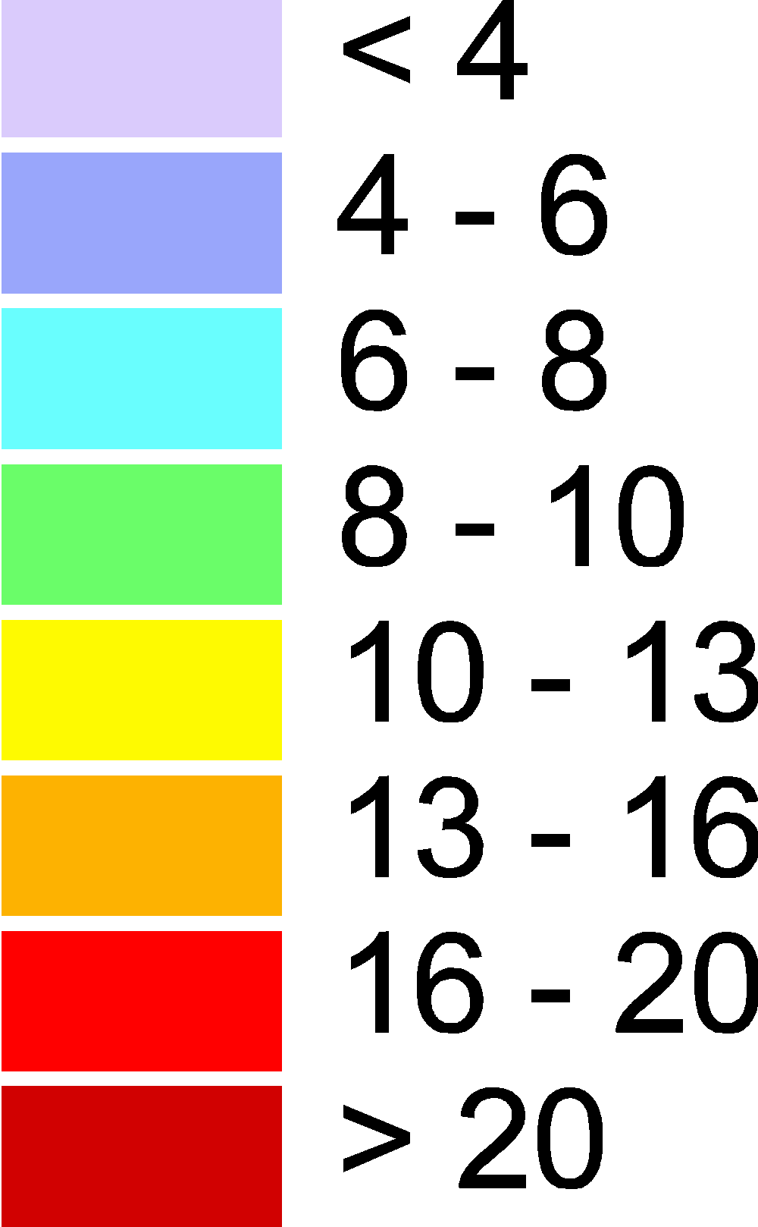
Co-operation with TFMM workplan item 1.2.1
Case study for Norway: Spatial patterns of Hg deposition
Hg deposition (2015)
Hg in moss (2015)
Main outcome:
No significant north-south gradient of Hg deposition over the country
Elevated Hg levels in the southmost part and along the Atlantic coast
The lowest Hg deposition in the inland areas of southern and northern parts of the country
Discrepancies in spatial patterns of Hg deposition and Hg in moss require additional analysis
g/km²/y
μg/g

Slide 7
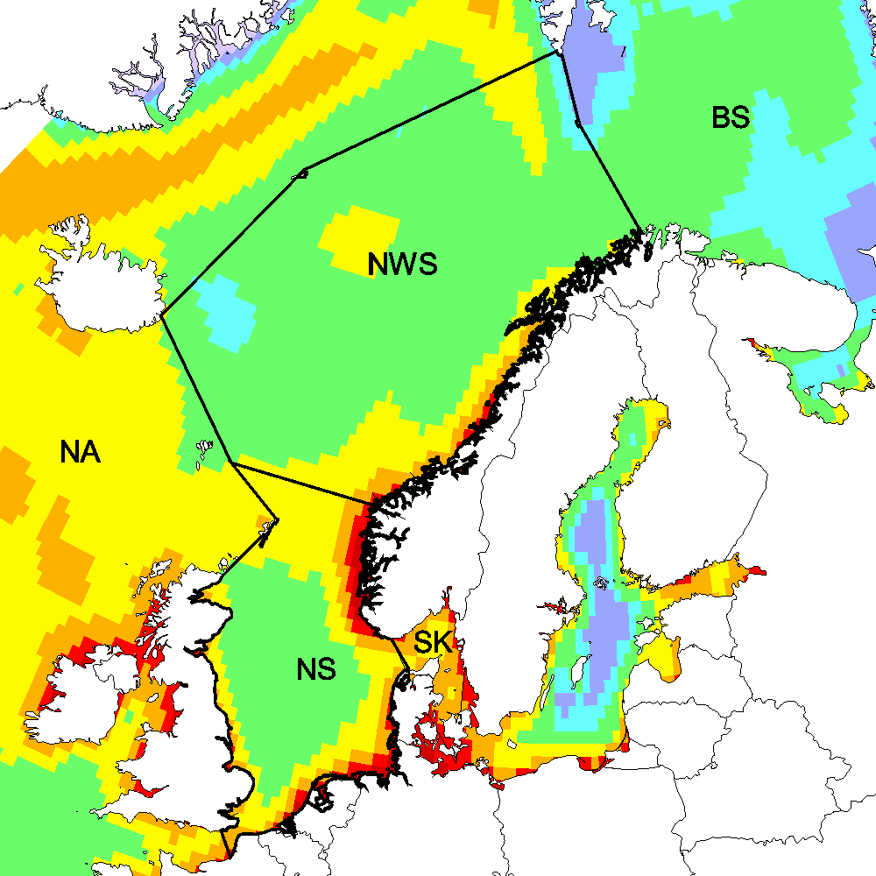
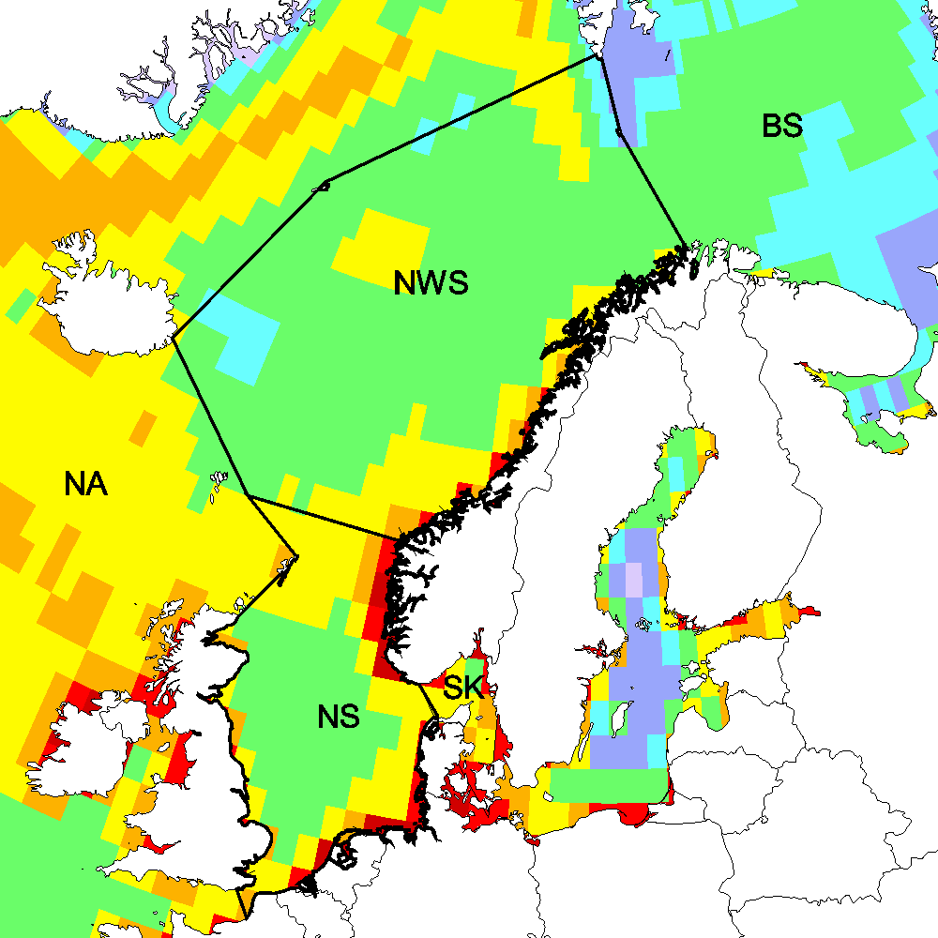
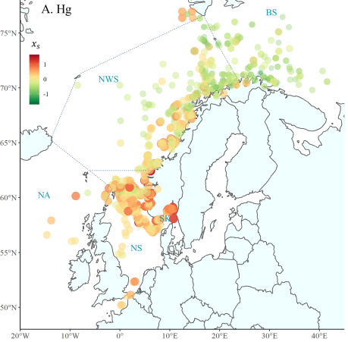
Co-operation with TFMM workplan item 1.2.1
Case study for Norway : Hg deposition to aquatic regions
Hg deposition to the North East Atlantic (2015)
Hg concentration in marine fish (2006-2019)
Mean Hg deposition vs. Hg concentration in fish
Fish measurements
(Ho et al., 2021)
Note:
Hg levels in fish geographically correlate with Hg atmospheric loads
Multi-model simulations
(GLEMOS, GEM-MACH-Hg, GEOS-Chem, DEHM)

Slide 8
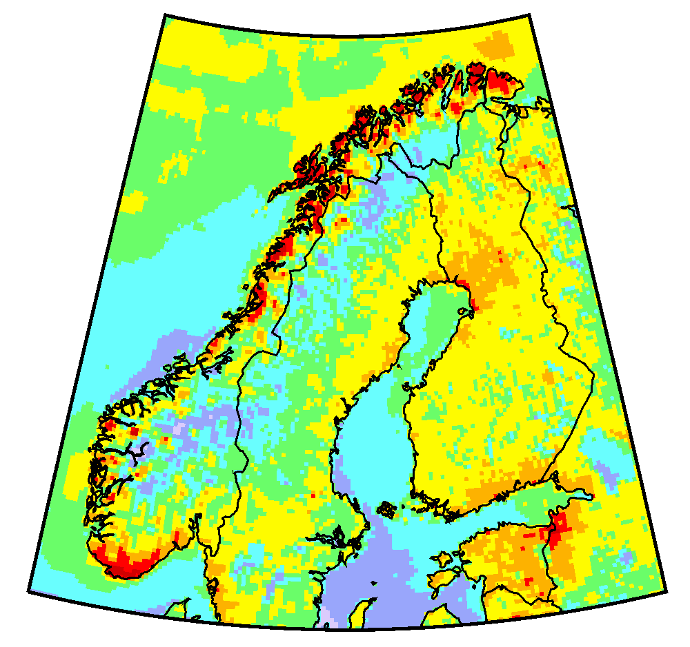
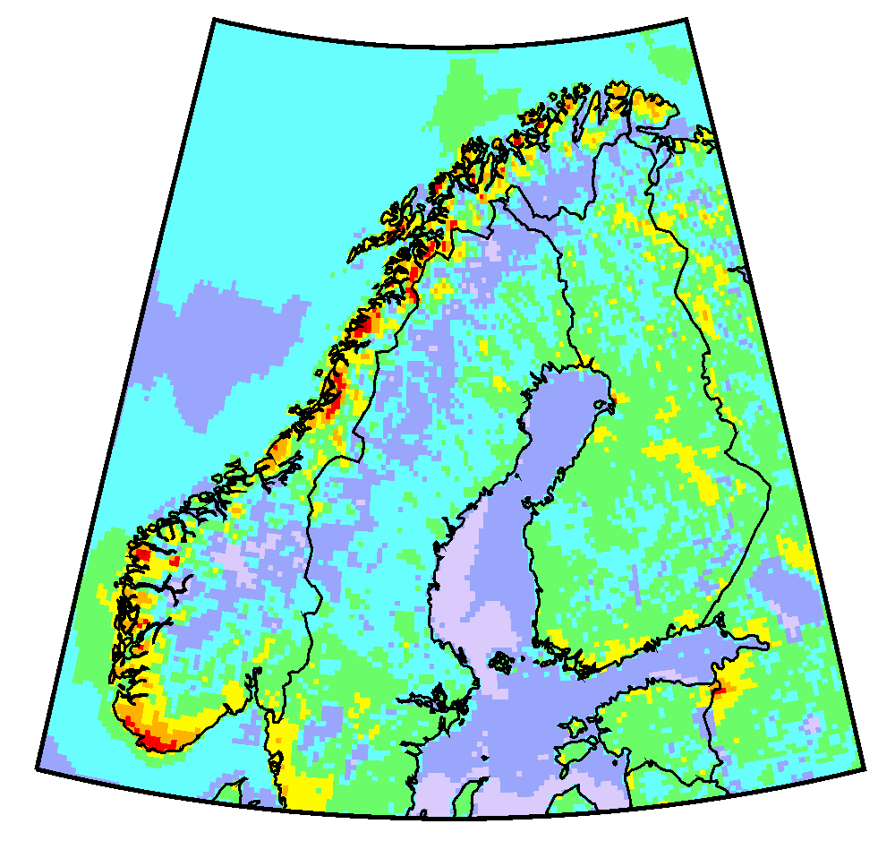
Co-operation with TFMM workplan item 1.2.1
Case study for Norway : Long-term trends of Hg pollution
Hg deposition vs. Hg in fish (Greenland halibut )
Hg atmospheric deposition (GLEMOS)
2000
2015
Hg wet deposition (Birkenes/Lista)
Note:
Reduction of Hg levels in fish is stronger than decrease of Hg deposition

Slide 9
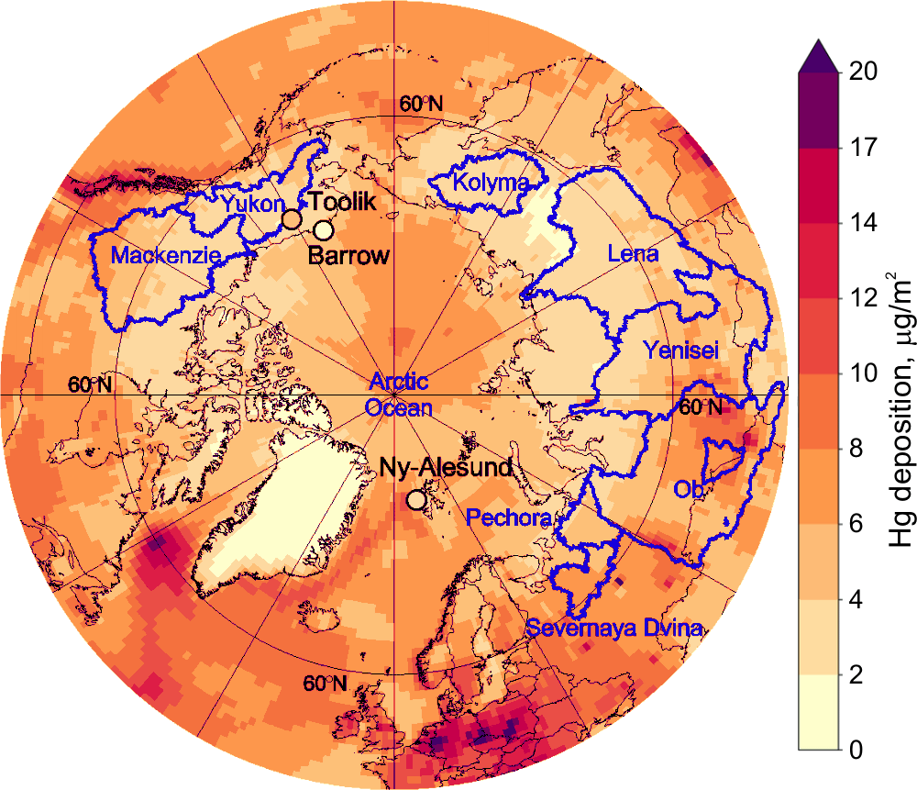
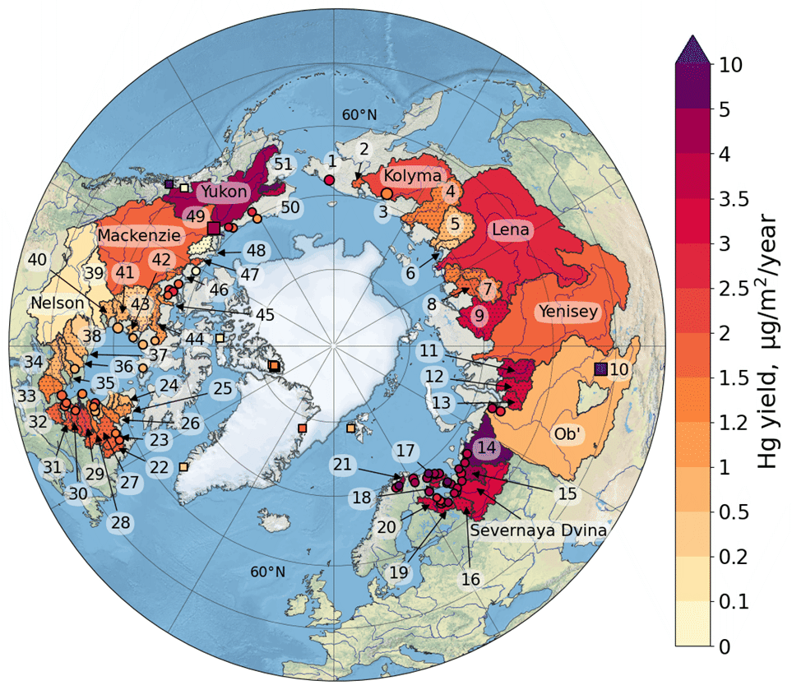
Co-operation with national experts
Mercury pollution in the Arctic
EMEP/MSC-E contribution to the co-operative follow-up studies based on AMAP Hg Assessment
Annual river Hg yields for pan-Arctic watersheds
Topics:
Literature review of Hg sources, transport and fate in the Arctic
Update and evaluation of global Hg emissions inventory
Estimates of the present-day Hg mass budget in the Arctic
Analysis of factors affecting changes of Hg pollution in the Arctic (permafrost thaw, glacier and sea ice melt, wildfires, etc.)
Hg atmospheric deposition
Publications:
Dastoor et al. (2022) Nature Reviews Earth & Environment
Dastoor et al. (2022) Science of the Total Environment

Slide 10
Co-operation with TF HTAP workplan items 1.1.4.3, 1.1.4.5
Scientific co-operation on Hg pollution assessment
(TF HTAP)
Recent and future activities (MSC-E):
TF HTAP virtual meeting on Hg (18 May 2022) focused on Hg global and regional emissions and modelling
  Identifying fields of co-operation between CLRTAP and Minamata Convention
  Formulation of near-term activates on Hg under TF HTAP
  Elaboration of an action plan for multi-model assessment of Hg trends and source attribution (white paper)
Contribution to the multipollutant model experiments on the effect of wildfire emissions on pollution levels
Emissions
inventories
Monitoring
Modeling

Slide 11
A pilot study of heavy metal pollution from wildfires
Model evaluation of wildfires contribution to HM pollution within EMEP region
Objectives:
Review of available wildfire databases (FINN2.5, GFAS1.2, GFED4s, QFED2.4)
PM_{2.5} emission from wildfires within EMEP region (2017)

Slide 12
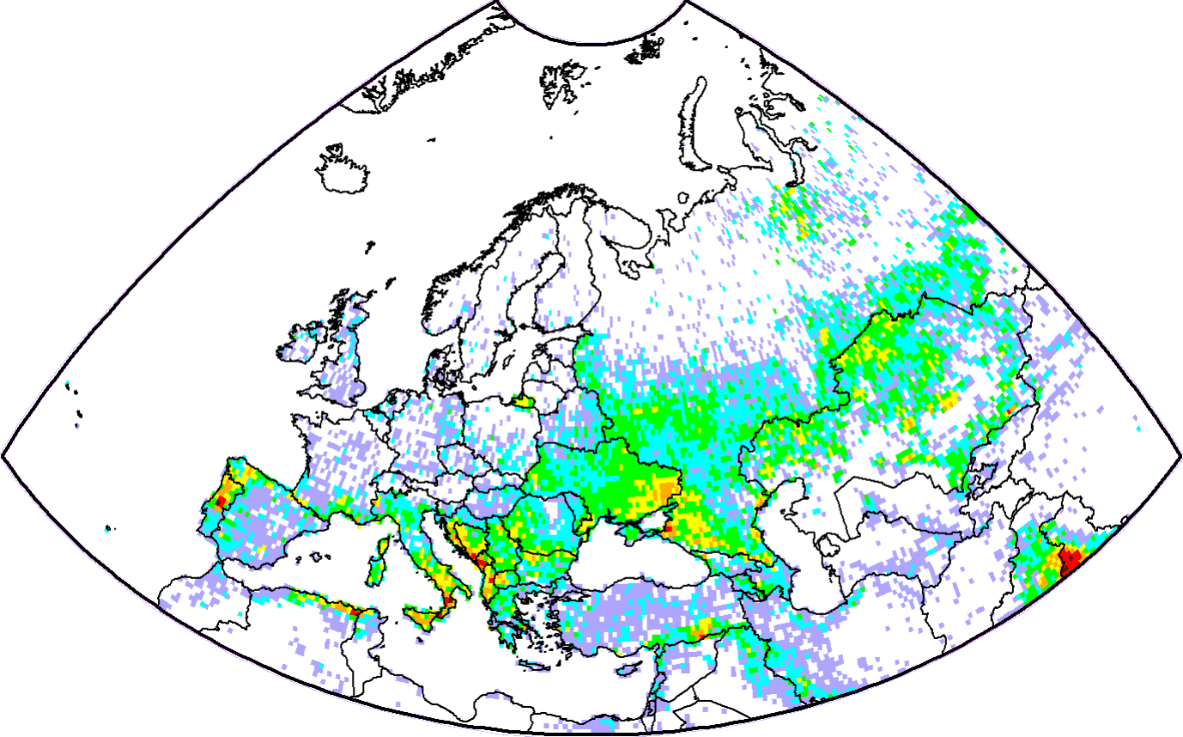
A pilot study of heavy metal pollution from wildfires
Model evaluation of wildfires contribution to HM pollution within EMEP region
Pb emission from wildfires in 2017
Objectives:
Review of available wildfire databases (FINN2.5, GFAS1.2, GFED4s, QFED2.4)
g/km²/y
< 1
1 - 5
5 -20
20 - 50
50 - 150
150 - 500
> 500
Estimates of heavy metal emissions from wildfires in the EMEP region
Anthropogenic
Wildfires

Slide 13
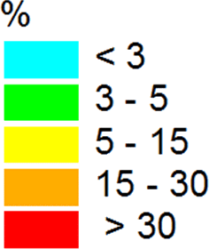
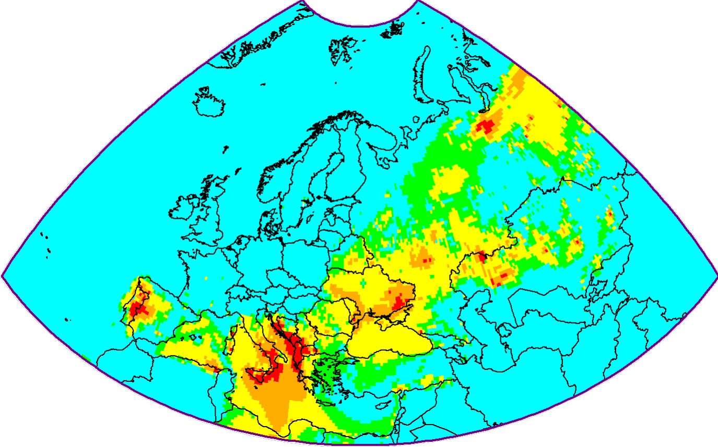
A pilot study of heavy metal pollution from wildfires
Model evaluation of wildfires contribution to HM pollution within EMEP region
Relative contribution of wildfires to Pb concentration (August 2017)
Objectives:
Review of available wildfire databases (FINN2.5, GFAS1.2, GFED4s, QFED2.4)
Estimates of heavy metal emissions from wildfires in the EMEP region
Simulations of the wildfires effect on pollution levels in the EMEP countries
Note:
Contribution of wildfires exceeds 30% in particular countries and months

Slide 14
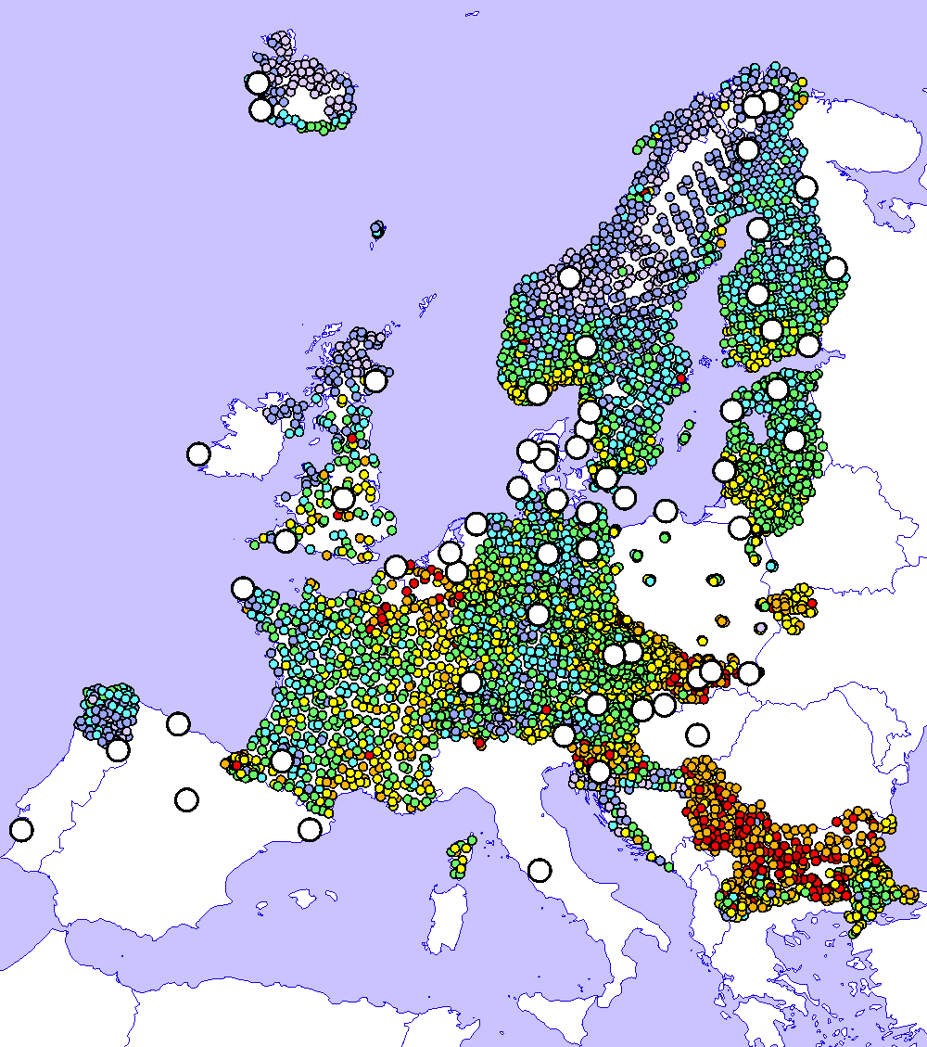

Co-operation with WGE workplan item 1.1.1.13
Co-operation with effect community
Use of EMEP observations, modelling, and moss measurements (ICP-Vegetation) for trend analysis
Key features:
Combination of different data types provides more reliable estimates of pollution changes on local and regional scales
Analysis of discrepancies allows revealing assessment uncertainties (e.g. emission estimates, model parameterizations etc.)
Pb concentration in moss
Presented at the ICP-Vegetation Task Force meeting (21-23 Feb 2022)
Conc. in moss (obs.)
Wet deposition (obs.)
Deposition (model)

Slide 15
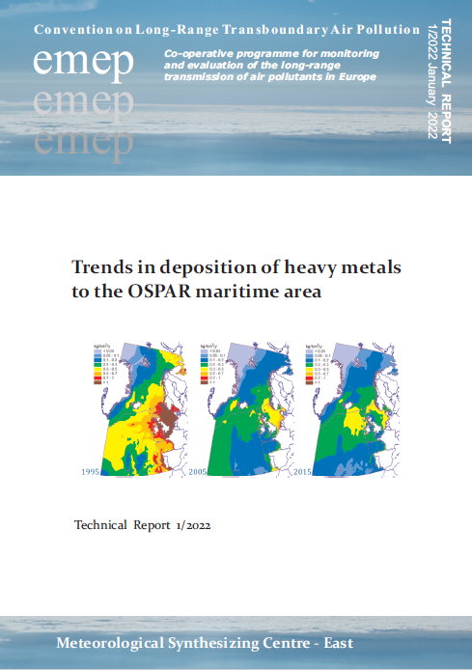
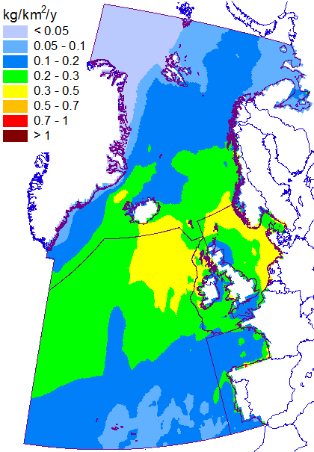

Co-operation with marine conventions workplan item 1.3.1
Contribution to marine pollution assessment
Model assessment of heavy metal loads to the Northern Atlantic (co-operation with OSPAR)
Assessment items:
Considered pollutants – Cd, Pb, Hg
Long-term trends of HM deposition to the OSPAR maritime regions
Source apportionment of HM deposition
Evaluation of modeling results vs. observations (EMEP/CAMP)
Pb deposition (2015)
HM deposition trends
Arctic waters
Greater North Sea
Wider Atrlantic
Celtic Seas
Bay of Biscay
The project was funded by OSPAR
OSPAR
COMMISSION

Slide 16
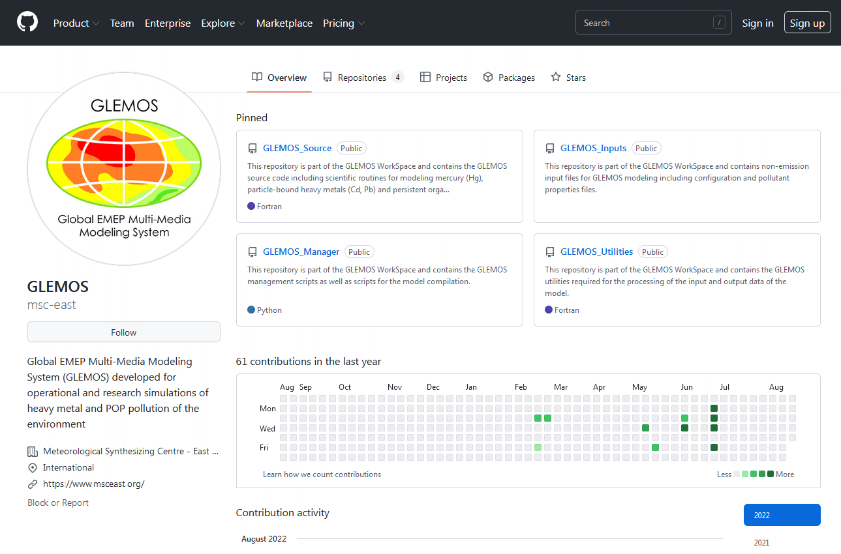
GLEMOS open source (pilot version)
GLEMOS model source code is available at GitHub platform
GLEMOS distribution:
Source code (GLEMOS_Source)
Control scripts (GLEMOS_Manager)
Input parameters (GLEMOS_Inputs)
Data processing utilities (GLEMOS_Utilities)
1
3
2
4
https://github.com/msc-east

Slide 17
Future research activities
(Work plan 2022-2023, EMEP Strategy)
  Scientific collaboration on multi-model assessment of Hg trends and source attribution (TF HTAP, Minamata Convention)
  Contribution to the multi-pollutant model experiments on the effect of wildfire emissions on pollution levels (TF HTAP)
  Co-operation with the effect community on assessment of heavy metal pollution and trends (WGE, ICP Vegetation)
  Research of heavy metal pollution of the marine environment (co-operation with OSPAR and HELCOM)
  Further development and support of GLEMOS open source distribution

