Slide 1


Monitoring and modelling of POP pollution: main activities and results
Alexey Gusev on behalf of MSC-E and CCC

Slide 2
Main directions of work in 2016/2017
2016/2017 workplan (ECE/EB.AIR/133/Add.1)
Review and improvement of POP emissions data for modelling
Analysis of long-term trends in POP pollution
Monitoring of POP pollution in the EMEP region
Assessment of POP transboundary pollution (regional/global)
Evaluation of PAH pollution of urban areas and selected cities
Scientific co-operation on improvement of model assessment quality
Transition of modelling to the new EMEP grid
Co-operation with subsidiary bodies, international organizations and programmes

Slide 3
Development of strategy to improve emissions
Analysis of key parameters of POP emission affecting model assessment
Emission parameters:
Quality of gridded emissions
Chemical composition
Seasonal variations
Vertical distribution
Global emissions
Historical emissions
Emissions to media
20%
40%
15%
10%
5%
0%
TCDF
TCDD
OCDF
OCDD
PeCDD
HpCDD
4HxCDD
6HxCDD
14HxCDF
7HxCDD
16HxCDF
23HxCDF
19HxCDF
78HpCDF
12PeCDF
89HpCDF
23PeCDF
Congener composition of PCDD/F emission

Slide 4
Development of strategy to improve emissions
Analysis of key parameters of POP emission affecting model assessment
Emission parameters:
Quality of gridded emissions
Chemical composition
Seasonal variations
Vertical distribution
Global emissions
Historical emissions
Emissions to media
Seasonal variation of B[a]P emission from residential heating

Slide 5
Development of strategy to improve emissions
Analysis of key parameters of POP emission affecting model assessment
Emission parameters:
Quality of gridded emissions
Chemical composition
Seasonal variations
Vertical distribution
Global emissions
Historical emissions
Emissions to media
20000
Min
16000
Ave
12000
Max
HCB emissions, t/y
8000
4000
0
1945
1949
1953
1957
1961
1965
1969
1973
1977
1981
1985
1989
1993
1997
2001
2005
2009
2013
Historical emissions of HCB
Contribution to joint CEIP/MSC-E report on the improvement of emission data for modelling

Slide 6
Evaluation of long-term trends in POP pollution
Contribution to CLRTAP, WGE and TFMM Assessments-2016
Analysis of trends for 1990-2012 indicates decrease of B[a]P, PCDD/F, PCB, and HCB air concentrations from about 30% to almost 90%
More significant reduction occurred in first decade (1990-2000)
Slower reduction in second decade (2001-2012), and stabilization of B[a]P air concentrations
100
B[a]P
30%
45%
80%
90%
80
60
PCDD/Fs
Decrease, %
40
PCB-153
20
HCB
0
1990
1992
1994
1996
1998
2000
2002
2004
2006
2008
2010
2012
Temporal changes of B[a]P, PCDD/F, PCB, and HCB air concentrations

Slide 7
Evaluation of long-term trends in POP pollution
Trends of PCB and B[a]P concentrations for 1990-2014
2
7
Value
Trend
6
Value
3
3
Trend
1.5
5
Main component
4
PCB-153 in air, pg/m
PCB-153 in air, pg/m
1
3
0.5
2
EMEP
1
Poland
0
0
1990
1992
1994
1996
1998
2000
2002
2004
2006
2008
2010
2012
2014
1990
1992
1994
1996
1998
2000
2002
2004
2006
2008
2010
2012
2014
Temporal changes of PCB-153 air concentrations in the EMEP countries
0.4
Value
Trend
0.9
Value
Trend
3
0.3
3
0.6
B[a]P in air, ng/m
B[a]P in air, ng/m
0.2
0.3
0.1
EU28
Czech Republic
0.0
0.0
1990
1992
1994
1996
1998
2000
2002
2004
2006
2008
2010
2012
2014
1990
1992
1994
1996
1998
2000
2002
2004
2006
2008
2010
2012
2014
Temporal changes of B[a]P air concentrations in the EMEP countries

Slide 8
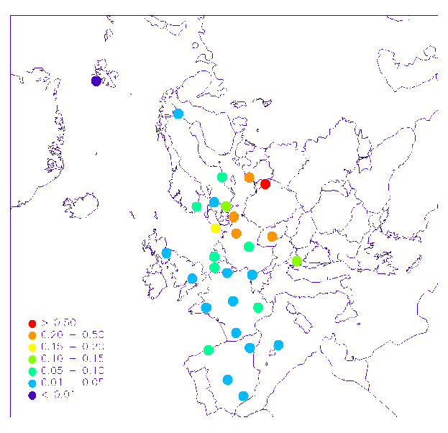
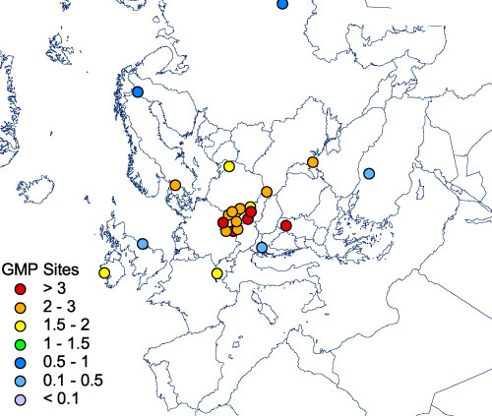
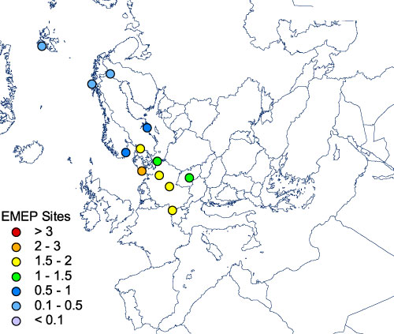
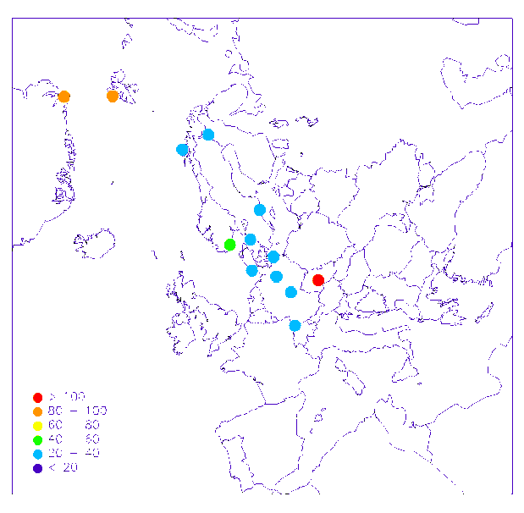
Measurement/Modeling assessment for 2014
Monitoring of PAH, PCB, and HCB concentrations in the EMEP region
B[a]P
PCB-153
HCB
Measurements of PAH concentrations were reported by 31 monitoring site
PCBs and HCB were measured at 13 sites
Passive sampling measurements of PCBs from UNEP SC GMP Datawarehouse
No regular measurements of PCDD/F concentrations

Slide 9
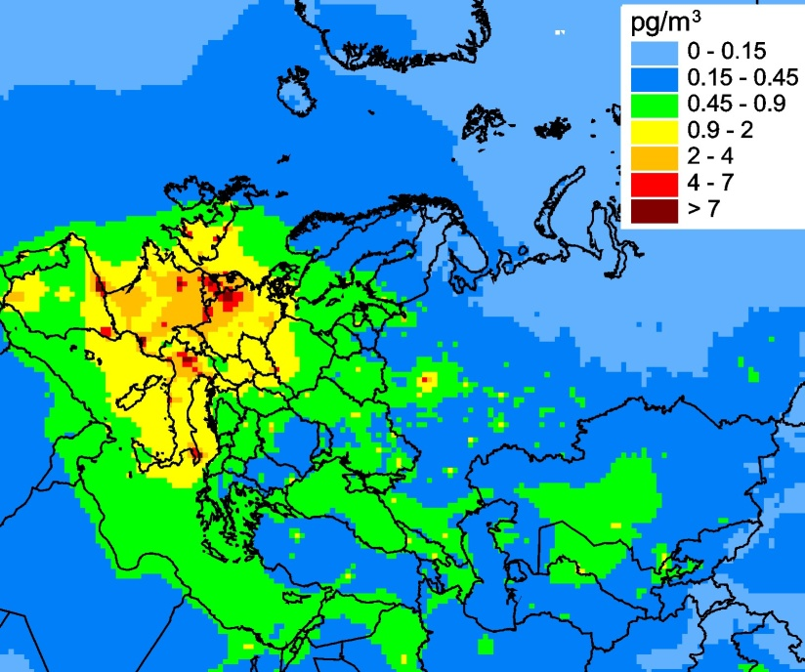
Measurement/Modeling assessment for 2014
Evaluation of PCB-153 pollution levels in the EMEP region
Annual mean modelled PCB-153 air concentrations, 2014
Measurement/modelling agreement
3
Observed
Modelled
2
PCB-153 in air, pg/m³
1
0
CZ3
DE1
DE2
DE3
DE8
DE9
FI36
SE12
SE14
NO2
NO42
NO90
Evaluation vs. measurements of EMEP monitoring stations
Modelled PCB-153 air concentrations agree with measurements
Variations of PCB-153 air concentrations from 2013 to 2014 amounted to about 30%

Slide 10
Measurement/Modelling assessment for 2014
Evaluation of PCB-153 pollution levels in the EMEP region
Annual mean modelled PCB-153 air concentrations, 2014
Measurement/modelling agreement
5
factor 3
factor 2
4
3
Modelled, pg/m³
2
1
0
0
1
2
3
4
5
Observed, pg/m³
Evaluation vs GMP DWH passive sampling measurements in Europe
Modeling results agree with passive sampling measurements within a factor of 2 – 3

Slide 11
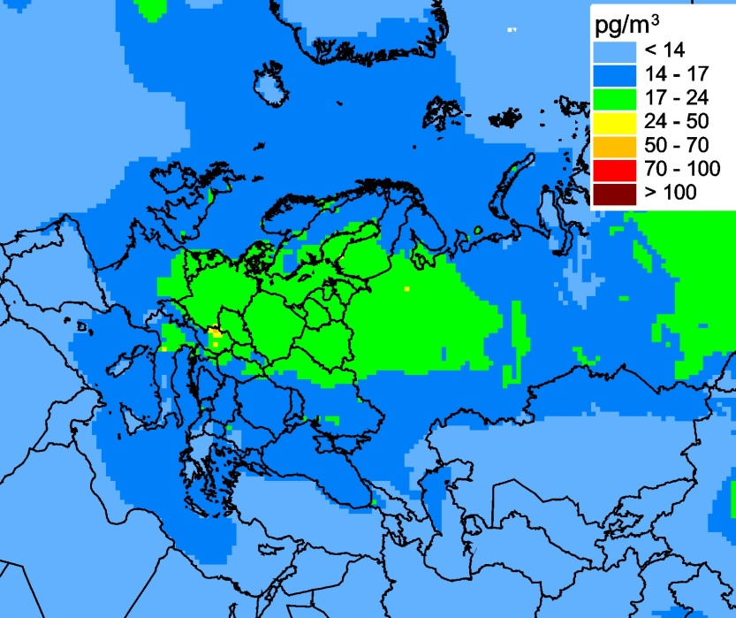
Measurement/Modelling assessment for 2014
Evaluation of HCB pollution levels in the EMEP region
Annual mean modelled HCB air concentrations, 2014
Measurement/modelling agreement
x3
x3
Evaluation vs. measurements of EMEP monitoring stations for 2012-2014
Modelled HCB air concentrations agree with EMEP measurements within a factor of 3
The model tend to underestimate measured HCB air concentrations

Slide 12
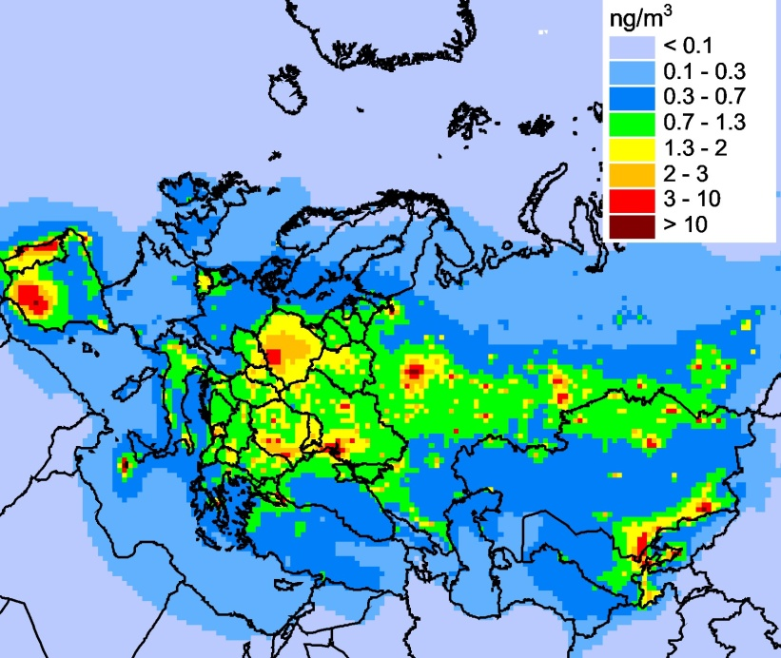
Measurement/Modelling Assessment 2014
Evaluation of PAH pollution levels in the EMEP region
Annual mean modelled PAH air concentrations, 2014
Measurement/modelling agreement
x2
x2
Evaluation vs. measurements of EMEP monitoring stations for 2014
~70% of modelled concentrations are within a factor of 2 in comparison with measurements of 4PAHs

Slide 13
Measurement/Modelling Assessment 2014
Evaluation of B[a]P pollution levels in the EMEP region
Annual mean modelled and observed B[a]P concentrations
Daily variations of B[a]P concentrations
0.8
Observed
Modelled
0.6
B[a]P in air, ng/ m³
0.4
0.2
0.0
PL0005R
CZ0003R
SE0011R
SE0012R
FI0036R
GB0036R
SE0014R
DE0002R
GB0048R
DE0009R
DE0001R
DE0008R
DE0003R
Modelled B[a]P concentrations are generally within a factor of 2 in comparison with measurements

Slide 14
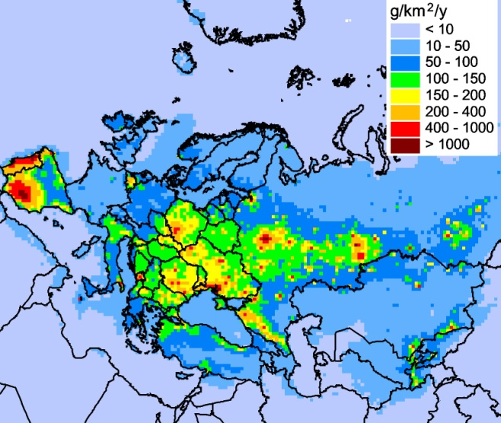
Measurement/Modelling Assessment
of PAH pollution, 2014
Transboundary transport of pollution
PAH deposition to EMEP countries
100%
75%
Transboundary transport
Contribution, %
50%
25%
National emissions
0%
France
Latvia
Belarus
Serbia
Croatia
Austria
Albania
Slovakia
Finland
Cyprus
Norway
Greece
Bulgaria
Slovenia
Hungary
Estonia
Iceland
Monaco
Georgia
Germany
Lithuania
Sweden
Moldova
Armenia
Kyrgizstan
Denmark
Uzbekistan
Azerbaijan
Switzerland
Netherlands
Luxembourg
FYR Macedonia
Czech Republic
Turkmenistan
Liechtenstein
Bosnia&Herzegovina
PAH deposition in 2014
For about 70% of the countries contribution of transboundary fluxes exceeded contribution of national emissions to deposition
Substantial part of deposition originated from emissions of several countries (the Russian Federation, Ukraine, Kazakhstan, Spain, and Poland)

Slide 15
Measurement/Modelling Assessment
of PAH pollution, 2014
Transboundary transport of pollution
Changes of PAH deposition from 2013 to 2014
100%
75%
50%
25%
0%
-25%
-50%
Latvia
Italy
Austria
France
Ireland
Norway
Finland
Belarus
Poland
Sweden
Estonia
Denmark
Lithuania
Slovakia
Germany
Belgium
Slovenia
Netherlands
Switzerland
United Kingdom
Czech Republic
Liechtenstein
PAH deposition in 2014
Inter-annual changes of transboundary fluxes lead to substantial changes of annual deposition in EMEP countries (about 50-70%)

Slide 16
Measurement/Modelling Assessment
of PAH pollution, 2014
Exceedance of EU target value for B[a]P (1 ng/m³)
1 ng/m³ 0.6 ng m/³ 0.4 ng/m³
B[a]P air concentrations in 2014
Population in areas with exceeded EU target levels for B[a]P
EMEP measurements: The 95th percentile concentrations exceed 1 ng/m³ at Kosetice (Czech Republic), Waldhof, Zingst (Germany), Rucava (Latvia), and Diabla Gora (Poland)
Modelling: B[a]P air concentrations near or above 1 ng/m³ are calculated for Central and Eastern Europe, and EECCA countries

Slide 17
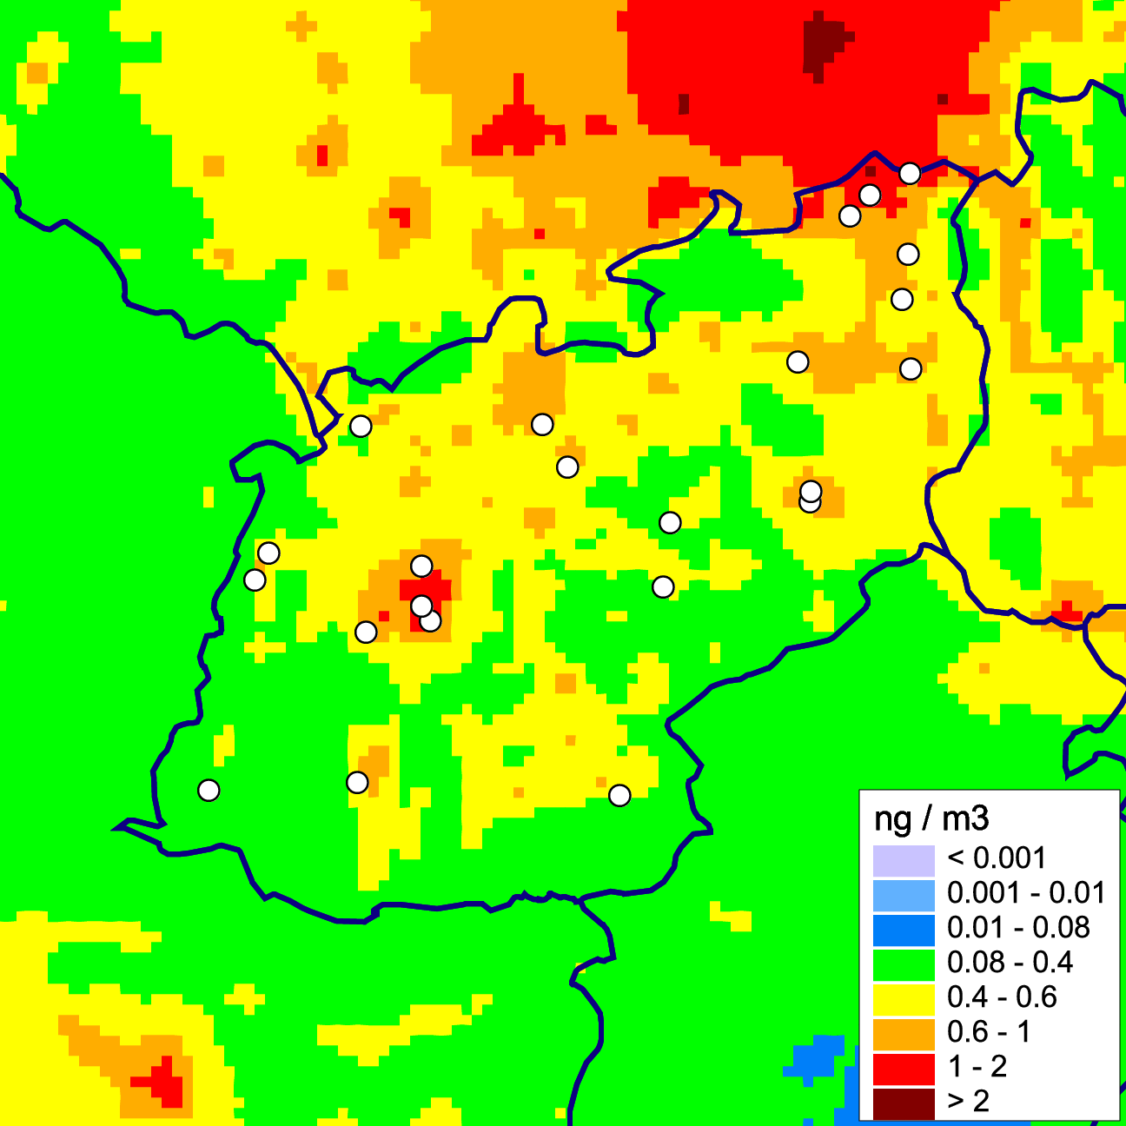
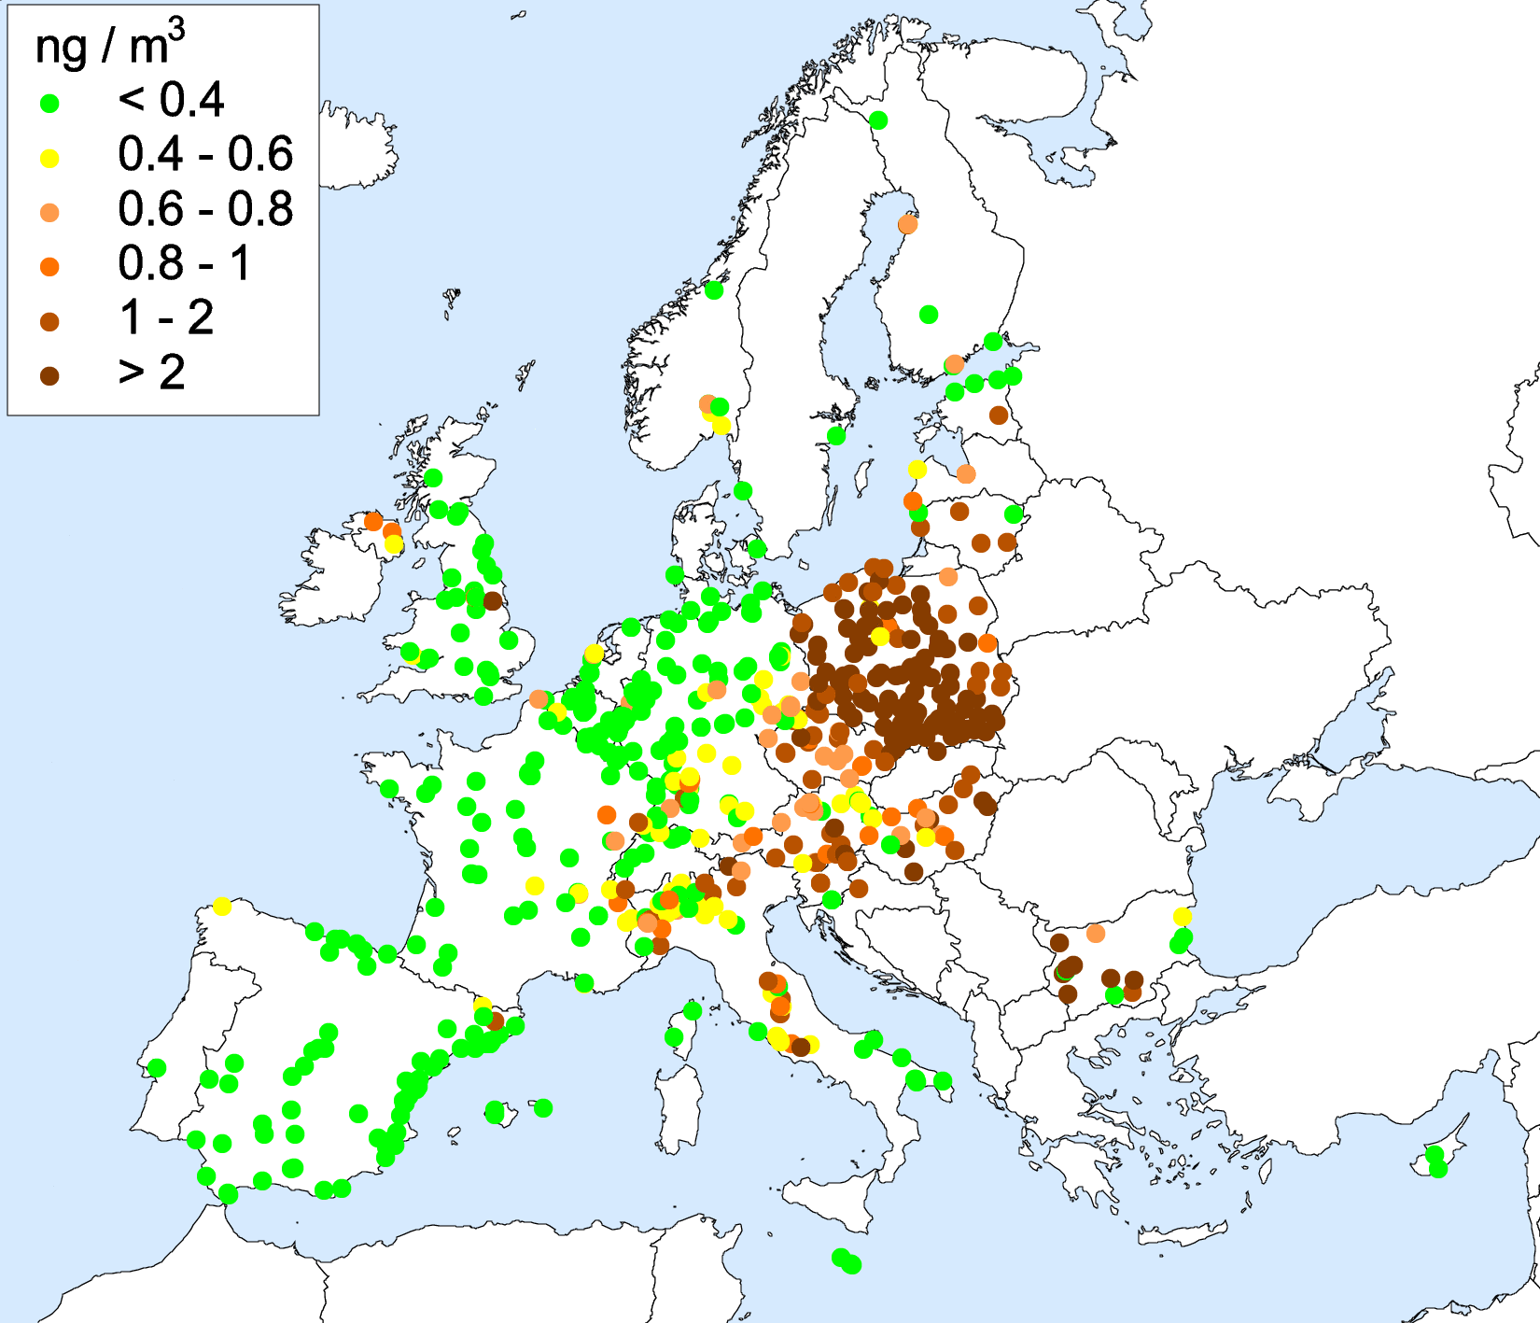
Evaluation of B[a]P pollution in urban areas
Significant part of population in the EMEP countries lives in areas with exceeded limit values for B[a]P air concentrations
About half of urban/suburban monitoring stations in Europe in 2013 measured B[a]P air concentrations above 1 ng/m³ (EEA, 2015)
A study is initiated to estimate B[a]P pollution levels in urban areas of EMEP countries and provide information for exposure evaluation
5 x 5 km²
Ostrava
Modelling domain
Prague
Measured B[a]P air concentrations in 2013 (EEA Airbase)
Modelled B[a]P air concentrations for 2013

Slide 18
Measurement/Modeling assessment for 2014
Assessment of pollution for PCDD/Fs, PCBs, and HCB is carried out using multi-scale (global/regional) model simulations
Initial and boundary conditions for evaluation of pollution of EMEP region are generated using global scale modelling with GLEMOS model
For evaluation of global scale transport available emission inventories and data from international organizations are used
To verify global modelling results measurement data from various monitoring networks, databases, and literature are compiled
EMEP
Global and regional scale modelled PCDD/F air concentrations for 2014

Slide 19
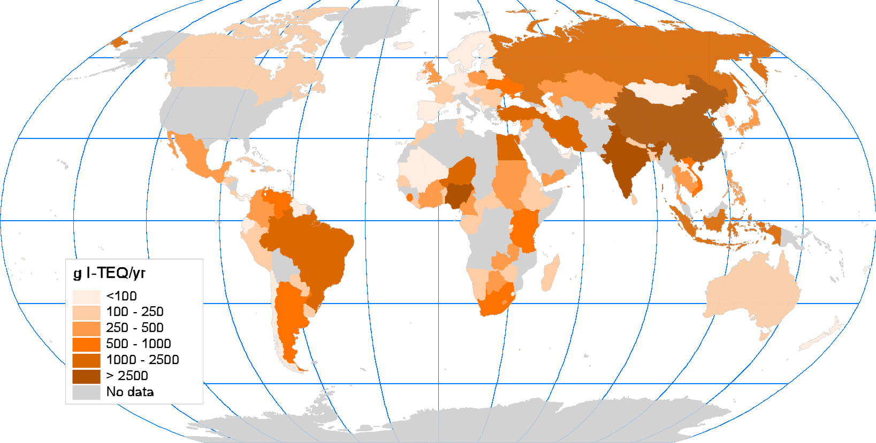
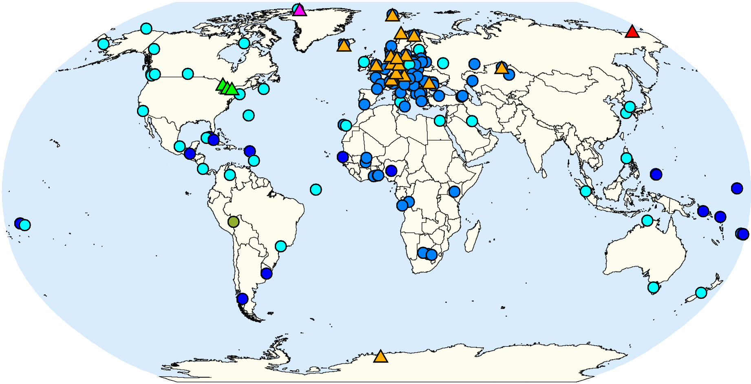
Global scale data for evaluation of POP pollution
UNEP SC global emissions and measurements of POPs in air and media
PCDD/F emissions of more than 140 countries (based on UNEP Emission Toolkit)
Emission data include PCDD/F releases to air, land, and water
Measurements of PCBs, PCDD/Fs, HCB air concentrations over the globe
(SC GMP Data Warehouse)
Annual PCDD/F emissions to air (g I-TEQ/yr)
Measured PCB-153 air concentrations (pg/m³)

Slide 20
Further development of POP modelling approach
Research activities related to regional and global scale modelling:
Refinement of parameterization of atmospheric transformation/removal processes and exchange with media
Further development of source-receptor methodology accounting for multi-media transport of POPs
Analysis of congener composition of emission and concentrations in media (PCDD/Fs, PCBs)
Multi-scale modelling to support transition to the New EMEP grid
Multi-model study of global POP transport applying UNEP SC GMP measurement data
GLEMOS (EMEP/MSC-E)
BETR-Research (Switzerland/Sweden)
Measured and modelled PCB153 in air for the period 2004-2013, pg/m³

Slide 21
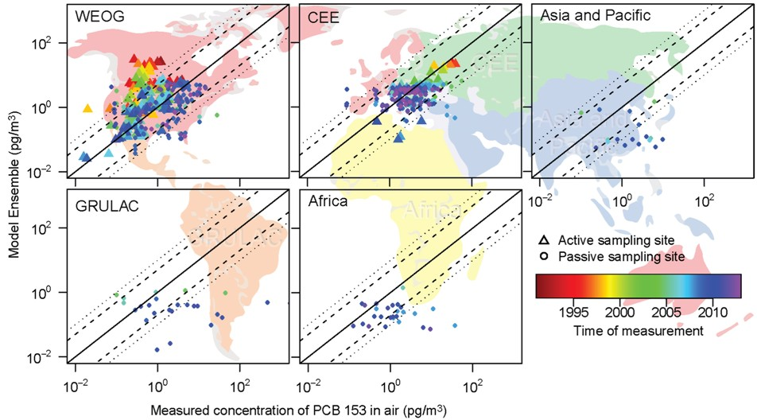
Co-operation with UNEP Stockholm Convention
Multi-model assessment of global POP pollution and trends
GLEMOS (MSC-E) and BETR (Sweden) models vs. measurements of UNEP SC GMP DWH
EMEP
Contribution to the assessment of effectiveness of UNEP SC
(Second Global GMP report, 2016)

Slide 22
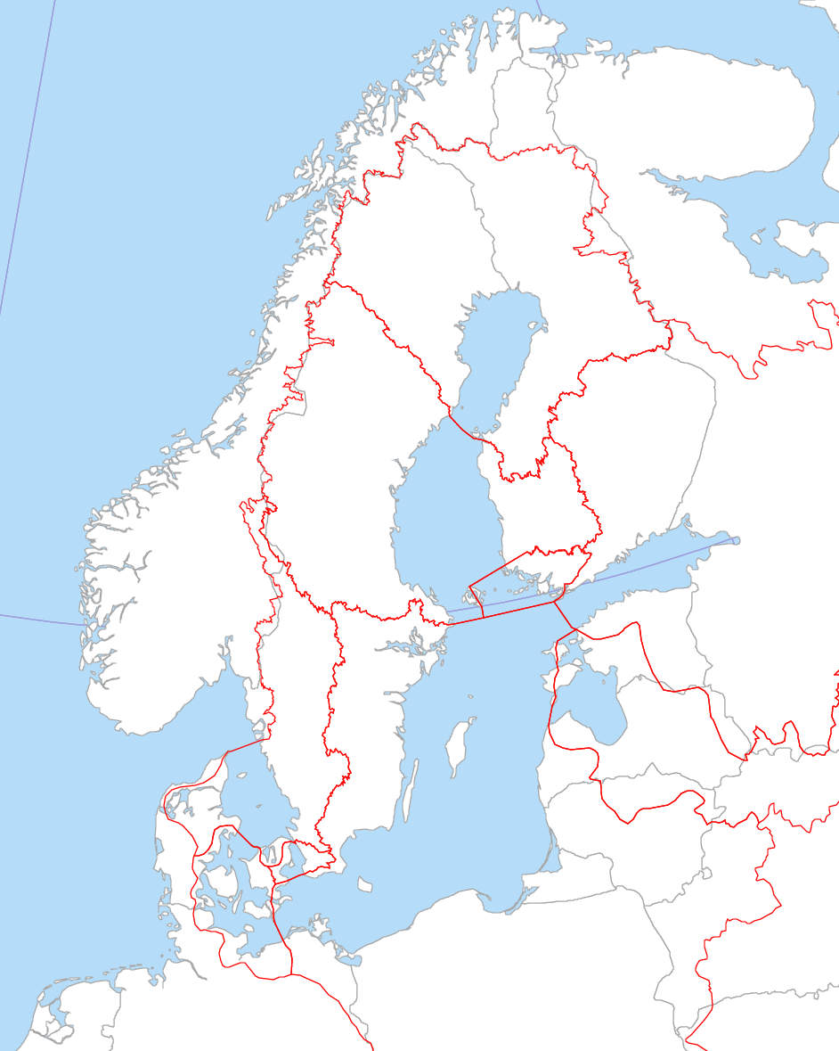
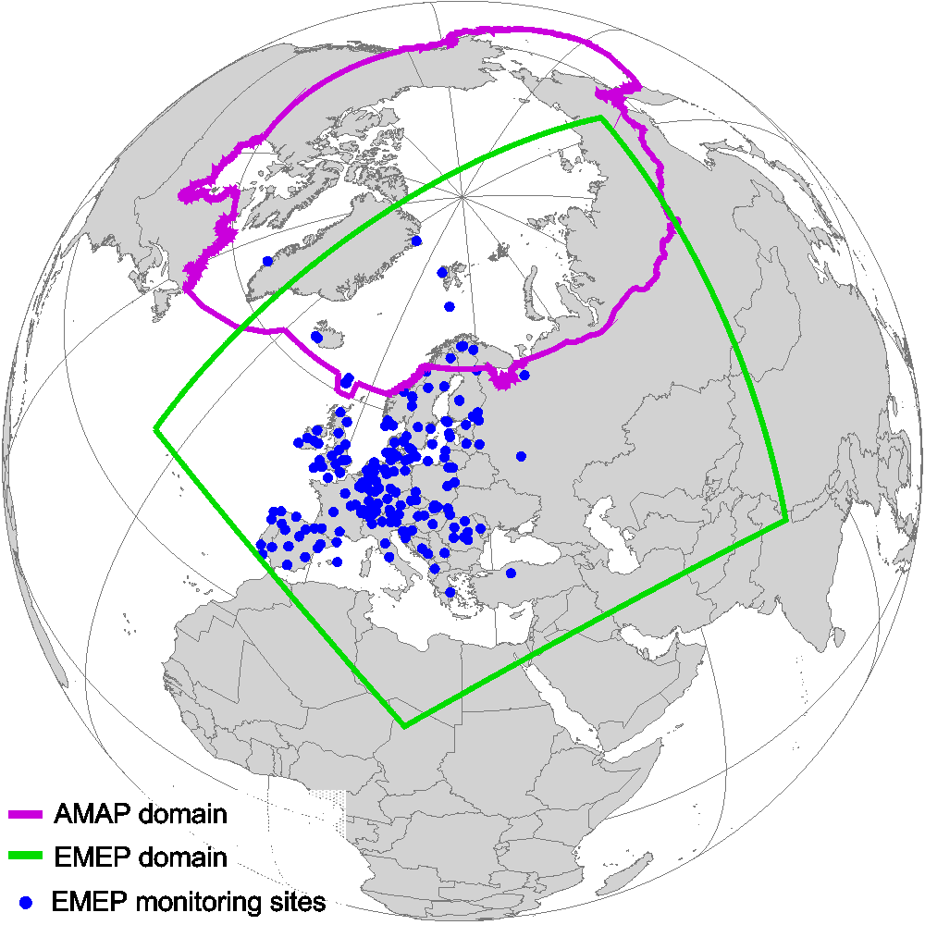
Cooperation with international programs (HELCOM and AMAP)
Baltic Sea region
Assessment of atmospheric input of POPs/HMs to Baltic Sea:
Substances – Pb, Cd, Hg, PAHs, PCBs, PCDD/Fs
Deposition maps and source-receptor relationships
Long-term trends (1990-2013)
HELCOM PRESSURE group meeting (Copenhagen, 2016): interest to evaluation of pollution by new substances
AMAP and EMEP domains
Joint AMAP/CLRTAP workshop (Potsdam, 2016)
AMAP
Regular pollution assessment over the EMEP domain:
Substances – PAHs, HCB, PCBs, PCDD/Fs
Concentration and deposition maps
Source-receptor relationships
Long-term trends (1990-2014)
EMEP

Slide 23
MSC-E work-plan elements for 2017
Operational monitoring and modelling of POP transboundary pollution within EMEP
Model evaluation of POP (B[a]P) contamination of highly populated regions (urban areas)
Evaluation of intercontinental transport and contribution of secondary sources
Refinement of model parameterization of phase partitioning and inter-media exchange of POPs
Contribution to development of emission strategy to improve emissions
Transition of POP operational modelling to the new EMEP grid
Co-operation and exchange of information on POP pollution with subsidiary and international bodies (TFMM, TF HTAP, UNEP, AMAP, HELCOM etc)

