Slide 1


5th Joint Session of the EMEP Steering Body and the Working Group on Effects
9-13 September, 2019, Geneva (Switzerland)
Assessment of POP pollution in EMEP region: current progress and further activities
MSC-E: A. Gusev, V. Shatalov, O. Rozovskaya
CCC: W. Aas, K. Breivik
CEIP: K. Mareckova, S. Poupa, C. Sosa, M. Tista, R. Wankmueller
INERIS: F. Couvidat

Slide 2
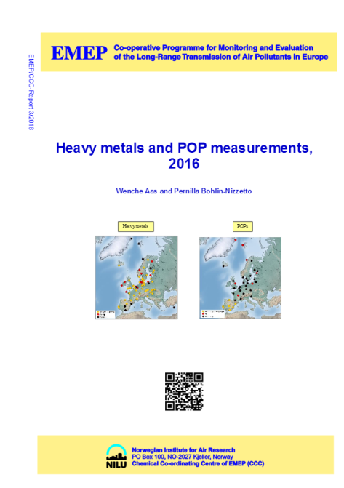
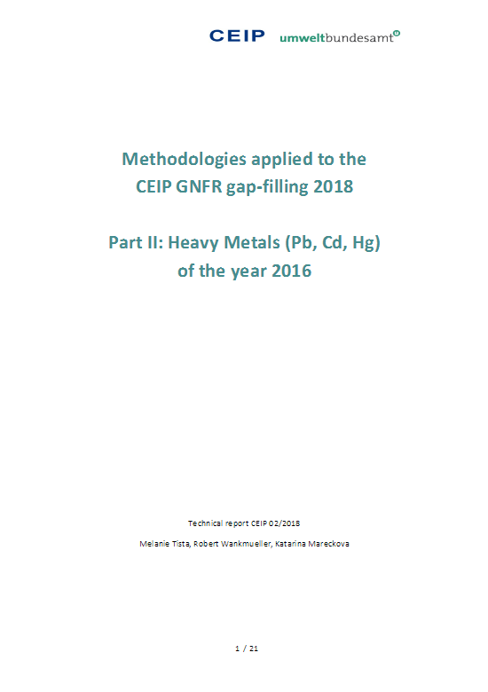
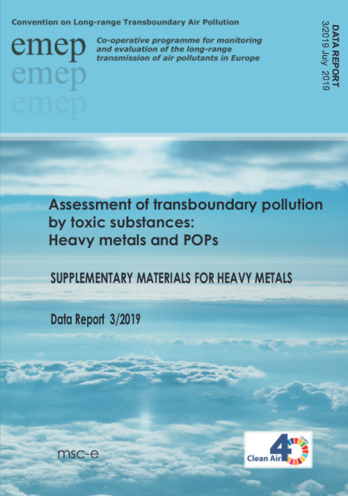
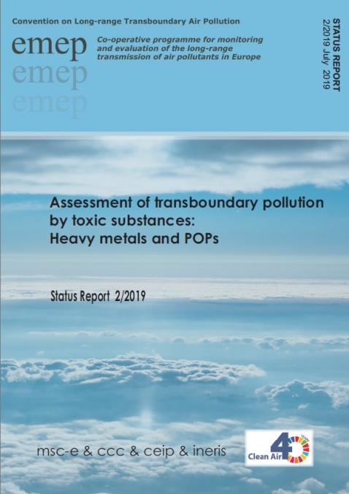
Outcome of activities on POPs in 2019
Main topics of Status Report 2/2019:
Emissions of POPs in the EMEP countries (CEIP)
POP monitoring in the EMEP region (CCC)
Model assessment of POP pollution for 2017 (MSC-E)
Contribution to TF TEI work:
Levels and trends in B(a)P pollution
Population exposure to high B(a)P/PAH levels
Research activities:
Case study on B(a)P pollution
Refinement of HCB pollution assessment
Co-operation with international organizations
Plans of further activities
Detailed results are available in internet:
www.msceast.org
www.ceip.at
www.nilu.no/projects/ccc/

Slide 3
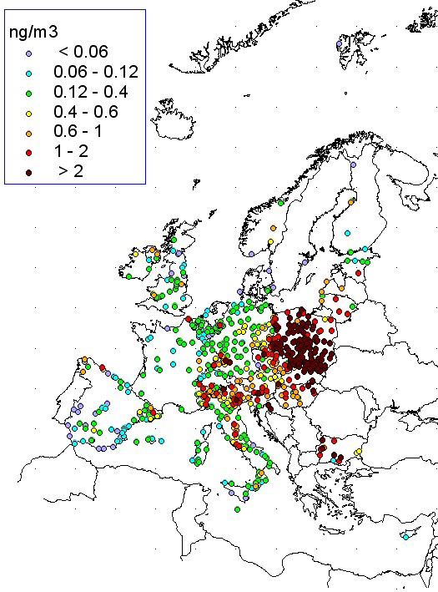
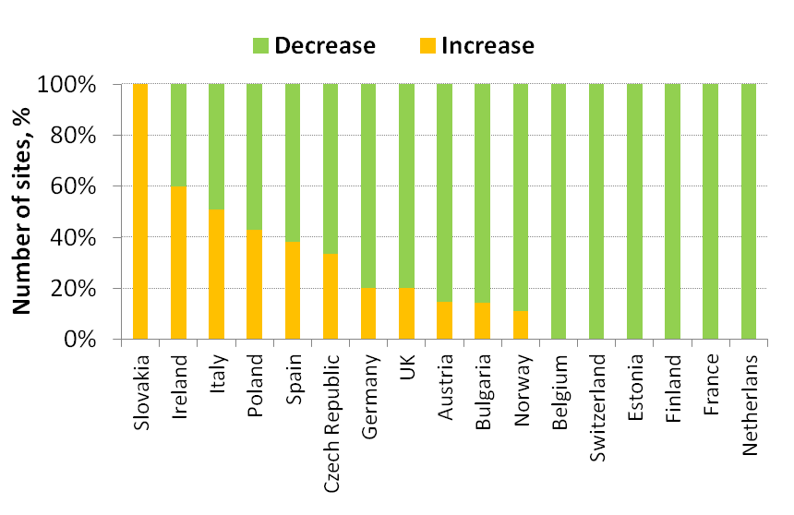
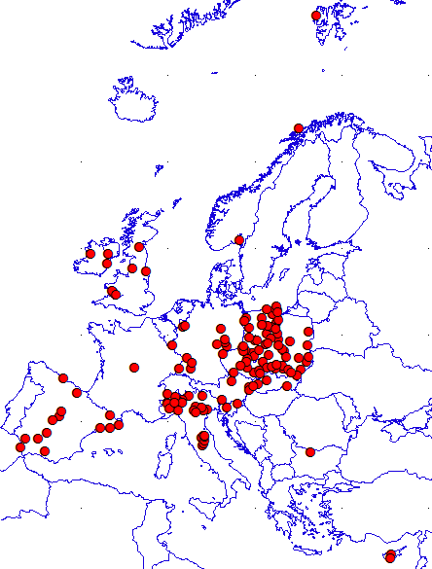
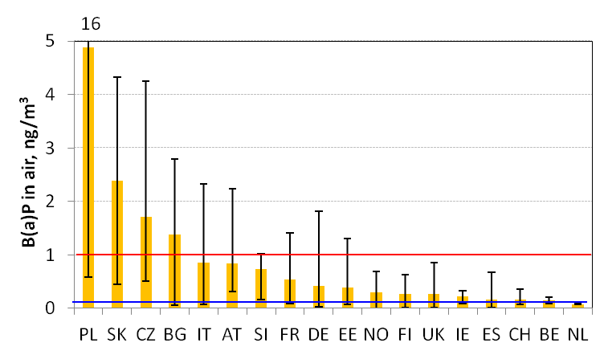
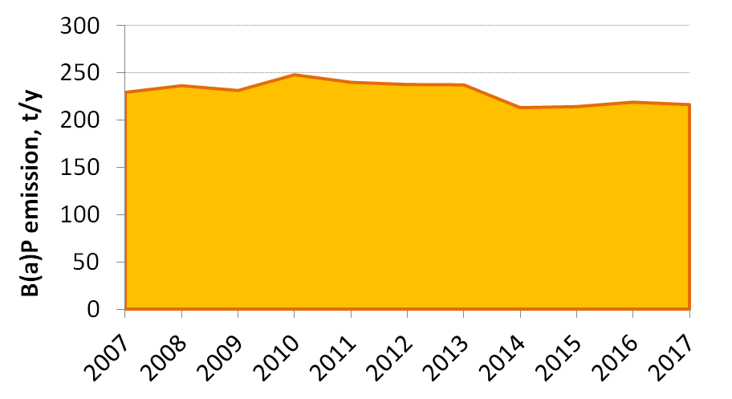
Analysis of B(a)P pollution trends (2007-2017)
Contribution to analysis of the effectiveness of the POP Protocol (TFTEI)
Observed B(a)P pollution levels still exceed EU/WHO limits in many countries
B(a)P air concentrations are increasing in some countries
B(a)P emissions in the EMEP region are almost stable in recent decade
EU limit
WHO limit
Exceedances of EU/WHO B(a)P limit values in EMEP countries
Observed B(a)P levels in air (AIRBASE+EMEP, 2017)
Locations of sites with increasing B(a)P levels
Amount of AIRBASE sites showing decrease/increase of B(a)P levels
B(a)P emissions of EMEP countries

Slide 4
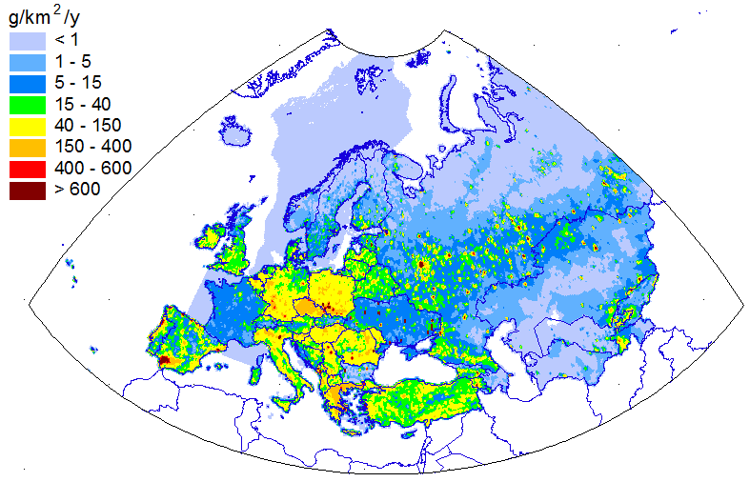
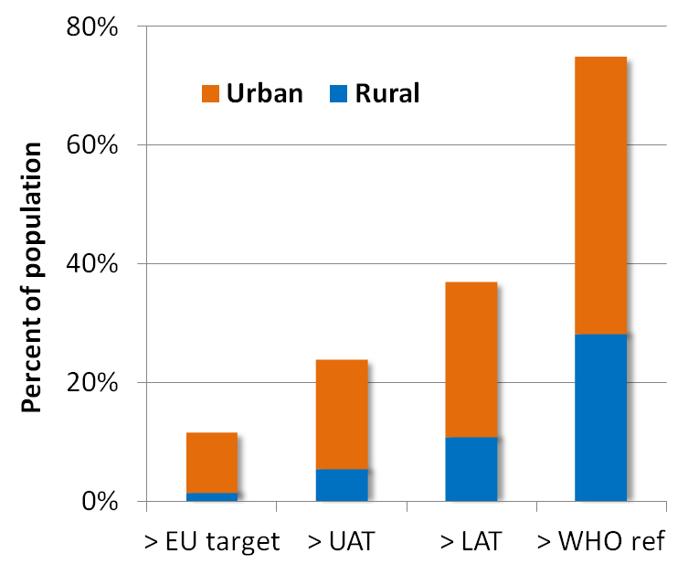
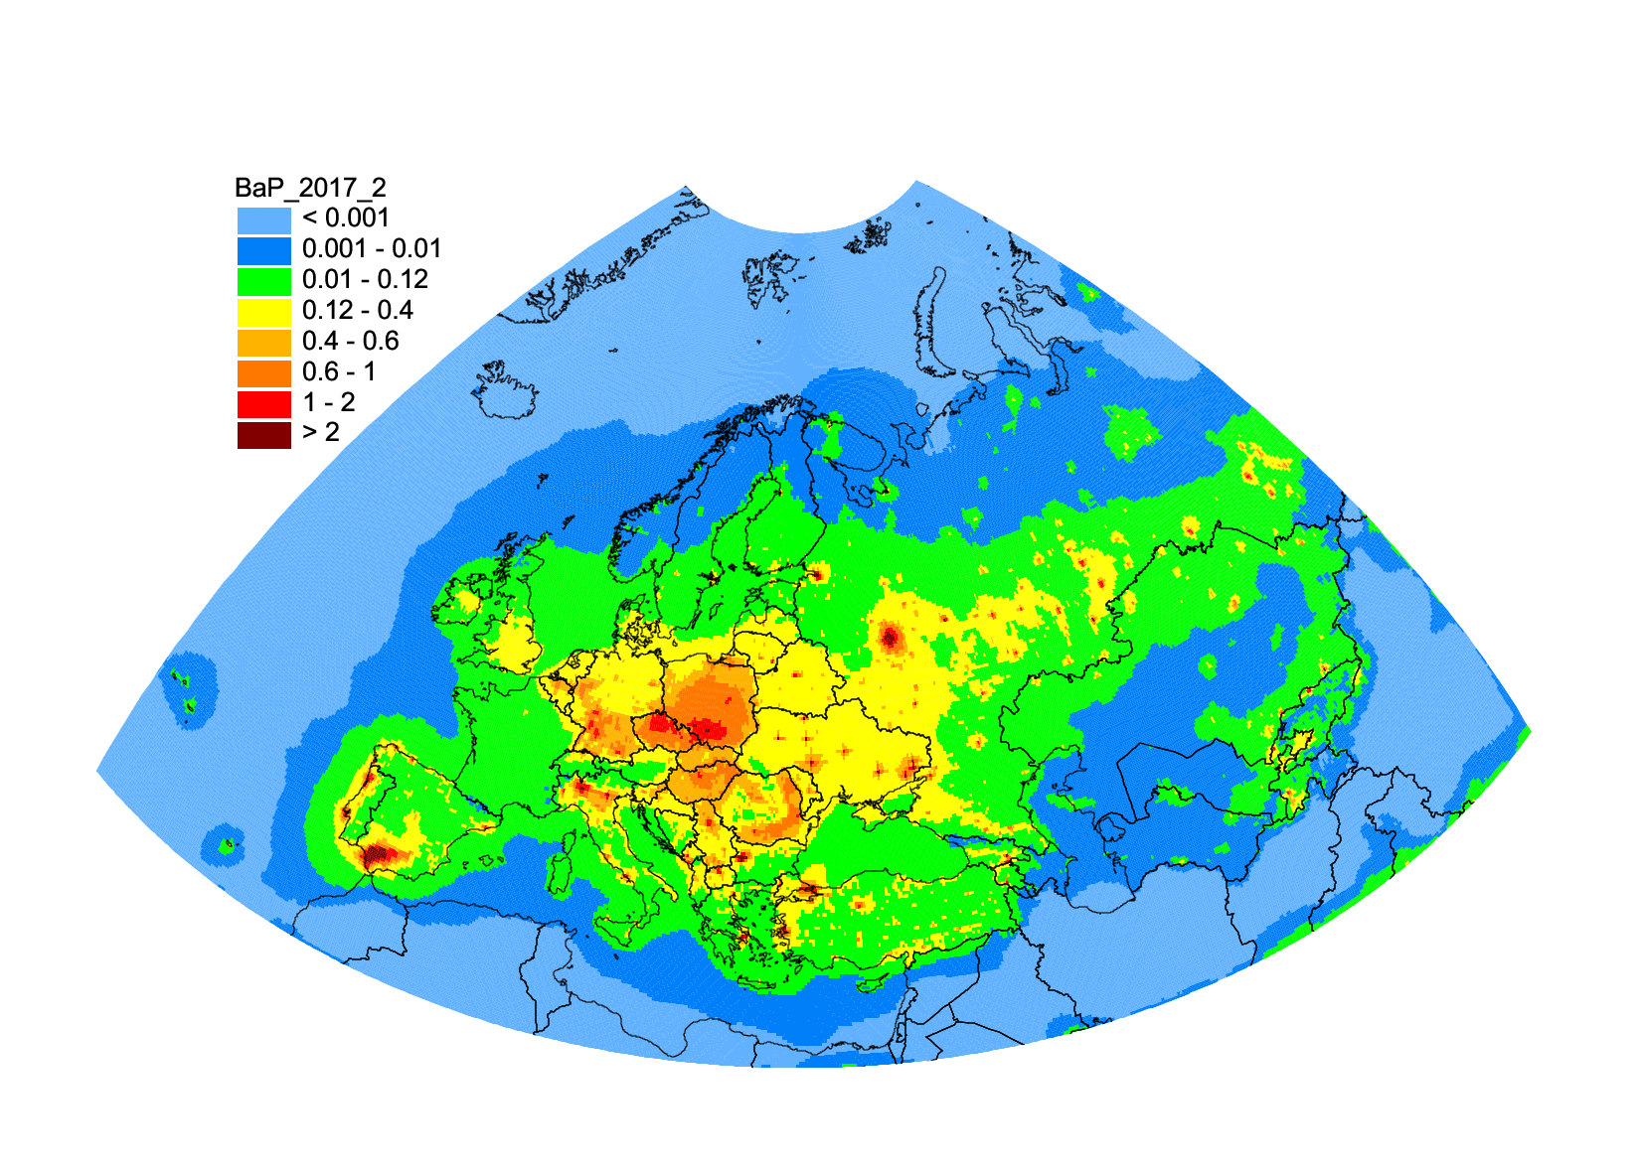
Human exposure to high B(a)P levels
Contribution to analysis of the effectiveness of POP Protocol (TFTEI)
B(a)P emissions (2017)
Population in areas with exceeded EU/WHO limits for B(a)P
Information on exceedances can be delivered to TF Health/WHO PAH group
B(a)P air concentration (2017)
1 ng/m³
0.12 ng/m³
~10% of population
~70% of population

Slide 5
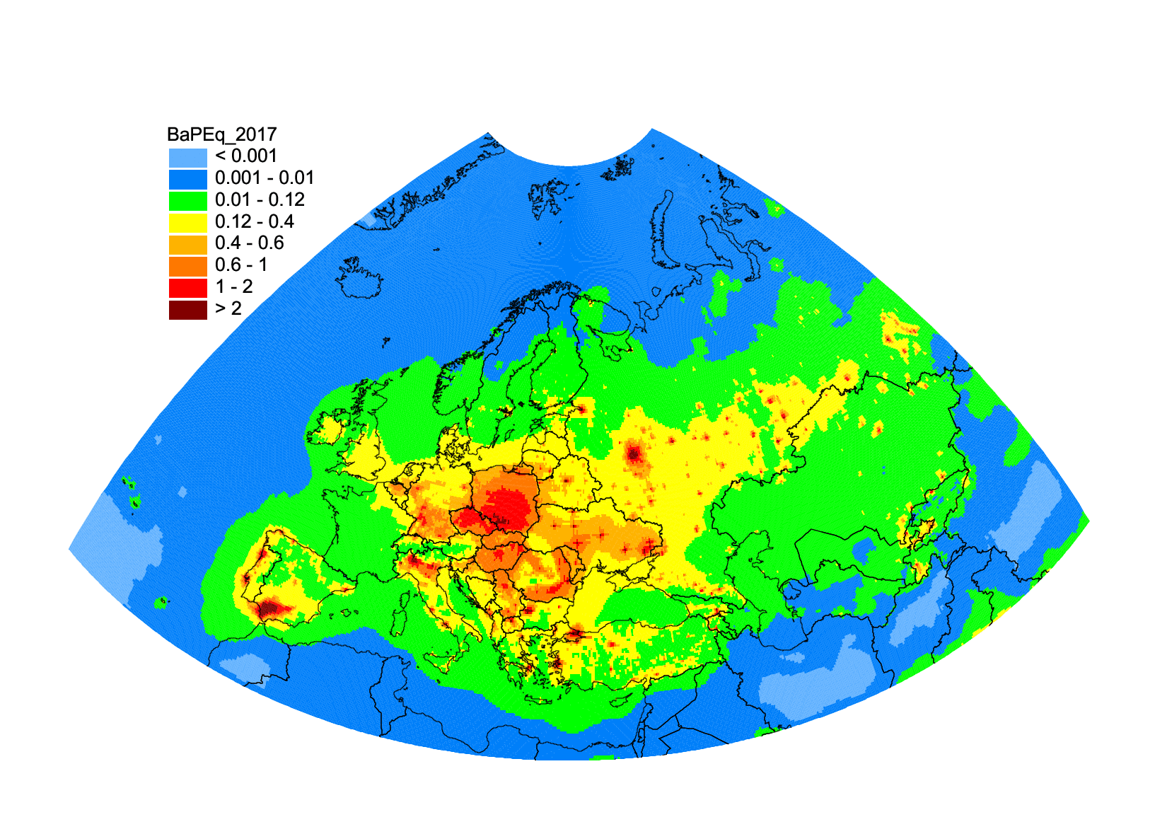
Human exposure to mixture of toxic PAHs
Evaluation of joint toxicity of PAH mixture
List of PAH to considered: POP Protocol – 4 PAHs
EU POP Regulation – 8 PAHs
US EPA – 16 PAHs
Gas-phase PAHs and toxic PAH derivatives (nitro-PAHs, oxy-PAHs)
Use of B(a)P-toxic equivalent factors (TEF) to predict toxicity of PAH mixture
Joint efforts of TFTEI, EMEP and Parties are needed for further analysis of effectiveness of POP Protocol.
Issues on PAH pollution/exposure are summarized in booklet prepared by MSC-E
B(a)P equivalent concentrations of 4PAHs:
4PAH (BaP_{eq}) = Σ PAH_{i} * TEF_{i}
PAH compound TEF
Benzo[a]pyrene 1.0
Benzo[b]fluoranthene 0.1
Benzo[k]fluoranthene 0.1
Indeno[1,2,3-c,d]pyrene 0.1
B(a)P-equivalent air concentrations of 4 PAHs for 2017 (ng m⁻³)

Slide 6
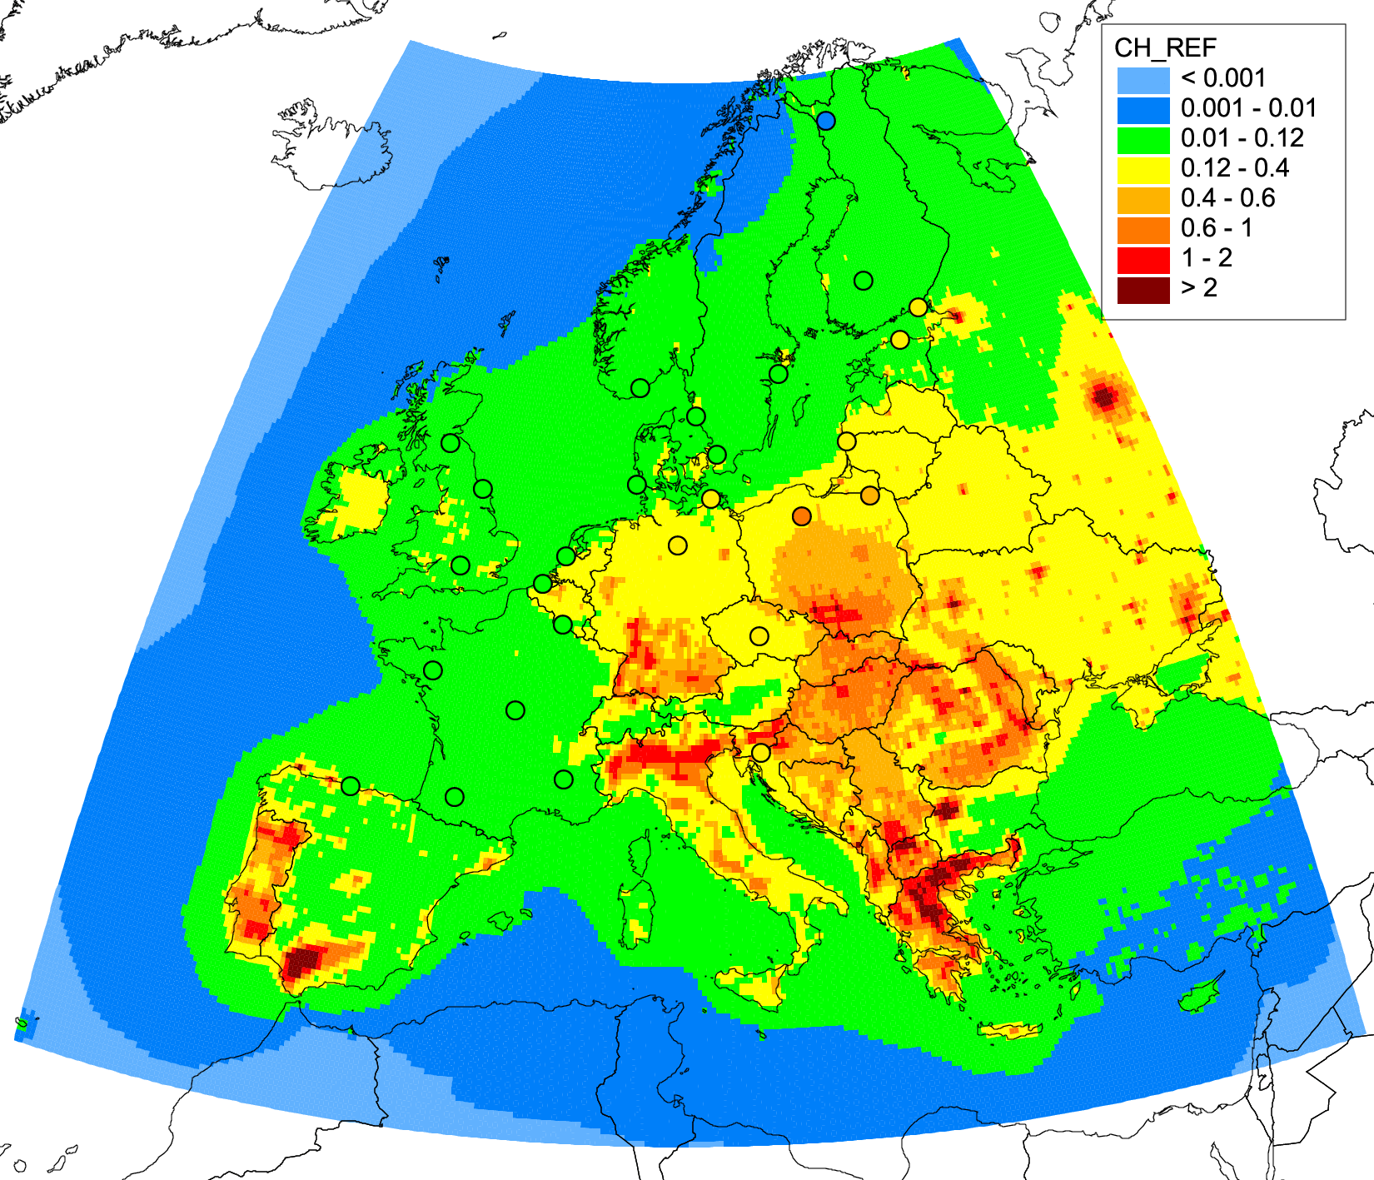
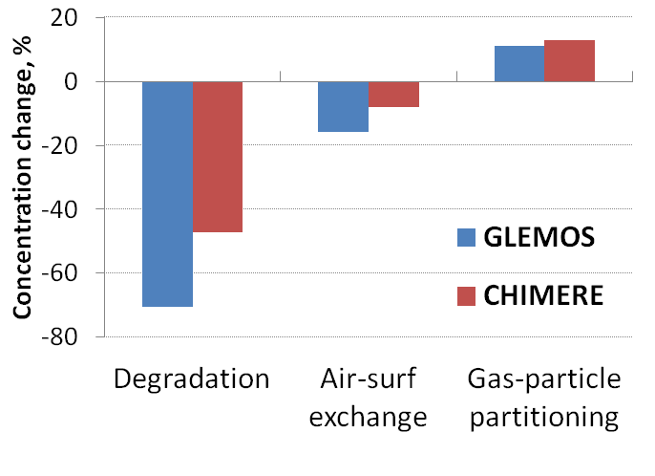
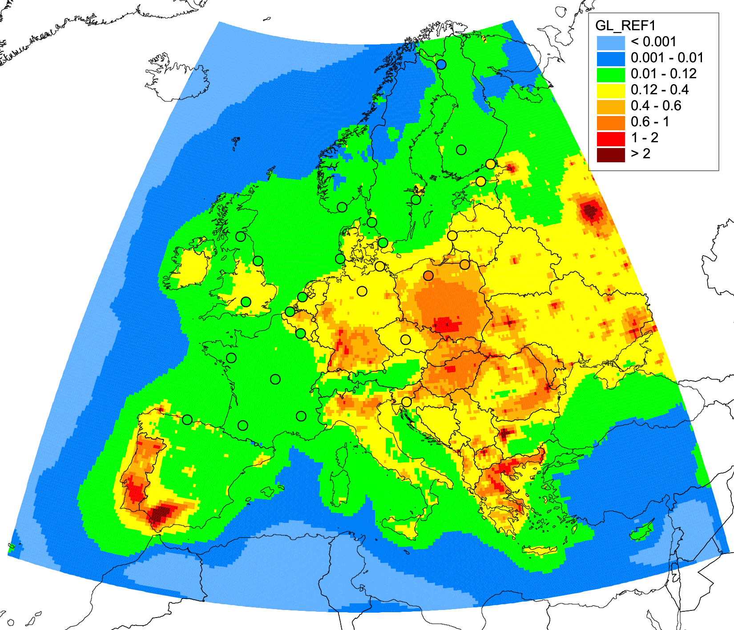
Research activities on B(a)P pollution
Case study on B(a)P pollution in Europe and France (2018-2019)
Analysis of model sensitivity to major B(a)P processes:
Key processes: degradation, gas-particle partitioning, air-surface exchange
Largest sensitivity to the model scheme of B(a)P degradation in air
Results of the study will be used to improve model parameterizations of GLEMOS
Further activities: 1) multi-model analysis of B(a)P transport (EuroDelta-Carb intercomparison), 2) B(a)P case study for Poland
B(a)P air concentration (2015)
Model sensitivity to major processes
CHIMERE
GLEMOS
Co-operation with national experts from France (INERIS)

Slide 7
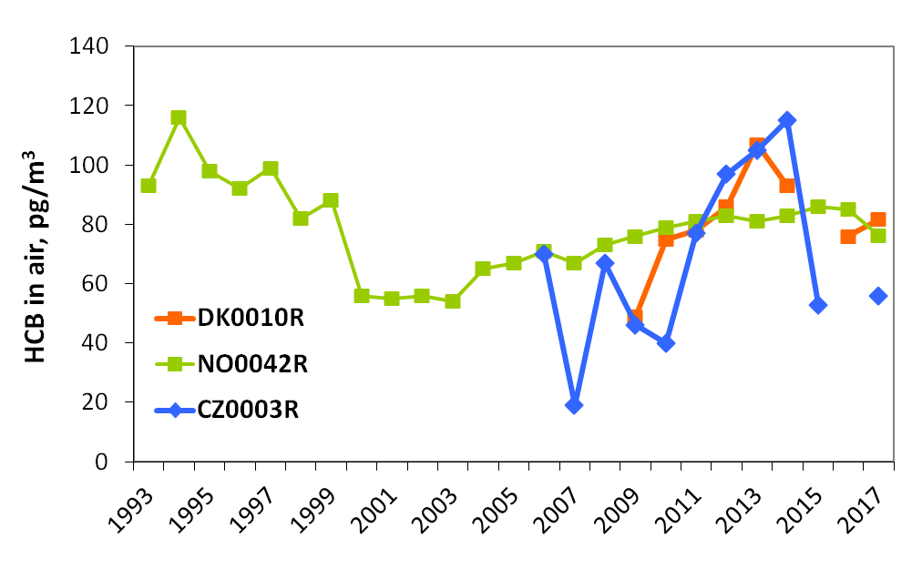
Research activities on HCB pollution
Refinement of HCB pollution assessment with focus on secondary sources
Motivation:
HCB is among priority POPs in the Long-term strategy of the Convention (LTS .38)
Slow decline of concentrations, increase at some EMEP sites (last 10 years)
Relative contributions of primary and secondary emissions
Measured HCB concentrations (CCC)
Contributions to
Objectives:
Analysis and improvement of HCB model assessment results (MSC-E, CCC)
Development of scenarios of HCB global/historical emissions (JRC, TF HTAP)
Reduction of uncertainties in national HCB emission inventories (TFEIP, Parties)
HCB air concentration
(model estimates)
EMEP secondary sources
EMEP anthropogenic sources
?
?
Global anthropogenic sources
Global secondary sources

Slide 8
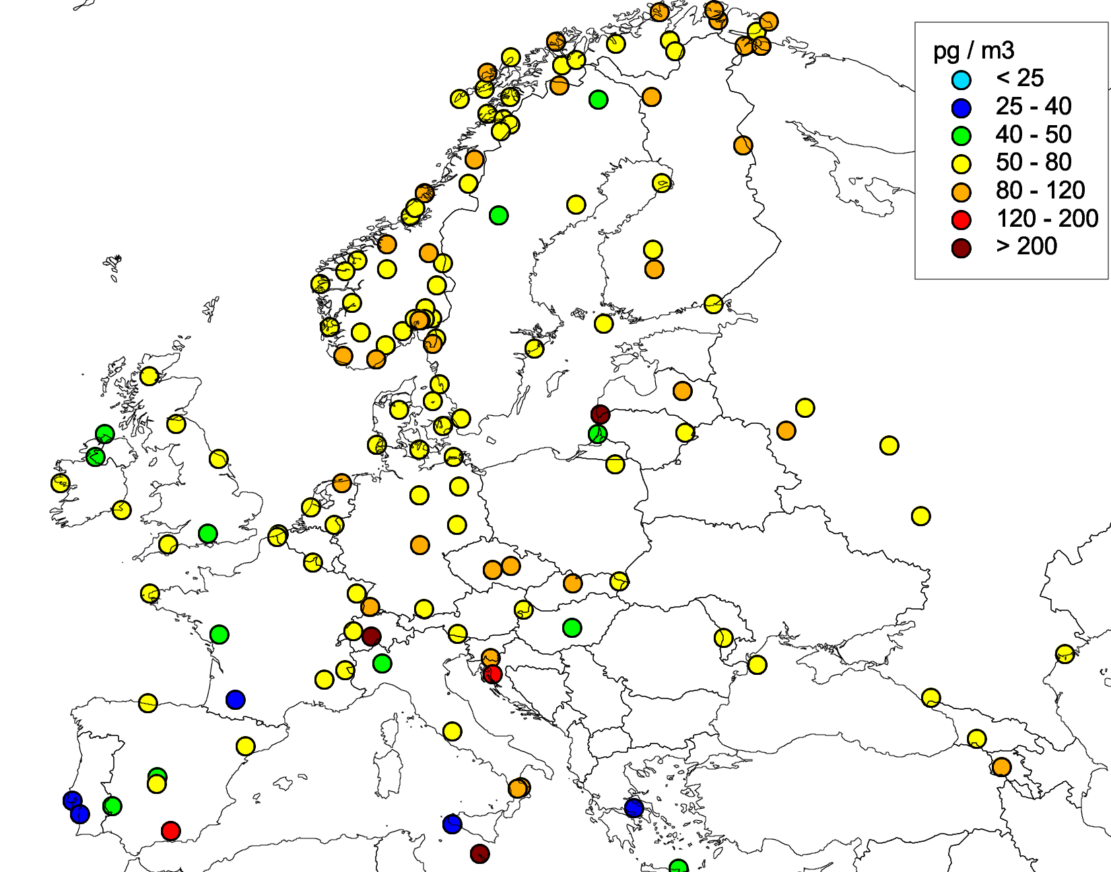
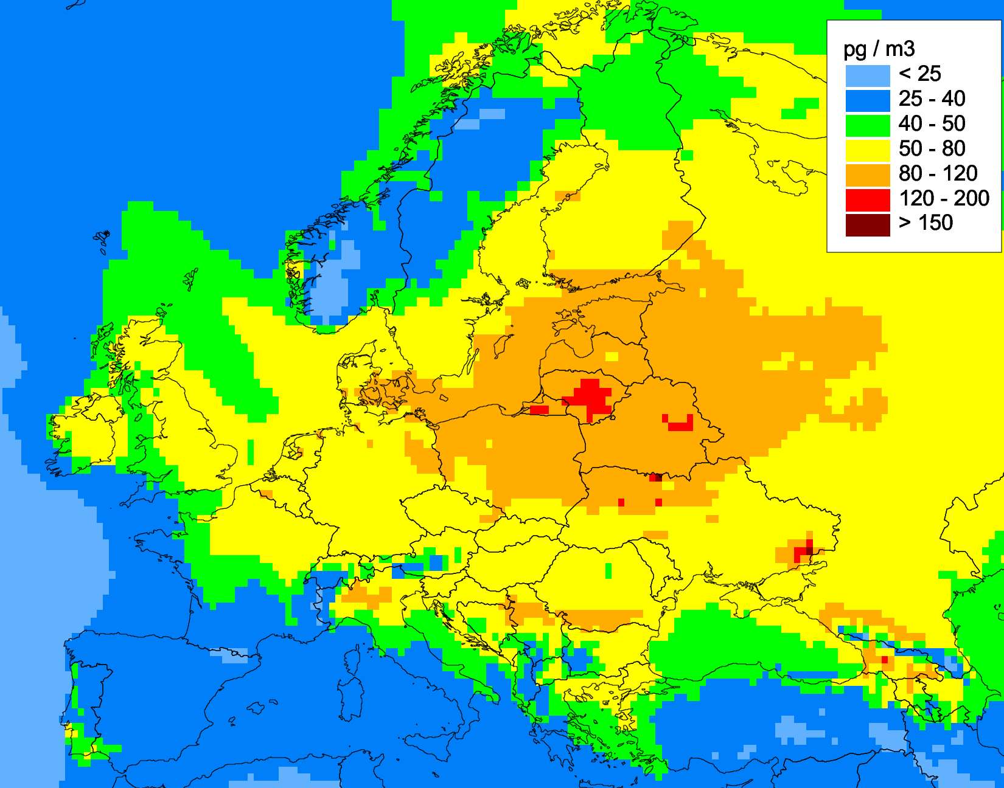
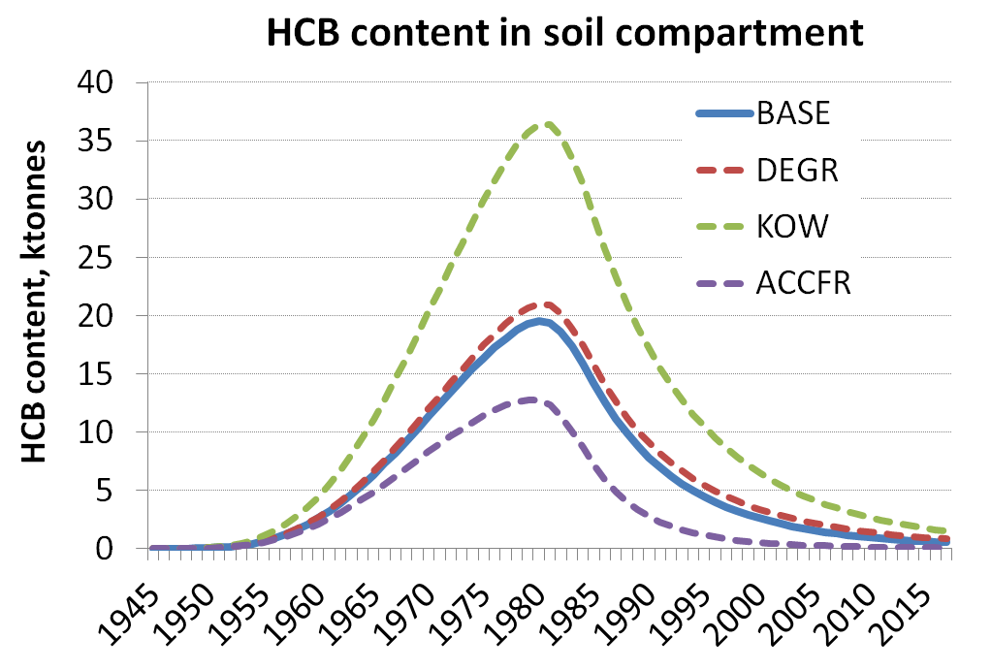
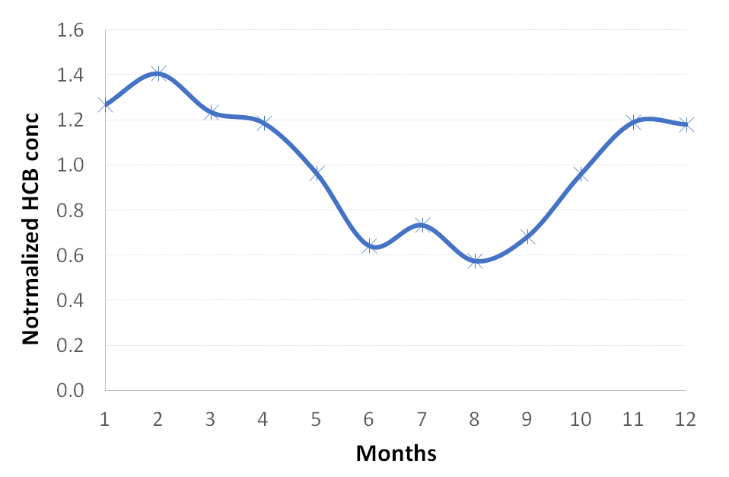
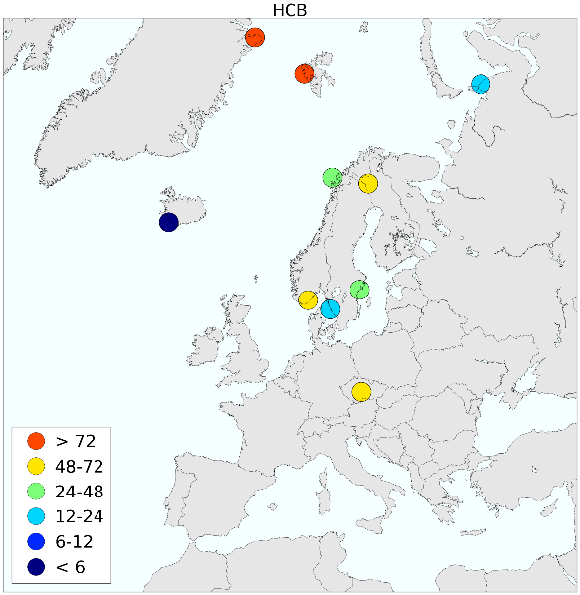
Research activities on HCB pollution
Refinement of HCB pollution assessment with focus on secondary sources
Ongoing and further activities:
Analysis of model parameterization and refinement of HCB accumulation in media (MSC-E)
Analysis of seasonality of HCB concentrations in 2017 (CCC)
Evaluation of model results using POP Passive Sampling campaign (CCC)
Experimental model simulations
Effect of primary emissions
HCB
BASE Base case
DEGR Decreased degradation rate in soil
KOW Increased HCB sorption in soil (KOW)
ACCFR Increased accessible fraction of soil for HCB
Passive sampling of HCB in air (CCC, preliminary results)
Modelled HCB air concentrations (2016)
Measurements of HCB in air (2017)

Slide 9
Co-operation with international organizations
Arctic Monitoring and Assessment Programme (AMAP)
  Contribution to the AMAP Assessment of POP Pollution of the Arctic region (2019)
Helsinki Commission (HELCOM)
  Assessment of atmospheric load of HMs and POPs to the Baltic Sea (HMs, PCDD/Fs)
Stockholm Convention (SC)
  Contribution to the SC effectiveness evaluation regional WEOG and Global assessment reports (2019-2021)
European Chemical Agency (EU regulation “Registration, Evaluation, Authorization and Restriction of Chemicals”, REACH)
  Updated EU Regulation on POPs (Regulation 2019/1021)
  ECHA supporting identification of new POPs for listing in the POP Protocol

Slide 10
Proposals for bi-annual work-plan (2020/2021)
Research and model development
  Attribution of long-term changes of POP pollution to regional and extra-regional (global, secondary) sources
  Multi-model analysis of B(a)P pollution using data of 2018 winter period monitoring campaign
National scale pollution assessments (co-operation with countries)
  Initiate studies on B(a)P pollution in Poland and Croatia (2020-2021)
Contribution to the evaluation of effectiveness of POP Protocol (co-operation with TFTEI)
  Analysis of trends and key sources of B(a)P pollution
  Co-operation with Working Group on Effects
  Data exchange with TF Health on B(a)P/PAH concentration and exceedances of target values
  Potential co-operation with JEG-DM on POP cycling and accumulation in the environmental media
  Co-operation with other international organizations
  AMAP, HELCOM, SC

