Slide 1
Main results of 2014 - 2015
Long-term trends of HMs and POPs on the basis of modeling results and measurements in mosses (cooperation with WGE)
2. Assessment of pollution levels with fine resolution in selected countries (Case studies)
3. Improved assessment of Hg and POPs pollution of EMEP domain from global sources
4. Application of EMEP mercury pollution assessment at the Minamata Convention

Slide 2
Long-term trends of HMs and POPs
Contribution to CLRTAP, WGE and TFMM Assessments-2016
Trend evaluation for the whole EMEP domain and particular countries
based on model calculations
Non-linear character of the pollution trends was investigated (methodology of
analysis was elaborated and applied)
100
Pb
Cd
Hg
B[a]P
80
60
EMEP
40
Total redcution, %
EU28
20
0
EECCA
-20
-40
Reduction of HMs and B[a]P in the EMEP region, EU28 and EECCA countries
B[a]P air concentrations in Germany

Slide 3
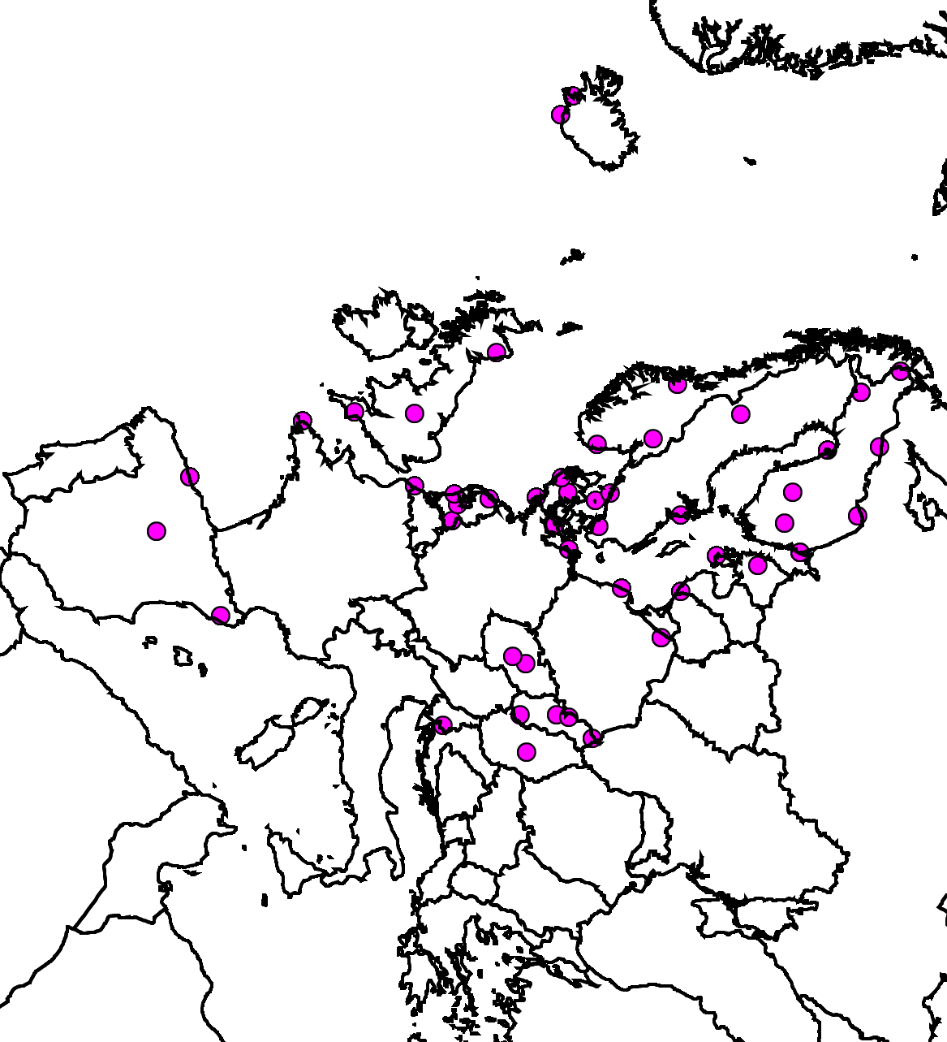
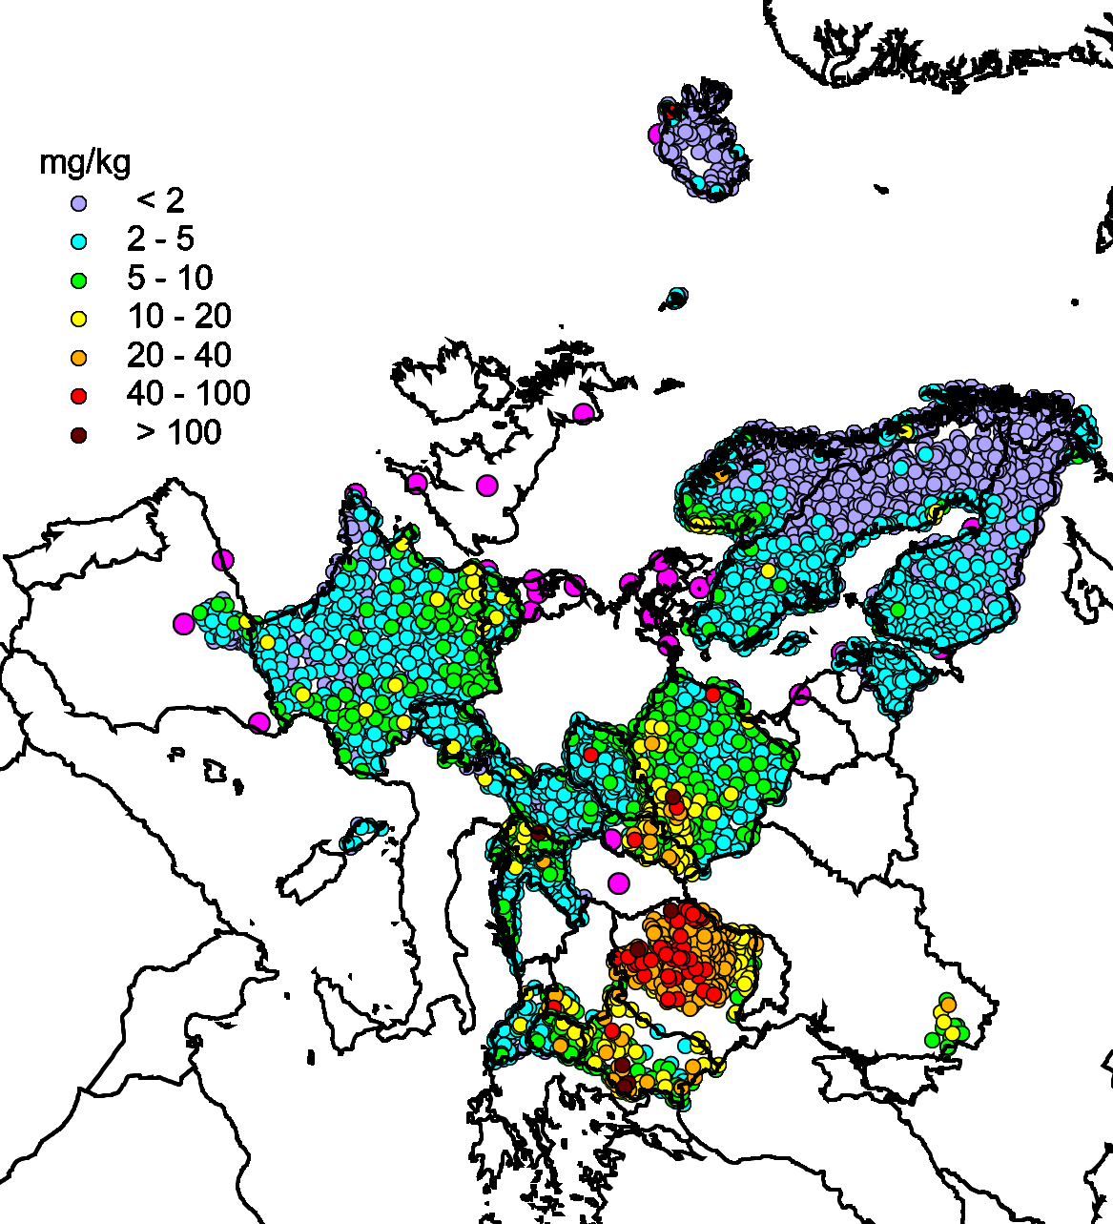
Cooperation with effects community
Long-term trends of HM pollution (measurements in mosses vs. modelling)
29th TF meeting of the ICP-Vegetation, Dubna, Russia, March 2016
Why do we need data on concentrations in mosses?
EMEP sites
Moss measurements
Measurements in mosses provide:
wider spatial coverage
more detailed spatial
resolution
EMEP monitoring stations
EMEP monitoring stations + moss measurements

Slide 4
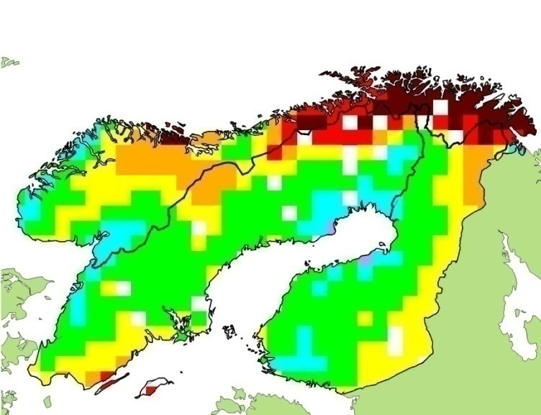
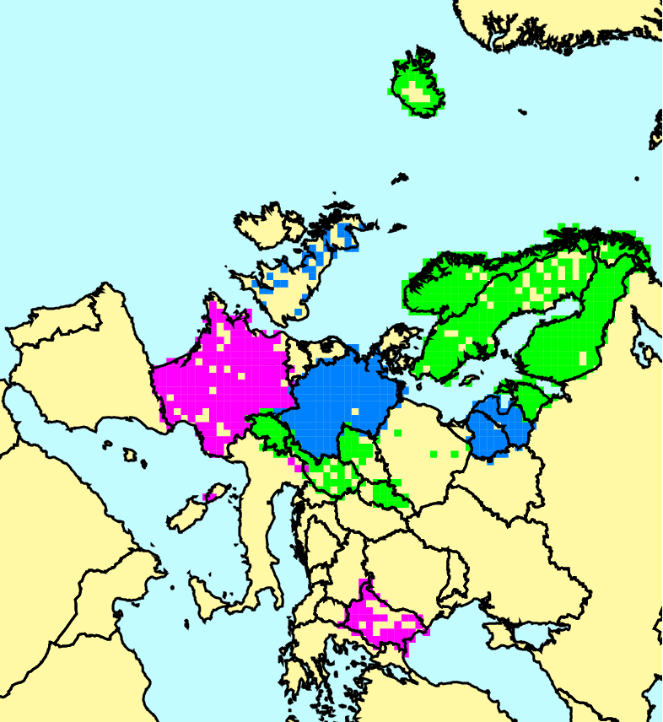
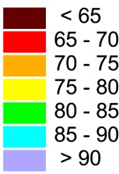
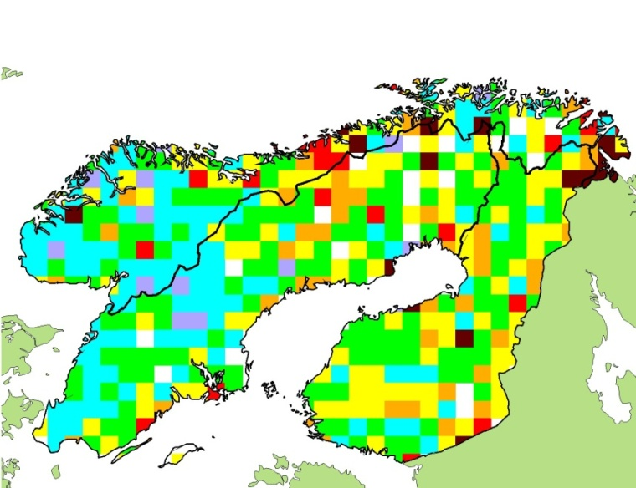
Cooperation with effects community
Comparison of changes of lead deposition and concentrations in mosses
Reduction (%) of modelled
total deposition
Reduction (%) of observed
conc. in mosses

Slide 5
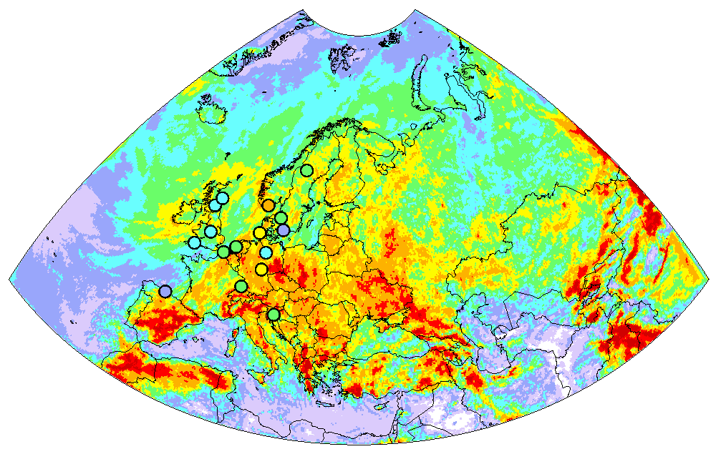
Transition to the new EMEP grid
Pilot simulations of HM pollution over the new EMEP grid
Model evaluation vs. measurements
at site DE02 (Waldhof, Germany)
Hg wet deposition (0.2°×0.2°)
Hg⁰
Day of year
Hg(II)_{part}
Day of year
Observations
Model

Slide 6
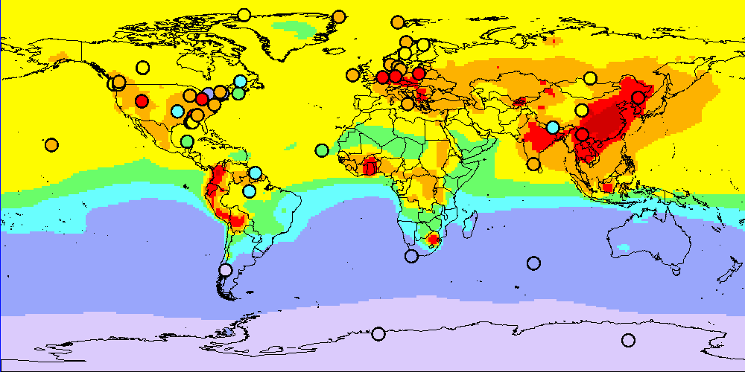
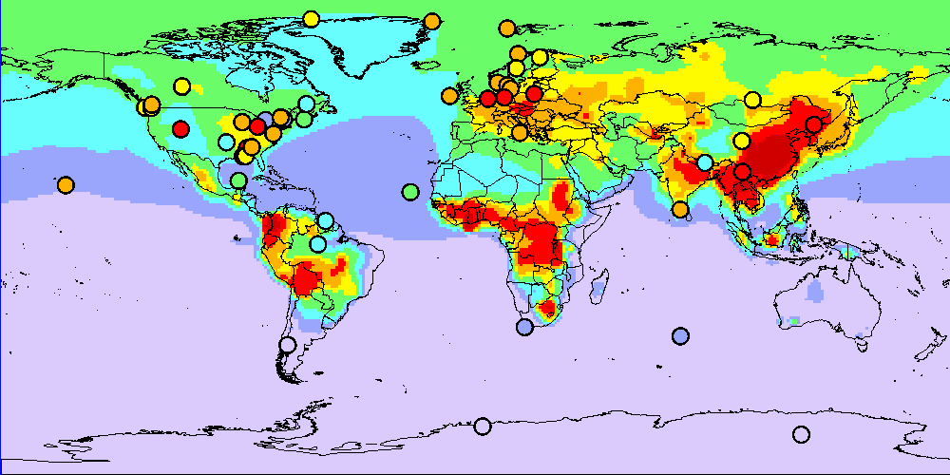
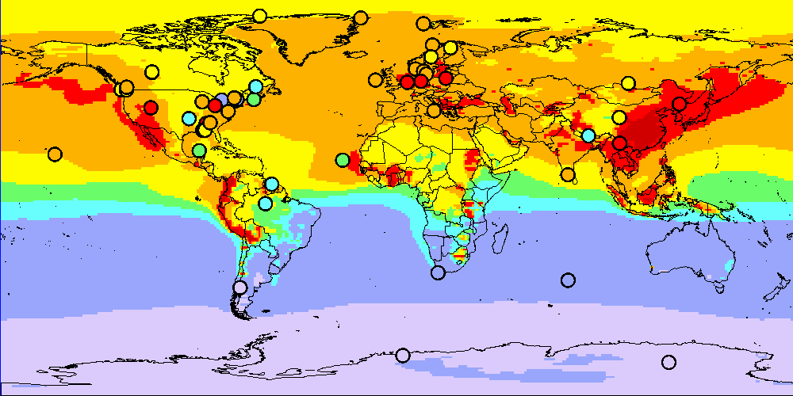
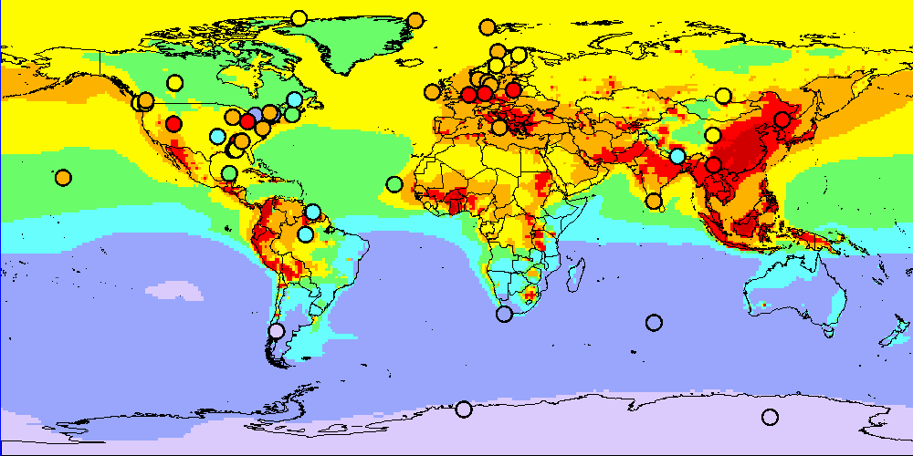






Multi-model assessment of mercury pollution and processes
Participating models:
Model | National experts
GLEMOS | EMEP/MSC-E
ECHMERIT | CNR-IIA (Italy)
CMAQ-Hg | HZG (Germany)
WRF-Chem | CNR-IIA (Italy)
GEOS-Chem | MIT (USA)
GEM-MACH-Hg | Environment Canada
p-TOMCAT | Cambridge (UK)
GEOS-Chem
ECHMERIT
GEM-MACH-Hg
GLEMOS
TF HTAP Workshop, Potsdam, Germany, February 2016
Environment Canada
Notes:
6

Slide 7
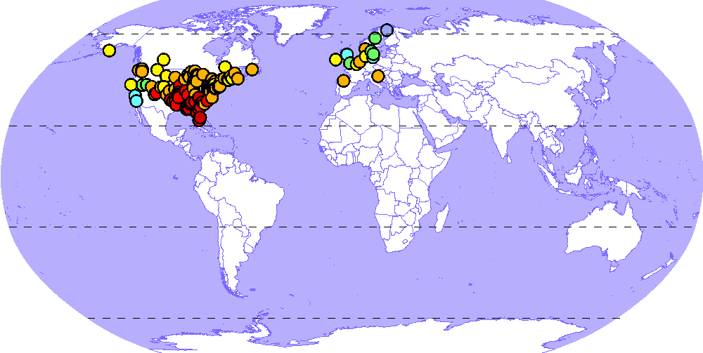
Multi-model assessment of mercury pollution and processes
Study of atmospheric chemistry
Sites measuring Hg wet deposition
/day
50
14 sites
2
40
30
Wet deposition, ng/m
20
10
0
Jan
Feb
Mar
Apr
May
Jun
Jul
Aug
Sep
Oct
Nov
Dec
/day
80
99 sites
2
60
1000
40
Br concentration
Wet deposition, ng/m
20
100
0
Br concentration, ppq
Br dataset I
Jan
Feb
Mar
Apr
May
Jun
Jul
Aug
Sep
Oct
Nov
Dec
10
Br dataset II
GEM-MACH-Hg
ECHMERIT
1
GLEMOS
GEOS-Chem
-90
-60
-30
0
30
60
90
Measurements
Latitude
Seasonal variation of Hg wet deposition

Slide 8
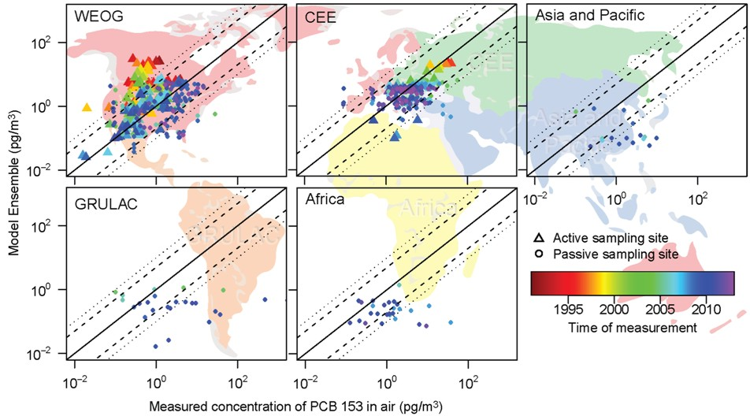
Multi-model assessment of POP pollution and processes
Study of global transport, phase partitioning, and media exchange
GLEMOS (MSC-E) and BETR (Sweden) models vs. measurements of UNEP SC GMP DWH
Contribution to the UNEP SC Second Global GMP report, 2016

Slide 9
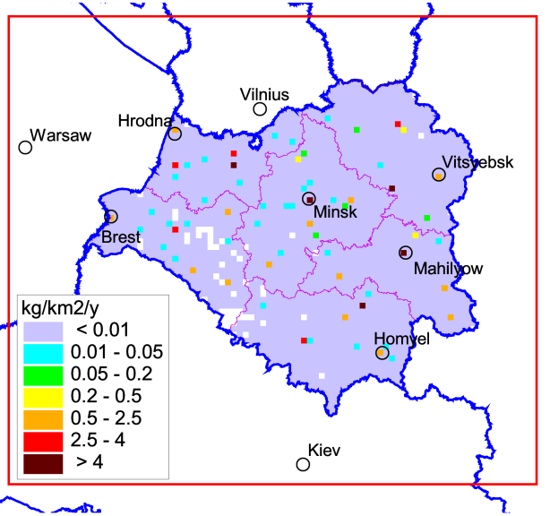
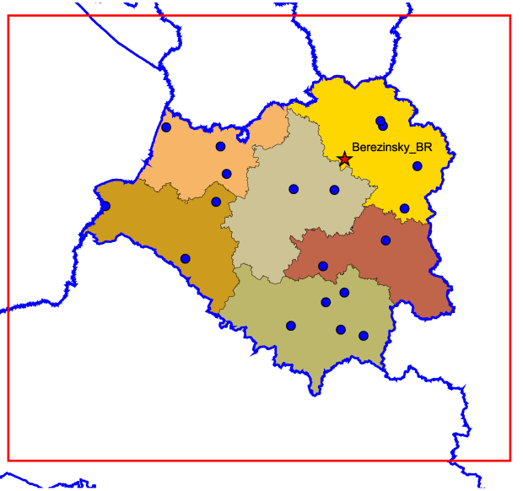
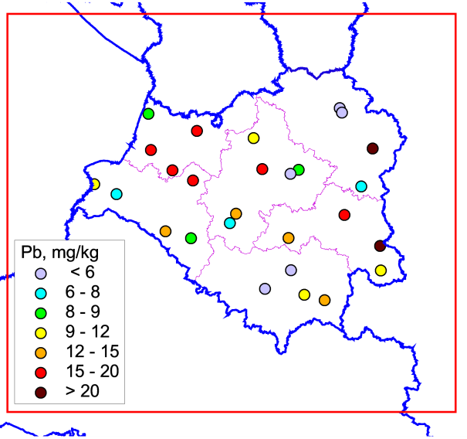
Cooperation with national experts
EECCA countries - Belarus
Main goal: Evaluate and analyse Pb pollution levels in Belarus with fine (10 x 10 km²) spatial and temporal resolution
Data provided by national experts (2012)
Pb emission, 2012
Monitoring data
Pb in soil

Slide 10
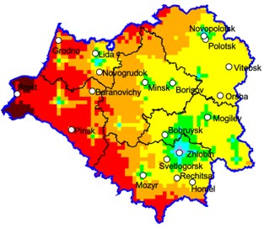
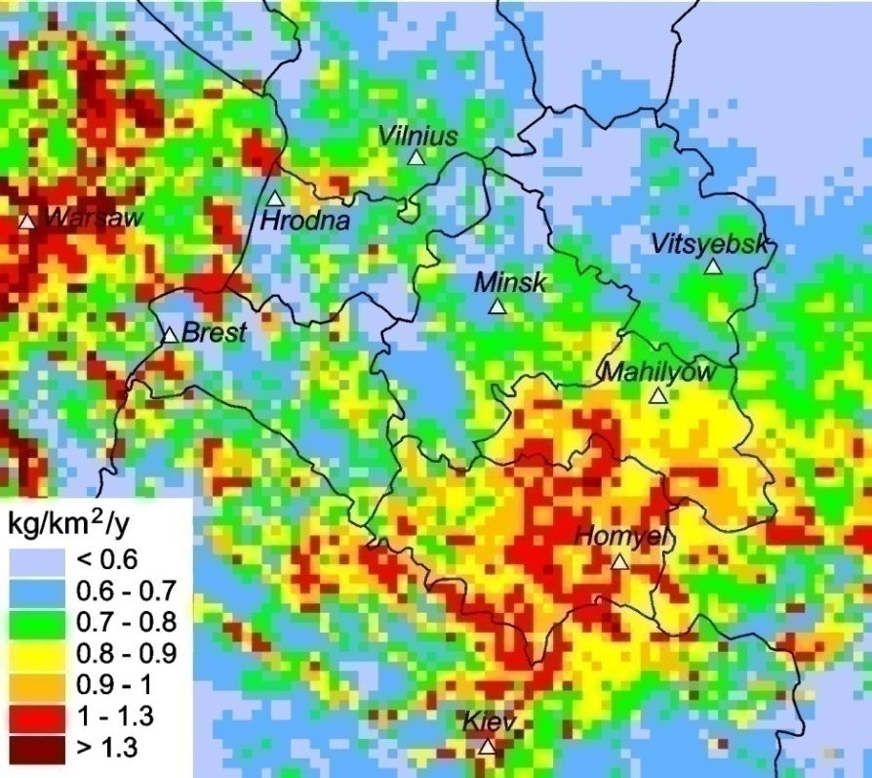

Cooperation with national experts
EECCA countries – Belarus
Model assessment of Pb levels with fine (10x10 km²) spatial resolution
Belarus
Remaining
6%
22%
Italy
3%
Slovakia
3%
Germany
Poland
3%
52%
Ukraine
11%
Total Pb deposition
Contribution of foreign sources
to Pb anthropogenic deposition

Slide 11
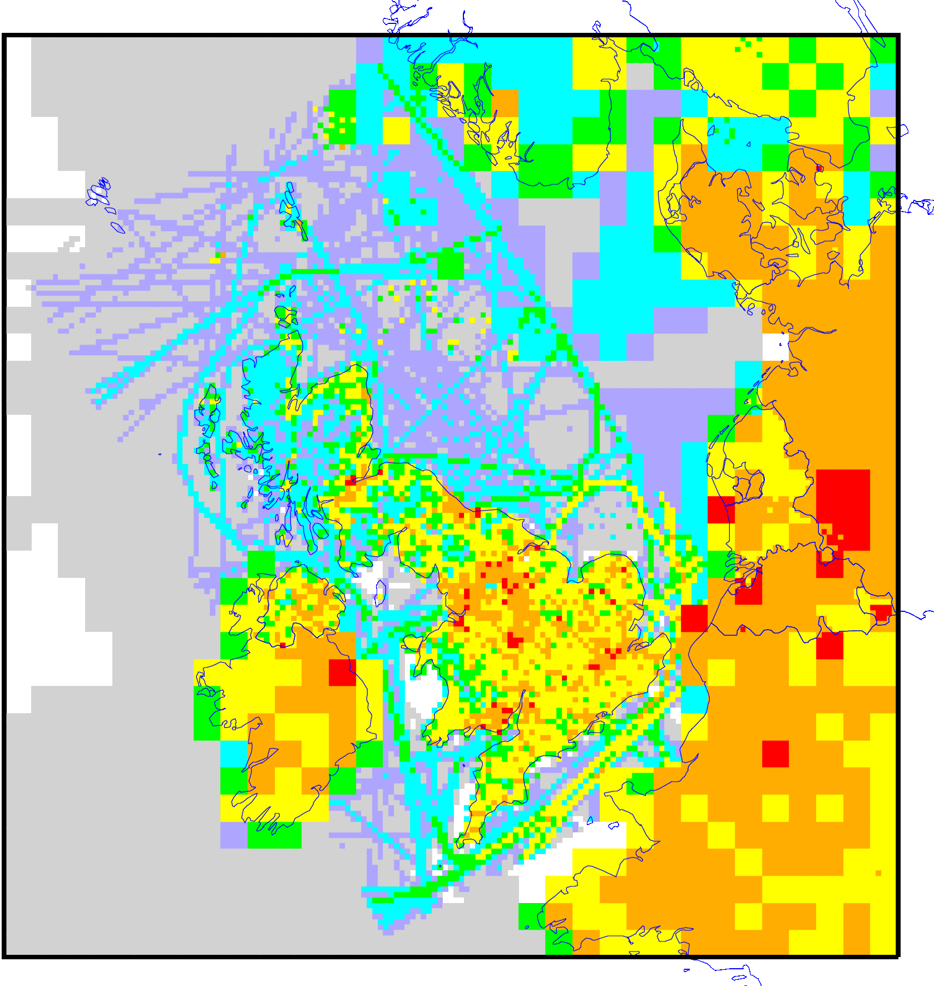
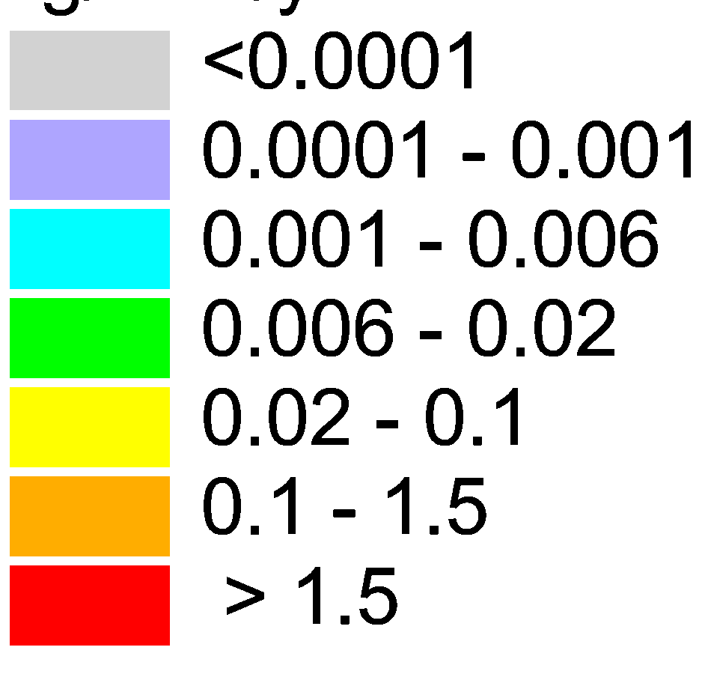
Cooperation with national experts
The United Kingdom (Centre for Ecology and Hydrology )
Main purposes:
Simulate Pb pollution levels with fine spatial resolution (10x10 km)
Compare modeling results of MSC-E and FRAME model
National data:
(1x1 km)
Emissions (1x1 km)
Monitoring data
Concentrations in soil
kg/km²/y
Comparison of MSC-E and FRAME model results with observations
Pb emissions

Slide 12
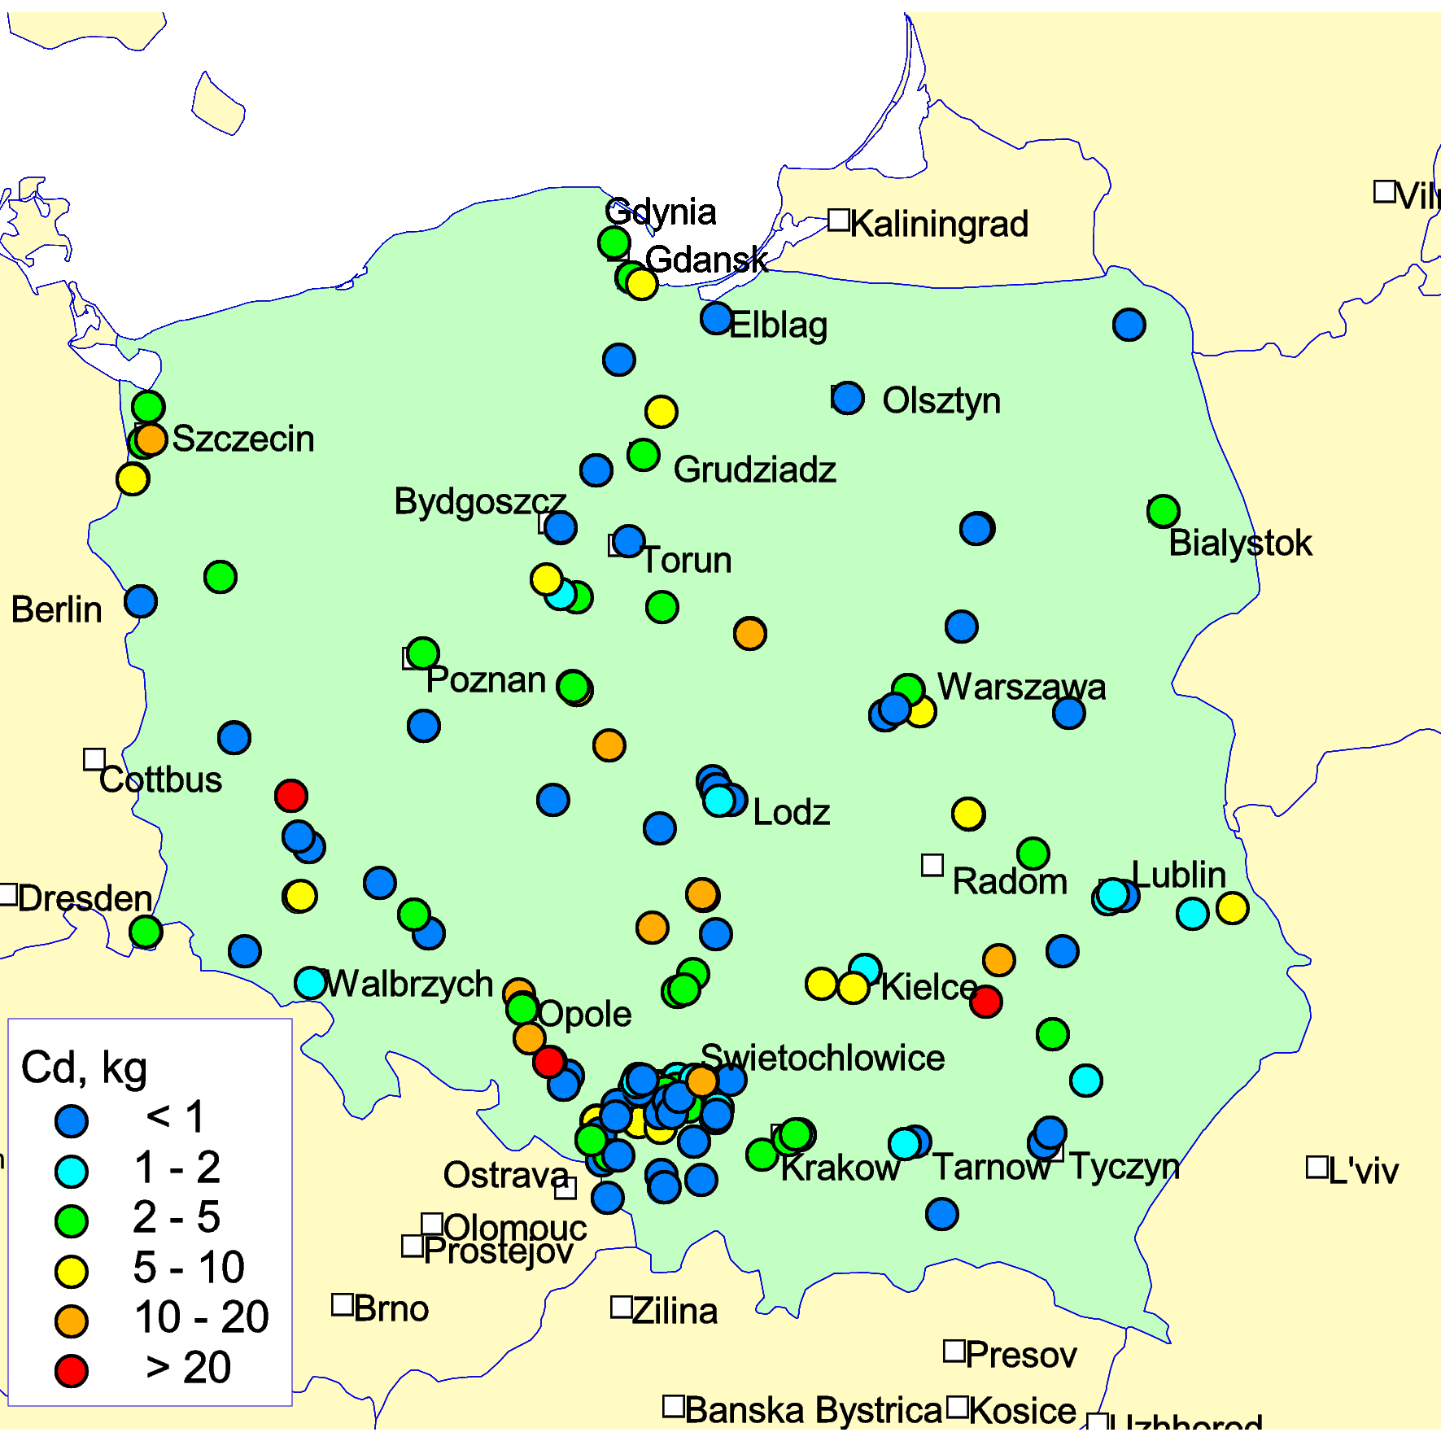
Cooperation with national experts
Poland
Purpose: Evaluate Cd pollution levels in Poland with fine spatial resolution
Available data:
Point-source emissions of Cd
- Power stations
- Production of coke
- Copper smelting
- Production of cement
Monitoring data
- EMEP data
- AirBase
Modelling under preparation
Emissions of Cd from point sources in 2012, kg/y

Slide 13

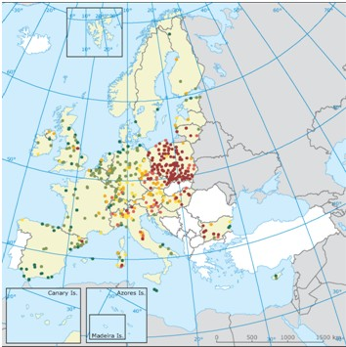
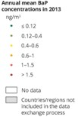
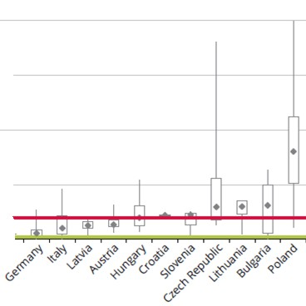
Pollution of cities
SOER 2015 - The European environment - state and outlook 2015 (EEA)
EU-28 (2013)
25% of urban population was exposed to B[a]P concentrations above EU target value (1 ng/m³)
91 % was exposed to B[a]P concentrations above the WHO reference level (0.12 ng/m³)
EEA/AirBase
The Czech Republic
EEA/AirBase
Observed B[a]P annual air concentrations , 2013
Attainment situation in 2013 in the EU-28

Slide 14
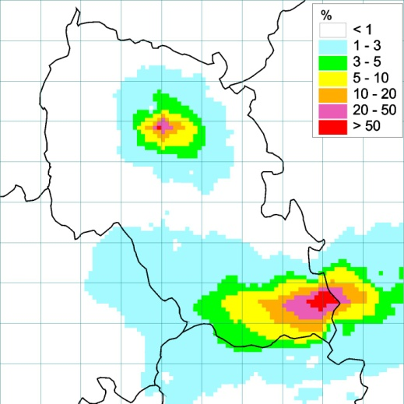
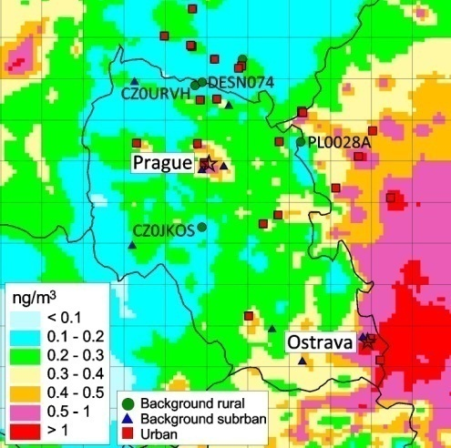
Pollution of cities by B[a]P
Modeling results with fine resolution (5x5 km²): Czech Republic
Prague
Ostrava
B[a]P air concentrations and locations
of monitoring sites
Relative contribution of sources of Prague and Ostrava to the total B[a]P air concentrations

Slide 15
Pollution of cities by B[a]P
Contribution of various source categories to total emission
Ostrava
Prague
IND – Industry
RES – Residential heating
ROT – Road transport

Slide 16
Pollution of cities by B[a]P
Contributions of various source categories to B[a]P air concentrations
in comparison with measurements (urban sites)
10
Ostrava
Prague
4
9
3.5
8
3
7
6
2.5
5
ng/m³
2
ng/m³
4
1.5
3
1
2
1
0.5
0
0
Jan
Feb
Mar
Apr
May
Jun
Jul
Aug
Sep
Oct
Nov
Dec
Jan
Feb
Mar
Apr
May
Jun
Jul
Aug
Sep
Oct
Nov
Dec
IND – Industry
RES – Residential heating
ROT – Road transport
Measurements
Mean annual concentrations

Slide 17
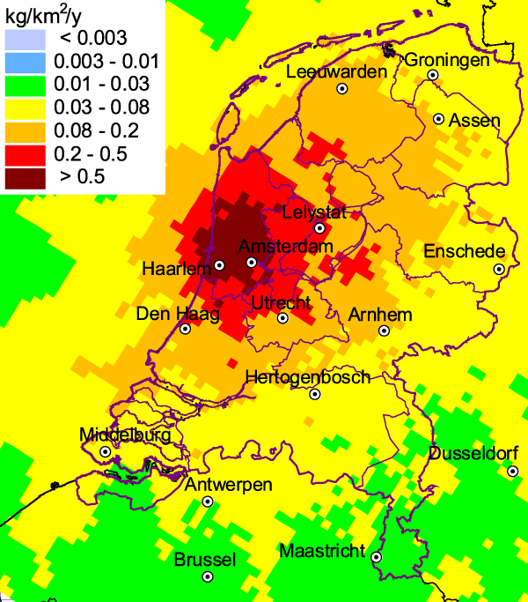
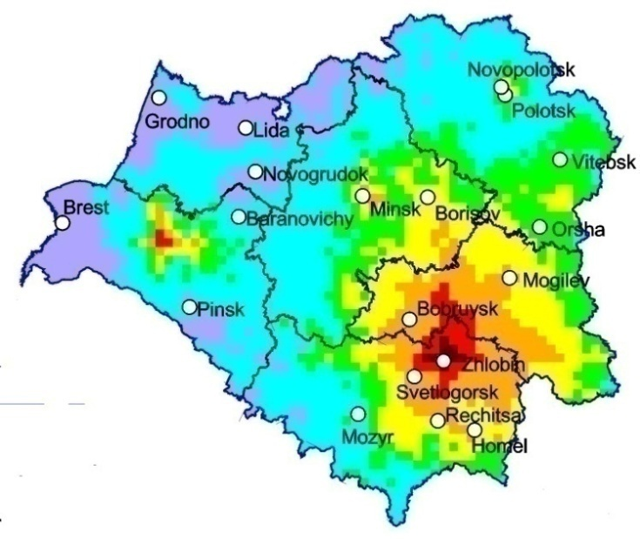
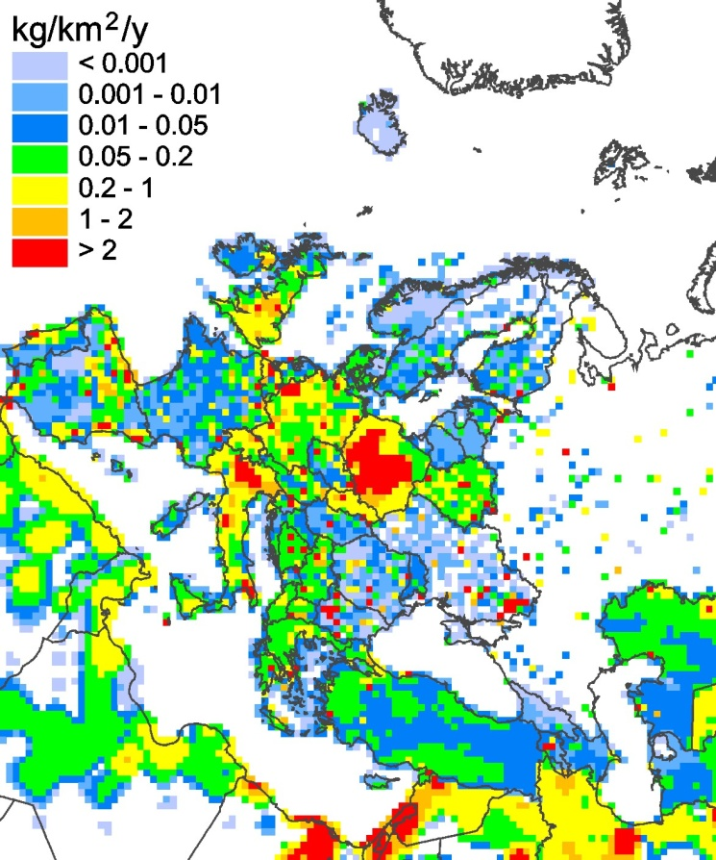
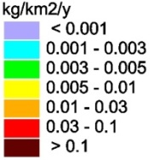
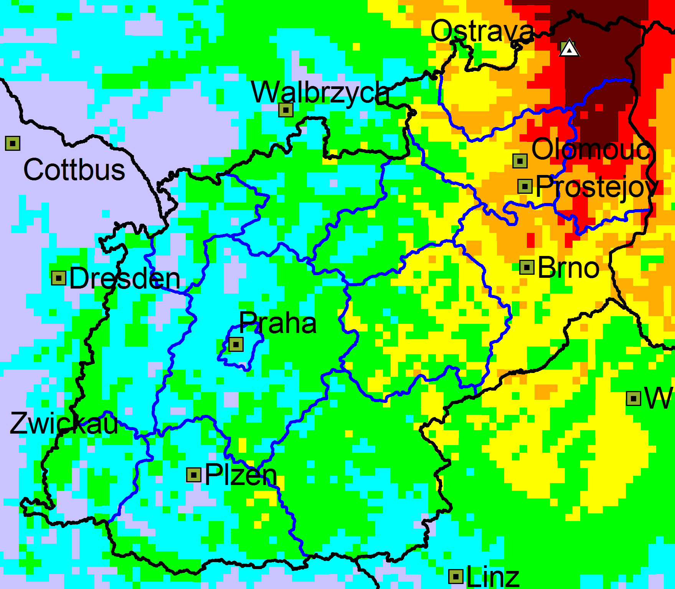
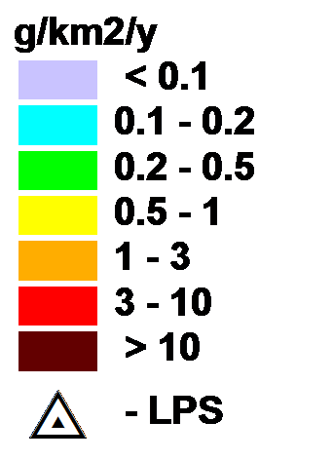
Pollution from Large Point Sources (LPS)
Pb, the Netherlands
Pb emissions from industry, 2013
Pb, Belarus
Cd, the Czech Republic

Slide 18
Cooperation with international bodies
Cooperation between CLRTAP and relevant international bodies
Implementation of CLRTAP provides a mechanism by which parties
can meet their obligations to other international agreements

Slide 19

Cooperation with international bodies (HELCOM)
Pb, Cd, Hg, PCB-153 deposition to the Baltic Sea for 1990-2013
Modelled and observed Cd deposition (2013)
HM deposition to Baltic Sea (1990-2013)
HELCOM expressed its interest for evaluation of Baltic Sea pollution by new substances (PBDE, HBCDD, PFOS) (PRESSURE group meeting, 2015)

Slide 20
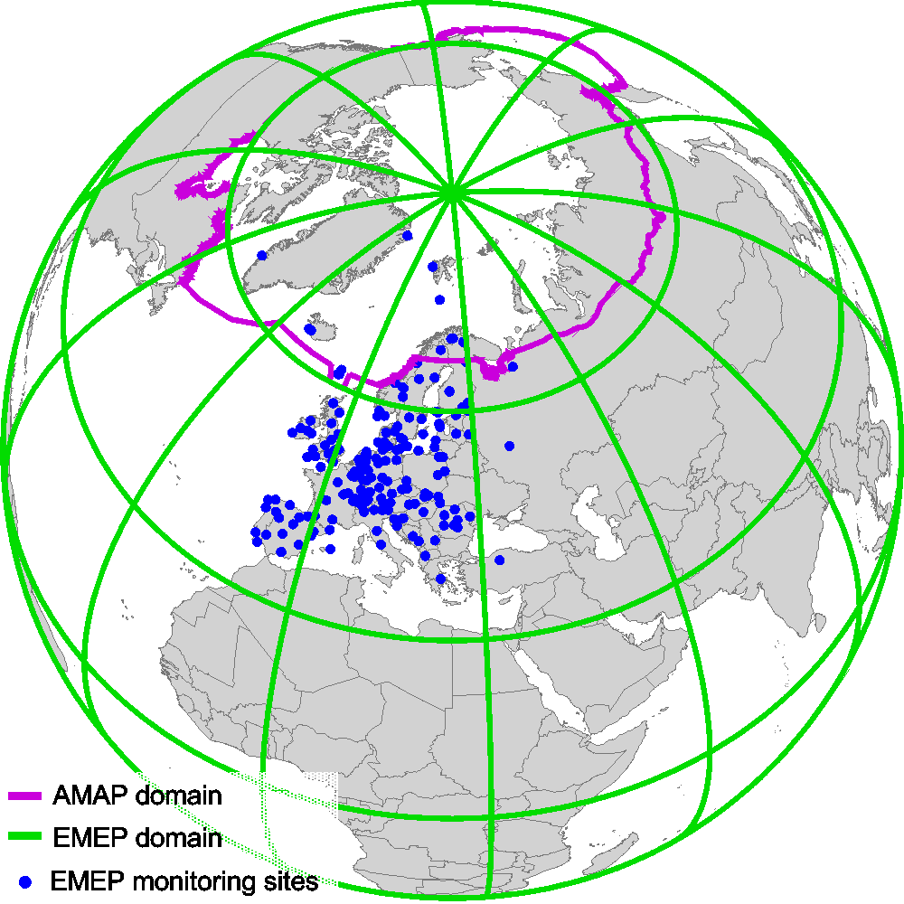
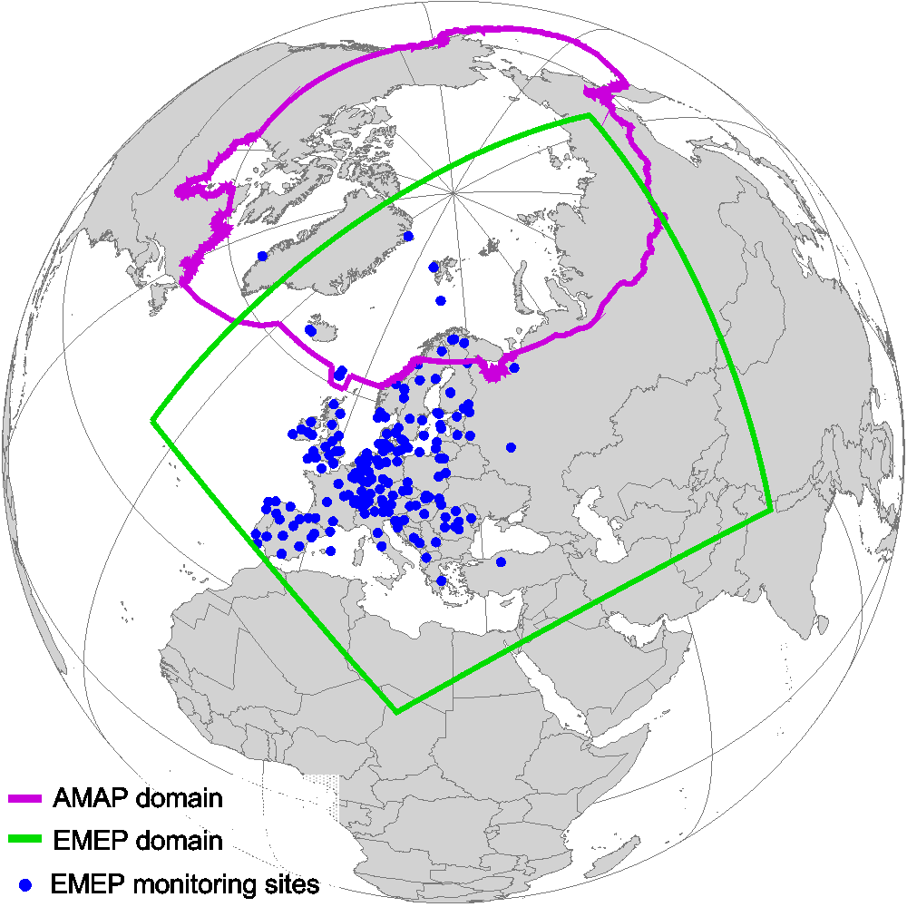
Cooperation with international bodies (AMAP)
MSC-E activities relevant to the Arctic
Joint AMAP/CLRTAP workshop, Potsdam, Germany, February 2016
Regular pollution assessment over the EMEP domain:
Substances – Pb, Cd, Hg, PAHs, HCB, PCBs, PCDD/Fs
Concentration and deposition maps
Source-receptor relationships
Long-term trends (1990-2013)
AMAP and EMEP domains
AMAP
EMEP
Pollution assessment on a global scale:
Substances – Hg, HCB, PCBs, PCDD/Fs
Includes the whole AMAP region
Intercontinental transport

Slide 21

Project Concept for the Global Mercury Assessment 2018
Updating information on modelling of atmospheric transport of mercury from source to receptor regions
Work on this component will be conducted by a core team of modelling experts (Modelling Team^{[1]}) involving international experts and organizations.
^{[1]} Modelling Team; Provisional lead: Meteorological Synthesizing Centre-East (MSC-E)
The First meeting of the Project Coordination Group for the Global Mercury Assessment 2018 will held 13-16 April 2016

Slide 22
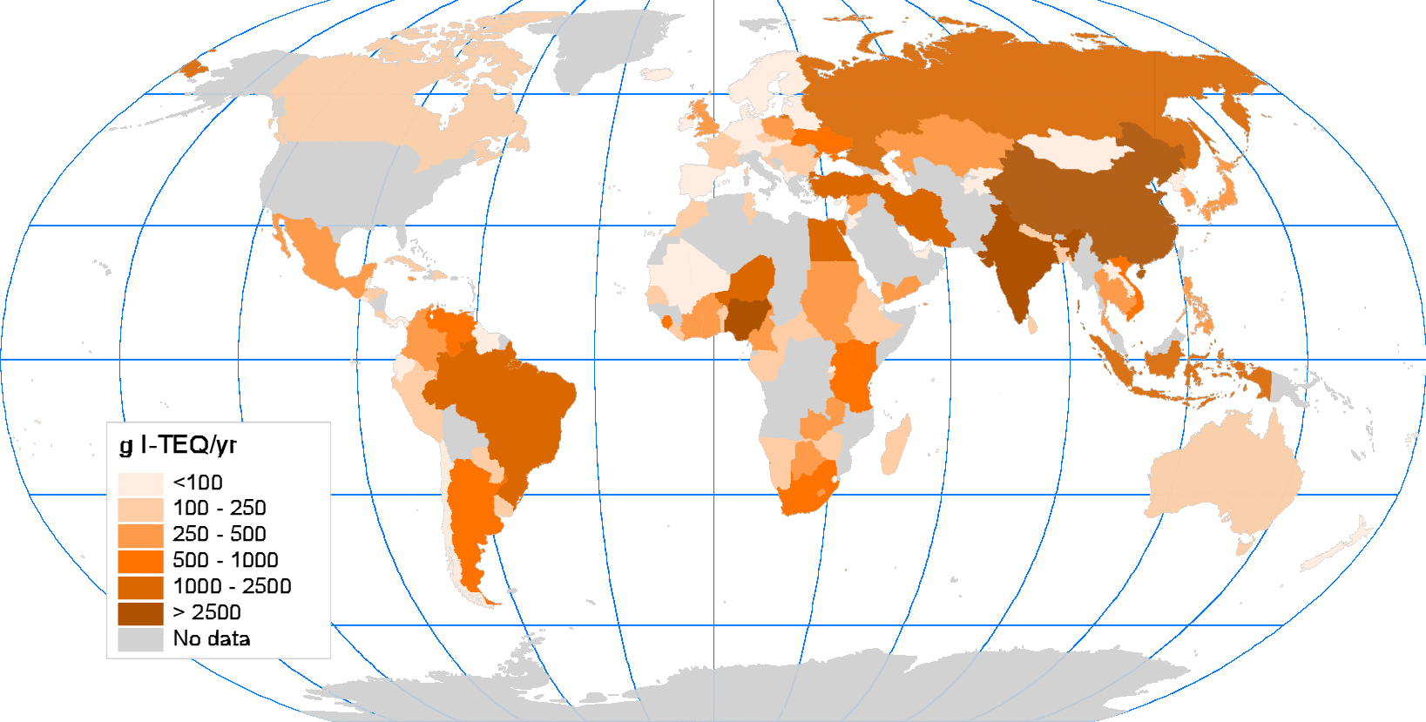
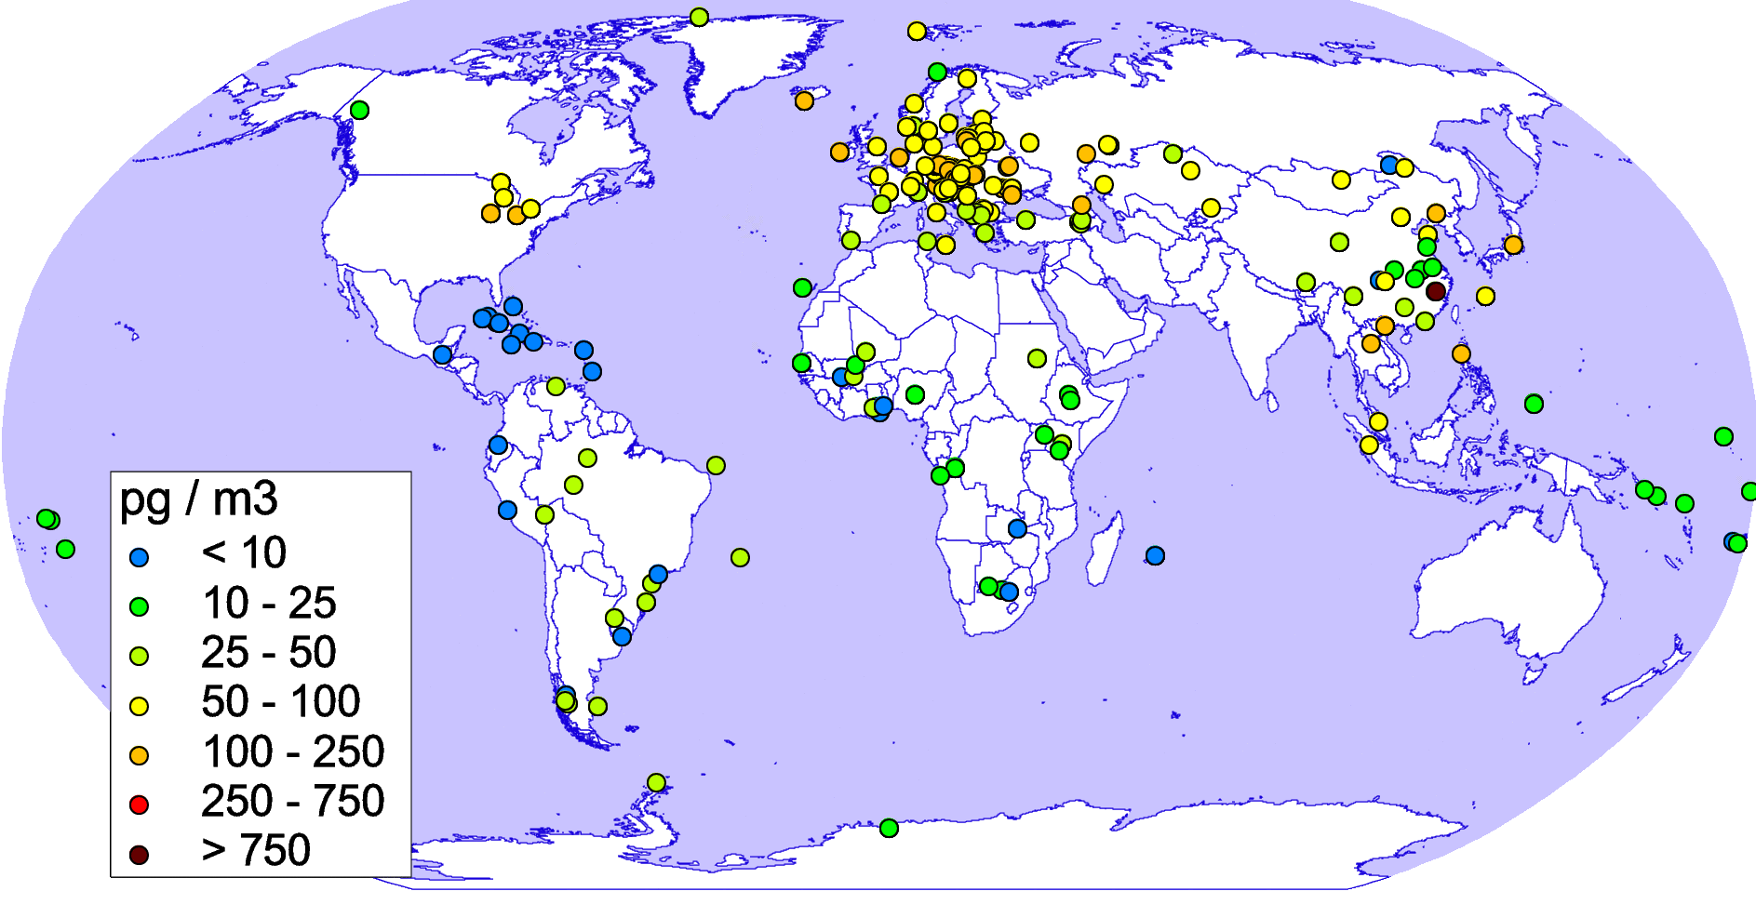
Cooperation with international bodies
(Stockholm Convention)
Global data on emissions and measured pollution levels
PCDD/F emissions of more than 140 countries (based on UNEP Toolkit)
Emission data include PCDD/F releases to air, land, and water
Measurements of POP air concentrations over the globe (SC GMP Data Warehouse) EMEP/MSC-E contribution to the UNEP SC Second Global GMP report, 2016
Annual PCDD/F emissions to air (g I-TEQ/yr)
Measured HCB air concentrations (pg/m³)

Slide 23
Emission data required for model assessment of pollution
Source: MSC-E contribution to the joint CEIP/MSC-E technical report
Information on HM (Pb, Cd, Hg) and POP (PAHs, HCB, PCBs, PCDD/Fs) emissions | Official emission data (CEIP) | Emission data required for modeling (MSC-E)
Time-series of national total emissions (annually) | X
Gridded sectoral emissions (once in five years) | X
Emissions of Large Point Sources (once in five years) | X
Gridded total emissions for the latest reported year generated by CEIP (except PCBs) (annually) | X
Time-series of gridded annual emissions 1990-2012 |  | X
Vertical distribution of emissions |  | X
Speciation of Hg forms (Hg˚, Hg(II)_{gas}, Hg(II)_{part}) |  | X
Congener composition for POPs (PCDD/Fs – 17 congeners, PCBs) |  | X
Temporal variation of emissions |  | X
Historical emissions of PCBs, HCB, PCDD/Fs up to 1990 |  | X
Emissions to other environmental compartments (PCDD/Fs, HCB) |  | X
Emissions for non-EMEP countries within the EMEP domain (North Africa and Middle East) |  | X
Natural emissions |  | X
Re-suspension, re-emissions |  | X
Global emission inventories (PCDD/Fs, HCB, PCBs, Hg) |  | X

Slide 24
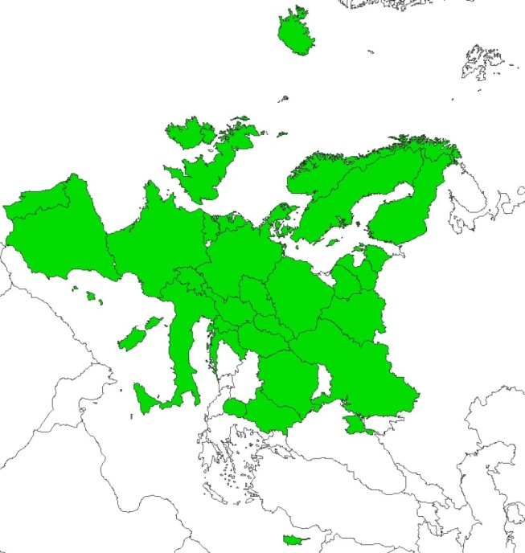
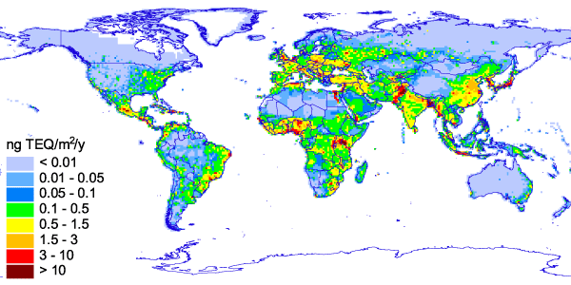
Emission characteristics affecting assessment of pollution
Temporal variations of B[a]P emissions at a particular location in Central Europe
Gridded emission data
areas covered
areas not covered
Spatial distribution of global annual PCDD/F emissions to the atmosphere

Slide 25
Priorities for emission data preparation for modeling
Emission parameter | Pb and Cd | Hg | PAHs | PCDD/Fs and PCBs | HCB
Quality of gridded anthropogenic emissions | 1 | 2 | 1 | 1 | 2
Chemical composition | - | 1 | - | 2 | -
Temporal variation | 2 | 6 | 2 | 6 | 5
Vertical distribution | 3 | 7 | 3 | 7 | 6
Global emissions inventory | 4 | 3 | 4 | 3 | 3
Historical emissions | 5 | 4 | 5 | 4 | 1
Emissions to other media | 6 | 5 | 6 | 5 | 4
- First priority - Second priority - Third priority
Key emission parameters affecting quality of model estimates

Slide 26
Main goals in 2016/2017
Local/regional/global transboundary transport
Transition to the new EMEP grid including model parameterization.
Cooperation with Belarus, UK, Poland (Case studies)
Pollution of cities (Prague, Ostrava …)
Exchange of information with AMAP, UNEP (Hg), SC, HELCOM
Contribution to the development of emission strategy (CEIP/MSC-E report)

