Slide 1

Heavy metal and POP pollution assessment: Progress and plans
Oleg Travnikov on behalf of MSC-E

Slide 2
Outline
EMEP operational modelling – need for new forms of output information
  Atmospheric loads to water ecosystems
  Human exposure to high B(a)P pollution levels
  Toxicity of atmospheric aerosol
In-depth analysis and evaluation of model assessment
  Complex model-measurement analysis
  Country-scale case studies (Germany, France)
Research and model developments (GLEMOS)
  Hg atmospheric chemistry
  Multi-media modelling of POPs and Hg
  Proposals for workplan 2020-2021

Slide 3
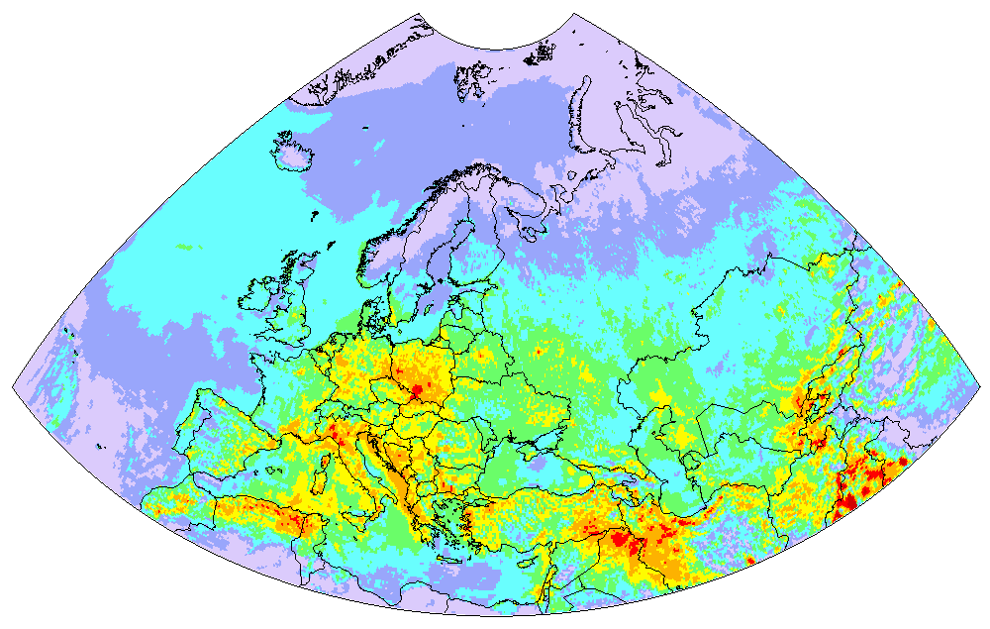
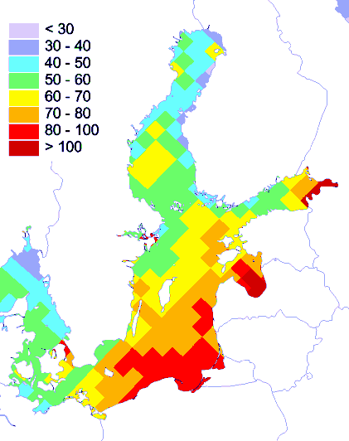
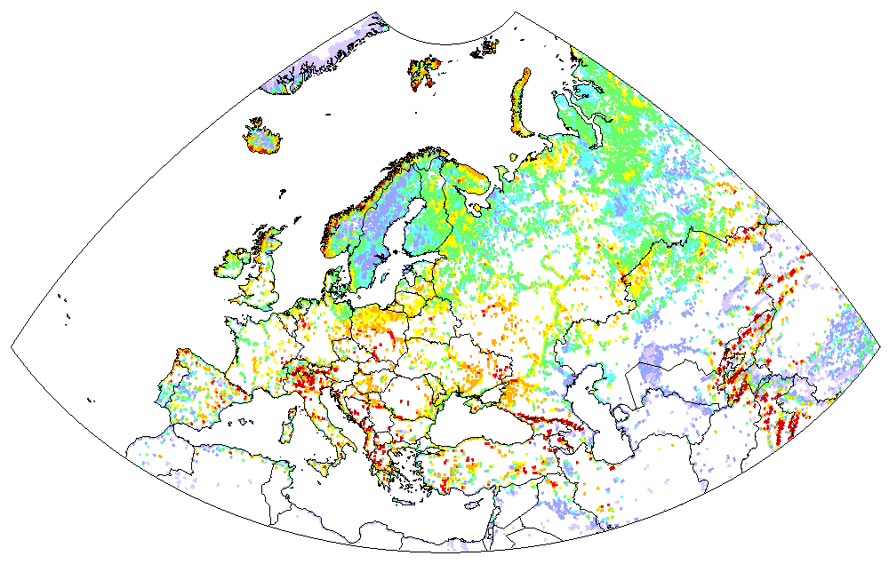
Operational modelling and co-operation with WGE
New output from operational modelling
Pb deposition (2017)
Standard EMEP output (new grid):
Concentration/deposition maps
Cd deposition to Austria
Austria
PCDD/Fs deposition to the Baltic sea
Country-to-country transboundary transport
Others
Slovenia
Slovakia
ng TEQ/m²/y
Italy
Deposition to marginal seas and special regions (e.g. Arctic)
Hg deposition to inland waters
Germany
Poland
Deposition to various LC types
What additional output information is needed for the effect community to support exposure assessment?

Slide 4
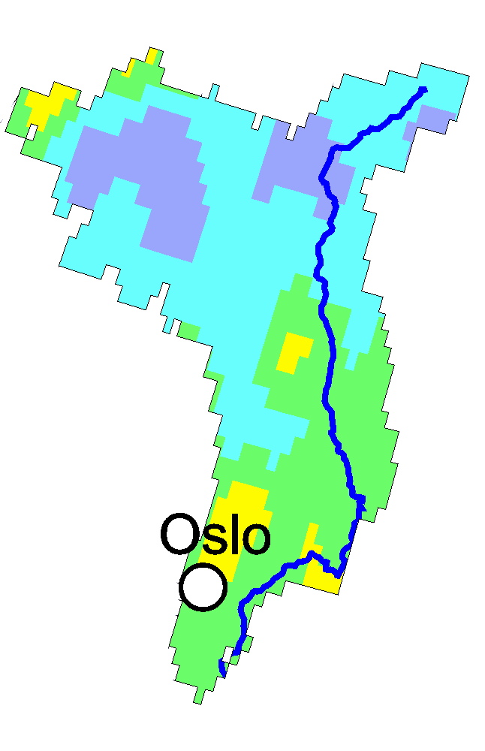
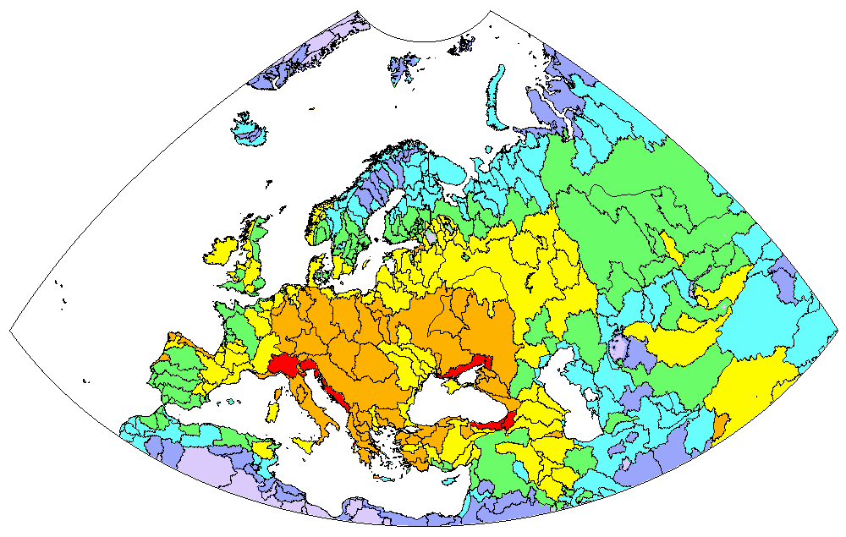
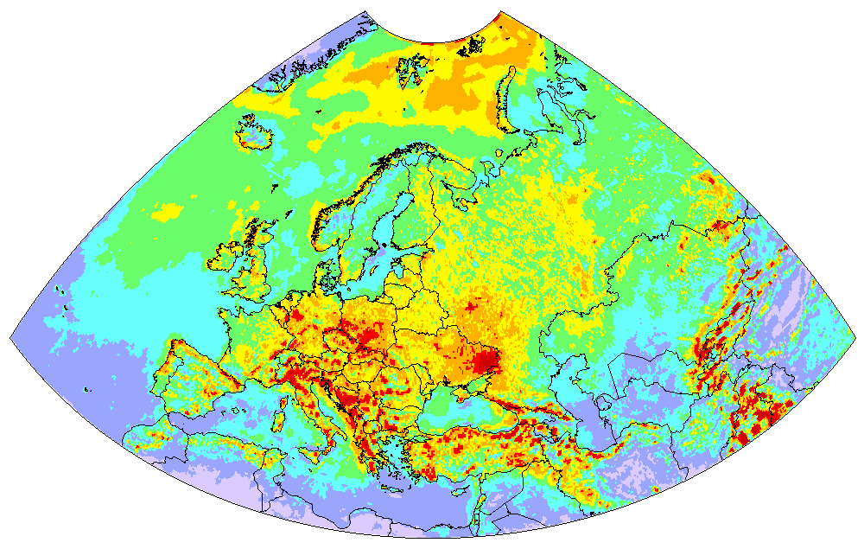
Operational modelling and co-operation with WGE
Atmospheric loads to water ecosystems
Model estimates of HM and POP deposition to watersheds
Glåma watershed
Hg deposition to river watersheds
Hg deposition in 2016
Po
Odra
Vistula
Hg deposition to LC categories of Glåma watershed
Aliakmon
Adige
Ugra
Nestos
Other
8%
Tiber
Mixed forest
4%
Danube
Don
Drini
Wooden grassland
8%
Coniferous forests
46%
Labe
Meuse
Simav
Grassland
8%
Rhine
Bug
Elbe
Jeja
Mures
Shrubs
26%
Dnepr
…
10
14
18
22
2
Mean Hg deposition, g/km /y

Slide 5
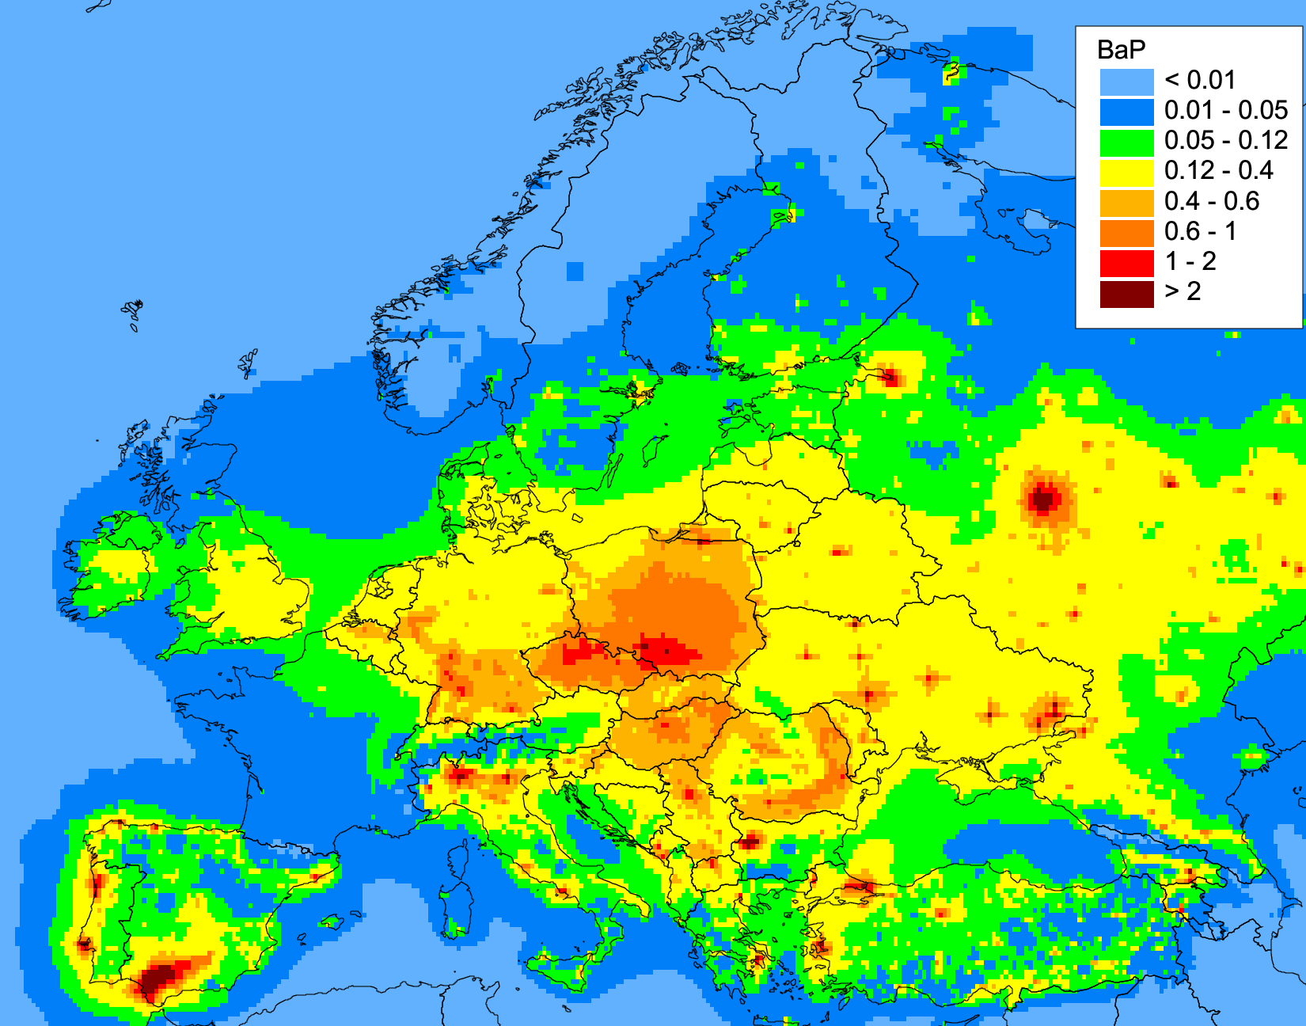
Operational modelling and co-operation with WGE
Human exposure to high B(a)P levels
Model assessment of target value exceedances of B(a)P air concentration
B(a)P air concentration (2017)
Population in areas with exceeded EU target value (1 ng/m³) for B(a)P
Exceedances of B(a)P limits in EMEP countries:
EU target value (1 ng/m³) | 17% of urban (10% of total) population
WHO reference level (0.12 ng/m³) | 46% of urban (75% of total) population
Exposure analysis requires co-operation with TF Health/WHO PAH group

Slide 6
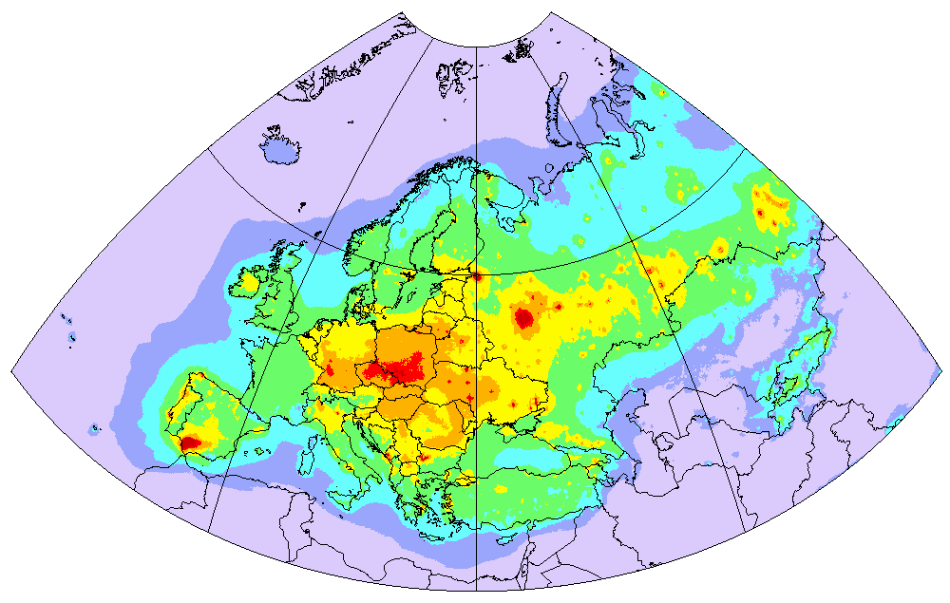
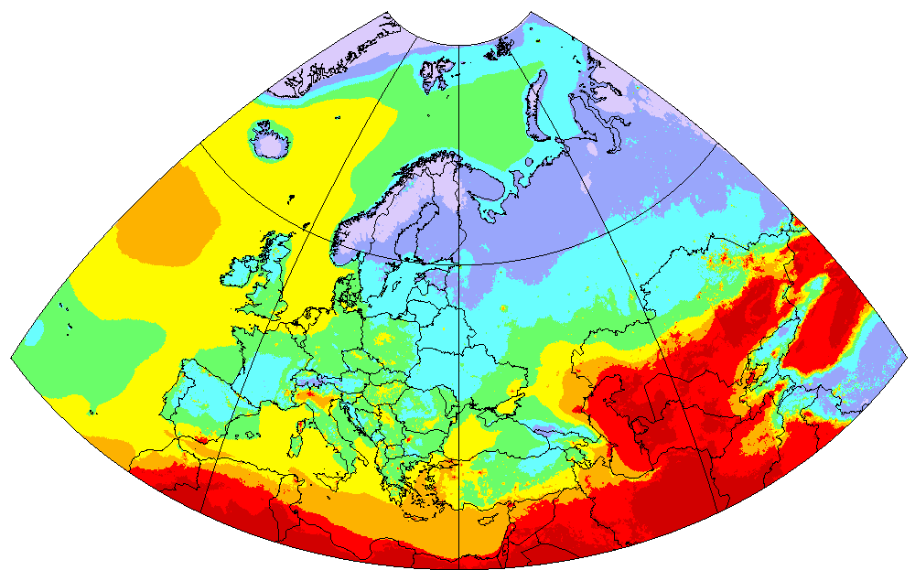
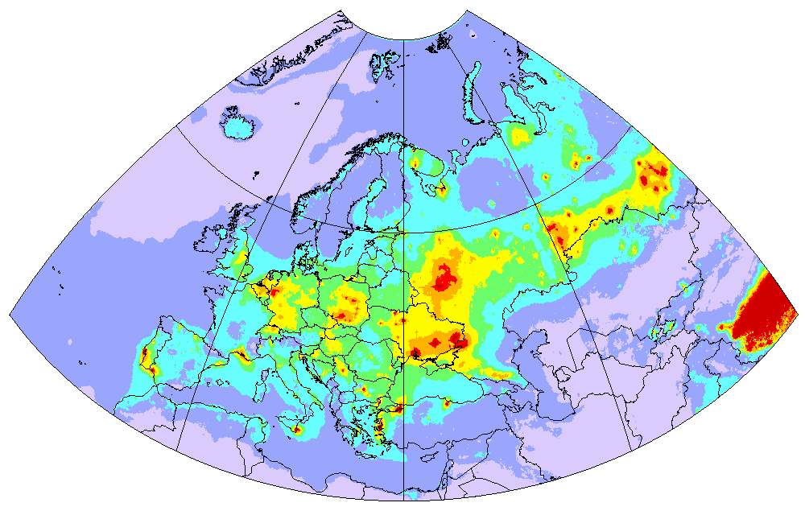
Operational modelling and co-operation with WGE
Toxicity of atmospheric aerosol
Estimates of PM2.5 enrichment with heavy metals and POPs
PM enrichment with BaP (mg/kg)
PM2.5 concentration in 2016 (MSC-W)
PM enrichment with Cd (mg/kg)
Aerosol enrichment with toxic pollutants may imply additional risks for human health and requires attention of the effect community

Slide 7
HMs and POPs in EU REACH Regulation
Classification of heavy metals and POPs as toxic substances in EU REACH *
Substance | Toxicity for humans | Toxicity for aquatic organisms
 |  | Effects | Threshold levels in freshwater **
Cd | Carcinogenic, mutagenic, reprotoxic | Acute and chronic | 0.19 µg/L
Pb | Reprotoxic |  | 2.4 µg/L
Mercury | Reprotoxic |  | 0.057 µg/L
B[a]P | Carcinogenic, mutagenic, reprotoxic |  | 0.89 µg/L
PCBs | Carcinogenic, mutagenic |  | n/a
HCB | Carcinogenic, mutagenic and reprotoxic |  | n/a
* EU regulation “Registration, Evaluation, Authorisation and Restriction of Chemicals” (REACH)
** The REGULATION (EC) No 1272/2008 on Classification, Labelling and Packaging of Substances and Mixtures, commonly known as CLP Regulation, entered into force on 20 January 2009

Slide 8
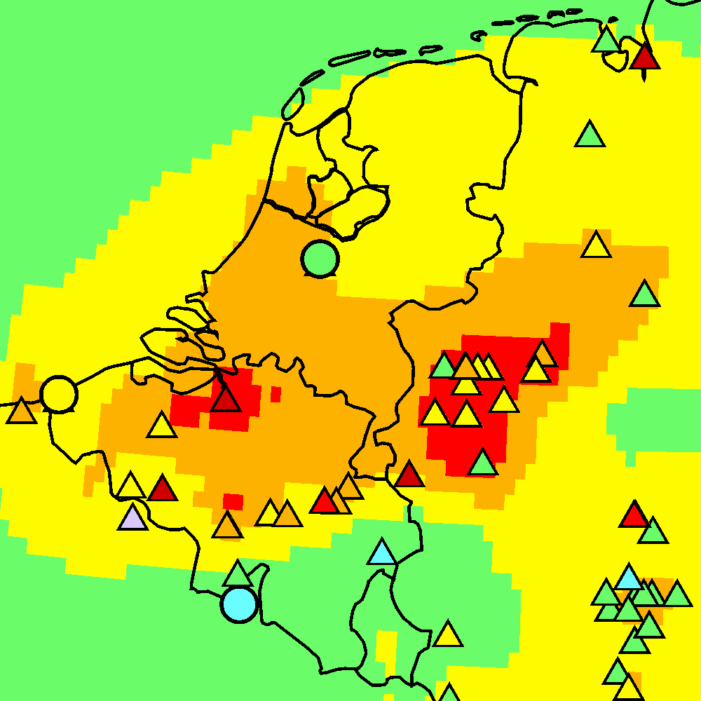
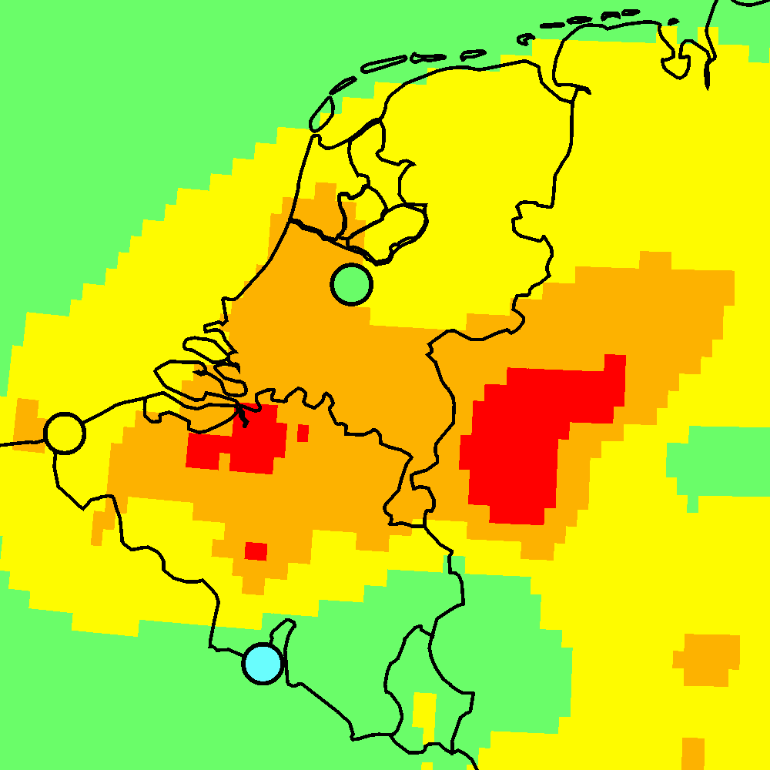
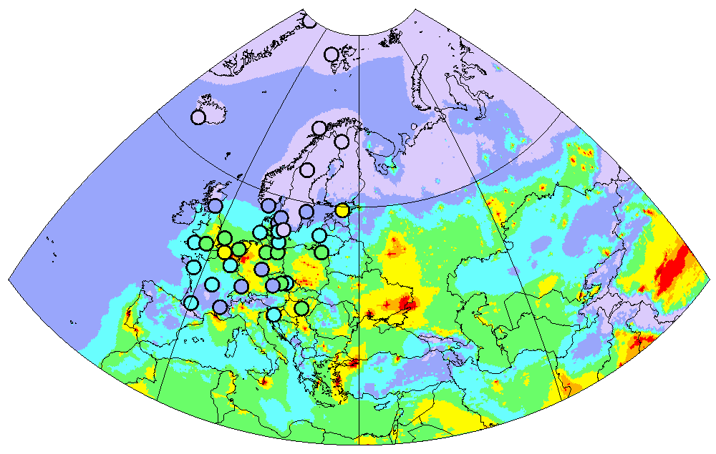
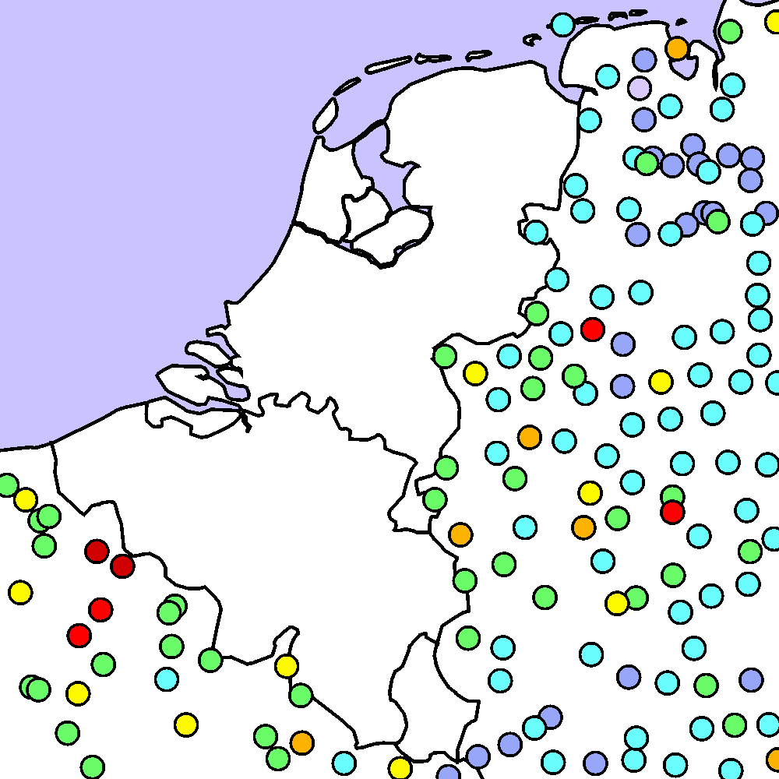
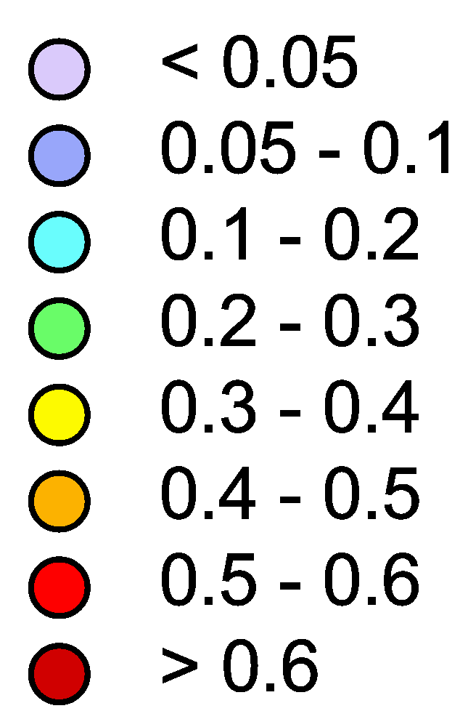
Operational modelling
In-depth analysis of modeling results
Use of modelling and measurements for evaluation of pollution patterns
Cd concentration (Benelux)
Cd air concentration (2016)
NL8
AirBase
BE14
FR9
Cd concentration in moss (2015)
mg/kg
The complex analysis is to be continued using variety of measurement and modelling data
Notes:
Model assessment of pollution levels in some cases required in-depth analysis involving variety of measurement data. As an example, I’ll show simulated Cd concentrations in the Benelux region. It is commonly characterized by high pollution levels, which is in agreement with emissions distribution. As you can see the EMEP measurements do not cover this area to evaluate these estimates. But involving external monitoring data (AirBase) we can see that in some cases the observations do not confirm the high levels. We also do not see these hot spots at Cd measurements in moss. So this discrepancy needs further analysis that will be continued.

Slide 9
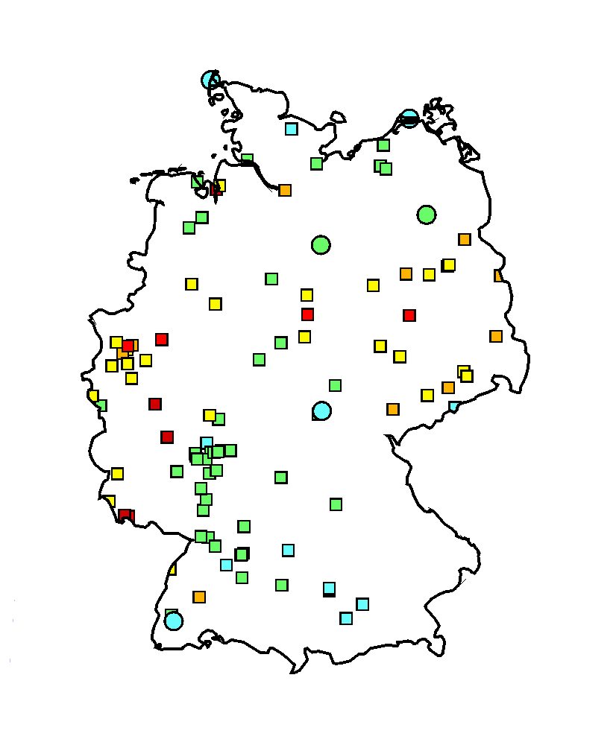
Country-scale assessment (Germany)
Co-operation with national experts
Case study on heavy metal pollution in Germany
Research program (2019-2020):
Collection of national input information (emissions, monitoring, etc.)
Detailed assessment of Hg, Pb and Cd pollution in Germany in 2014-2016
Evaluation of modelling results vs. national and EMEP measurements
Analysis of model-to-measurement deviations, recommendations for improvement
Pb measurements in Germany (2016)
The project is partly funded by the country (UBA, Germany)

Slide 10
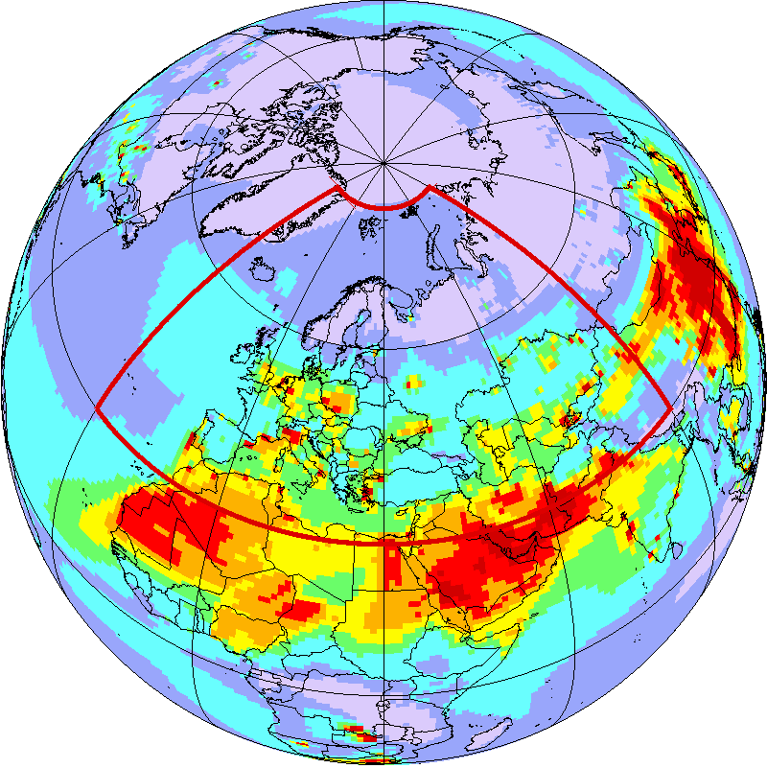
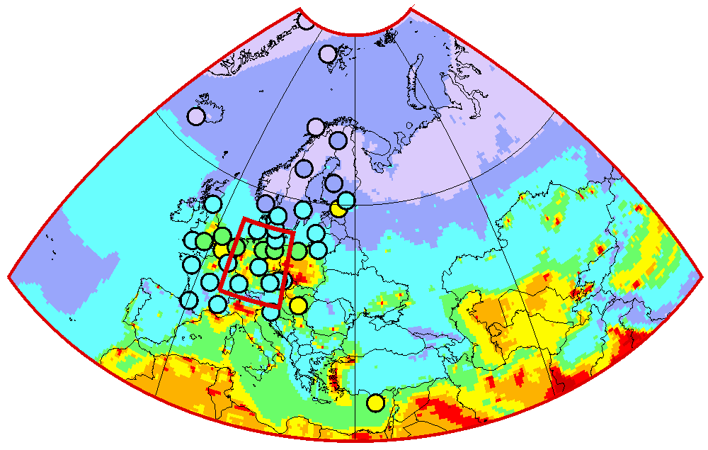
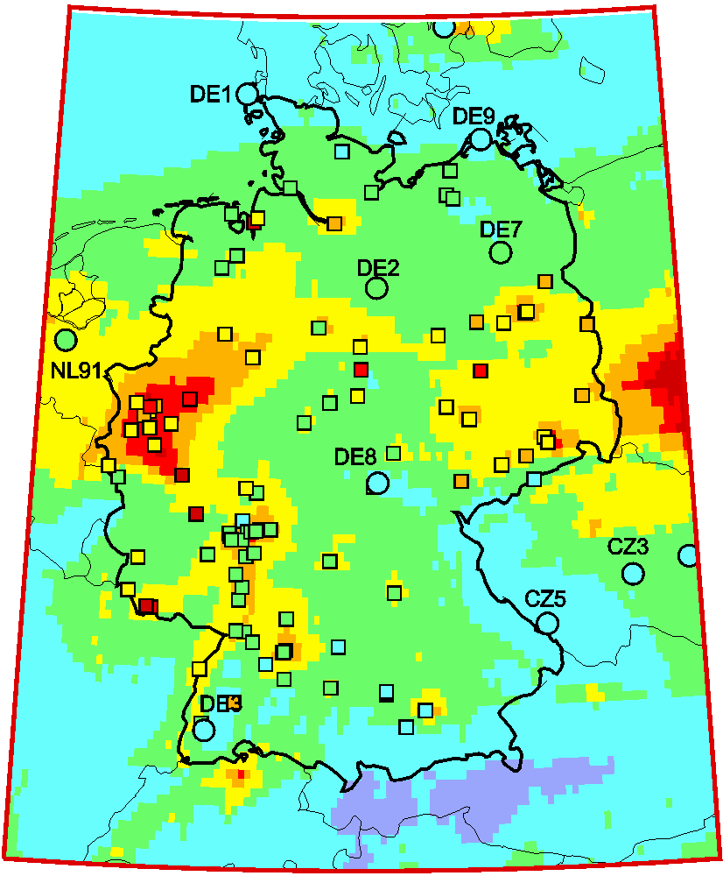
Country-scale assessment (Germany)
Co-operation with national experts
Preliminary results of multi-scale modelling of Pb levels in Germany
(Pb concentration in air, 2015)
Global scale
EMEP region
Germany
DE7 (Neuglobsow)

Slide 11
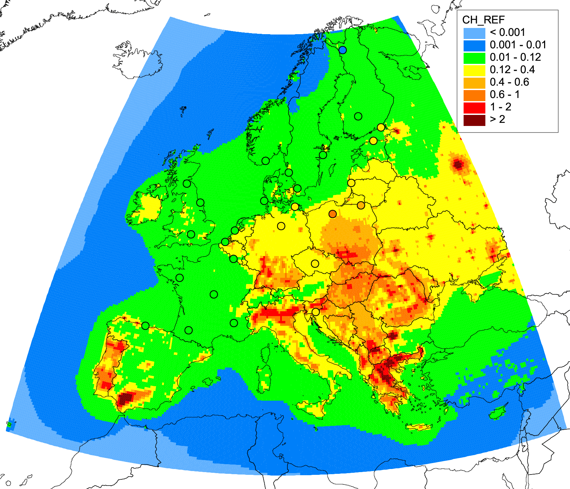
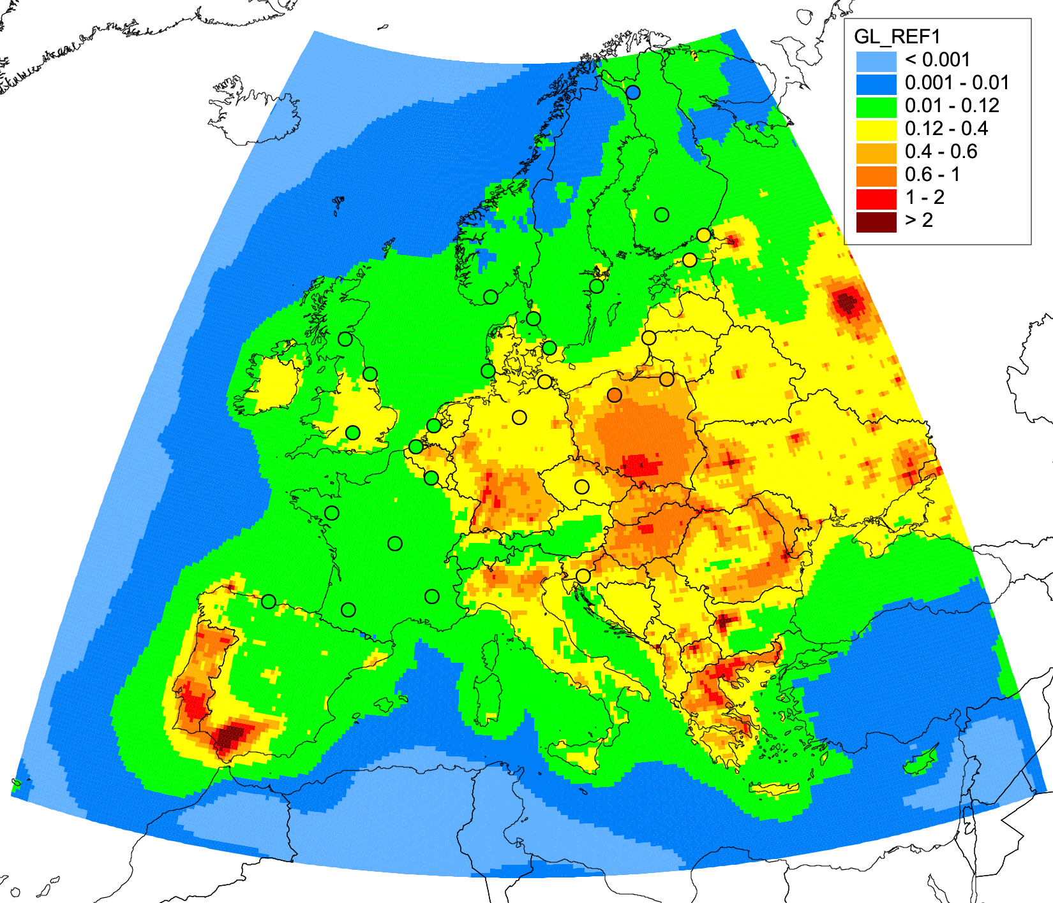
Co-operation with national experts
Country-scale assessment (France)
Case study on B(a)P pollution in Europe and France (2018-2019)
Analysis of model sensitivity to major B(a)P processes:
Key processes: degradation, gas-particle partitioning, air-surface exchange
Largest sensitivity to the model scheme of B(a)P degradation in air
Results of the study will be used to improve model parameterizations of GLEMOS
B(a)P air concentration (2015)
Model sensitivity to major processes
CHIMERE
GLEMOS
Degradation
Gas-particle partitioning
Air-surface exchange
Co-operation with national experts from France (INERIS) and Spain (CIEMAT )

Slide 12
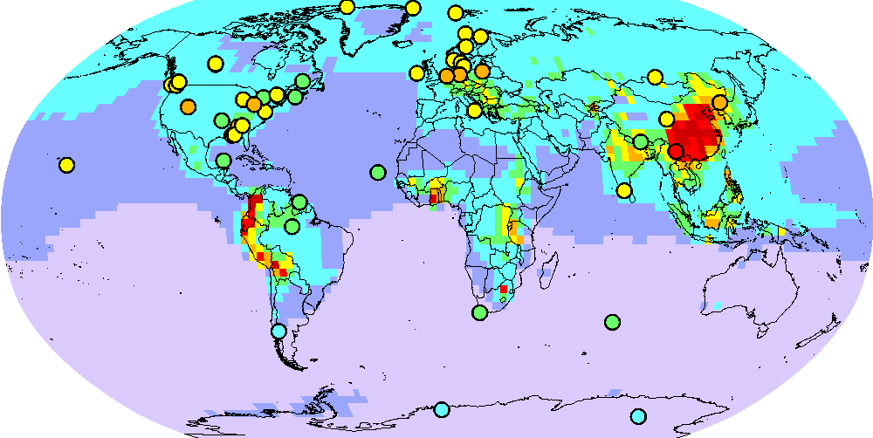
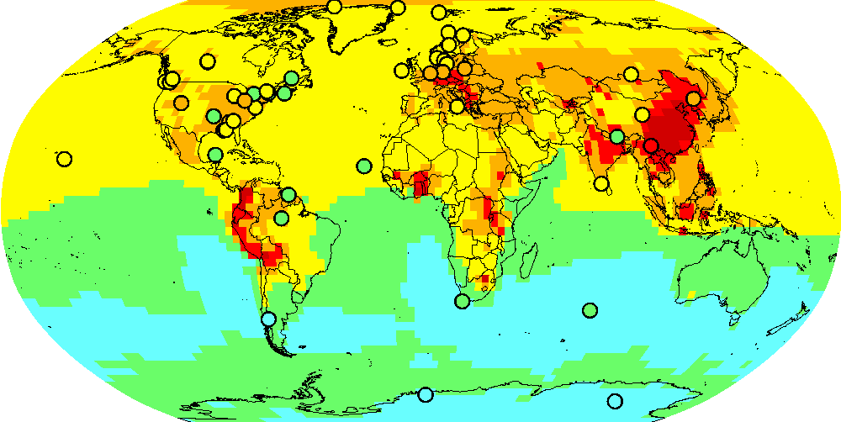
Research and model development
New findings in Hg atmospheric chemistry
Study of a new photo-reduction mechanism:
International research group (Spain, France, Canada, USA, UK, EMEP/MSC-E)
MSC-E performed model evaluation (GLEMOS) of the new mechanism
Results published in Nature Communications (Saiz-Lopez et al., 2018)
Hg chemical transformations
Br, Cl, OH …
Hg^{II}
gas
PM
Hg⁰
gas
Hg^{II}
hν - ?
part
Testing the new Hg oxidation/reduction chemistry (GLEMOS)
Test 1 (Br oxidation, no reduction)
Test 2 (Br oxidation, new photo-reduction)
The new chemical mechanism requires further evaluation for possible use in the EMEP operational modelling
Hg⁰ concentration

Slide 13
Research and model development
Updates of POP multi-media modelling
Improvement of POP parameterisations with focus on HCB secondary sources
Motivation:
Large contribution of secondary emissions to POP pollution levels within EMEP
High uncertainties of existing estimates of HCB re-emission secondary emissions
HCB air concentration
EMEP secondary sources
EMEP anthropogenic sources
Global anthropogenic sources
Global secondary sources
MSC-E/CCC joint study:
Scenario modelling of HCB long-term (1945-2015) accumulation and re-emission
Use of data from POP Passive Sampling campaign (CCC) for evaluation of model results
Update of HCB model parameterizations in GLEMOS
HCB accumulation in media
- Atmosphere
- Ocean
- Soil

Slide 14
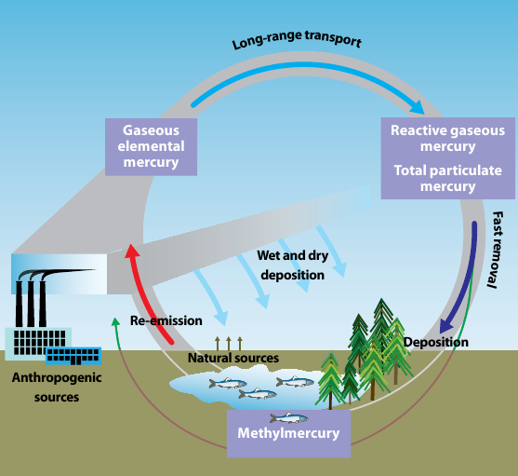
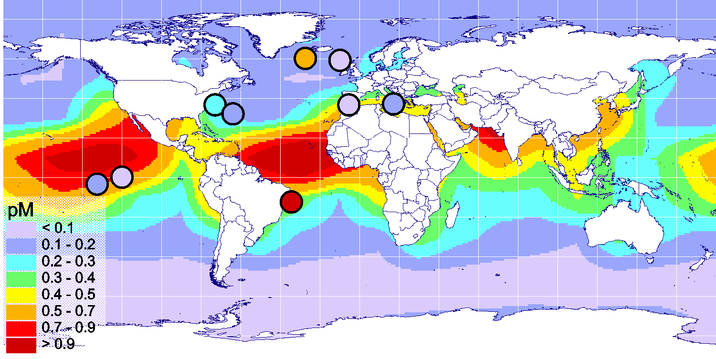
Mercury multi-media modelling
Research and model development
Initial development of multi-media modelling approach for Hg
Hg cycling in the environment
Motivation:
Mercury easily cycles between the atmosphere and water/soil/vegetation
Legacy/natural sources make up 65% of Hg deposition within EMEP
Time lag in the Hg media levels and exposure response to Hg emission reduction
UNEP/AMAP, 2008
On-going work:
Development of Hg media modules for GLEMOS (ocean, soil, vegetation)
Assessment of long-term Hg accumulation in media since pre-industrial times
Evaluation against observations
Hg⁰_{aq} in seawater (pilot results)

Slide 15
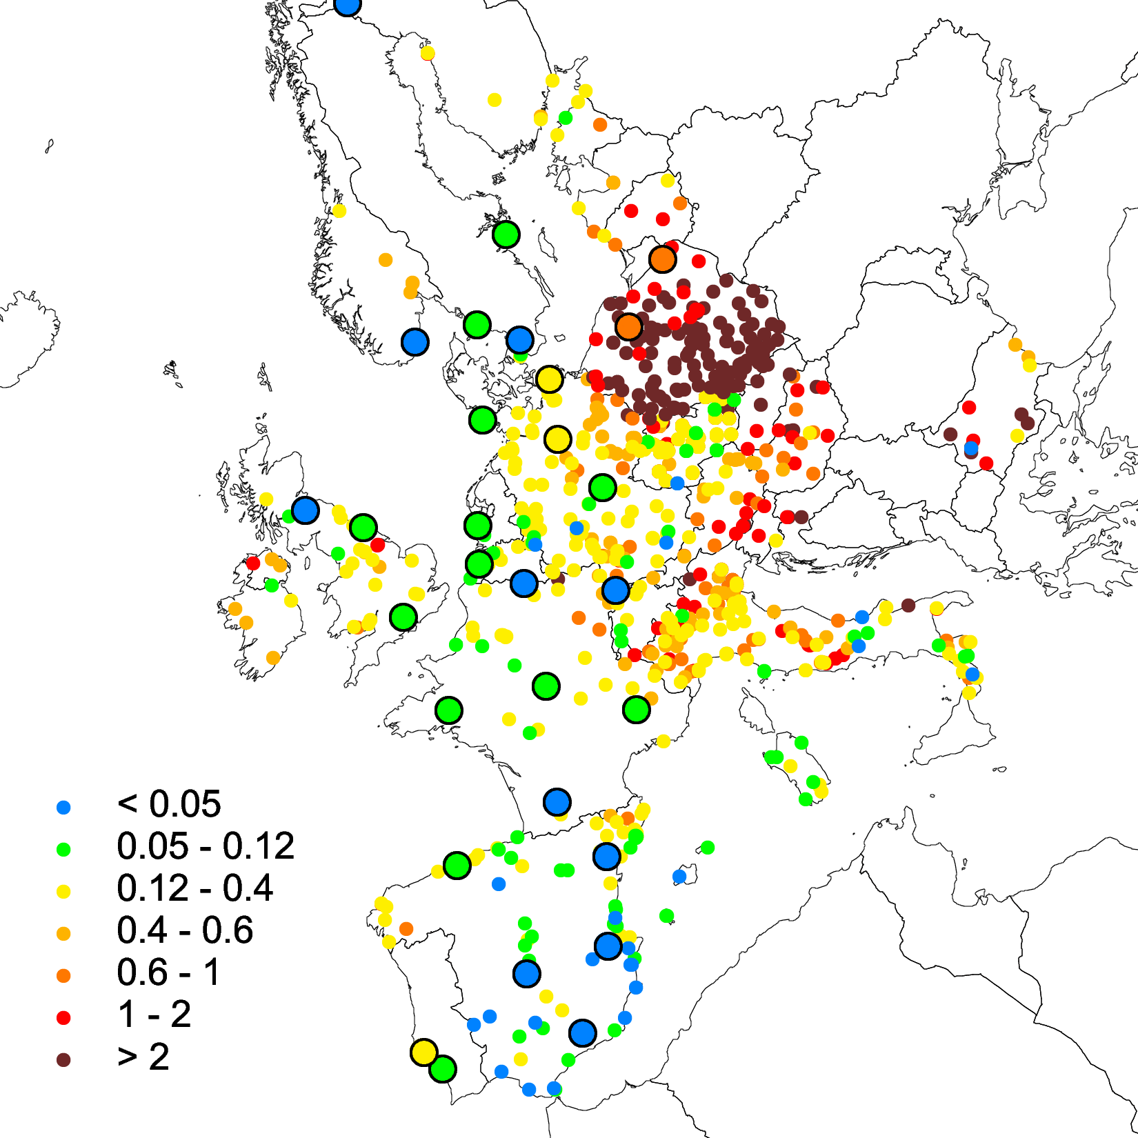
Heavy metal and POP monitoring data
Use of complementary measurement data for model evaluation and improvement
Complementary data:
B(a)P concentration in air (2016)
National monitoring in Europe (AirBase)
  Need assistance in evaluation of sites representa-tiveness and data quality (countries, CCC)
AirBase
Passive sampling POP and Hg (?)
  Support of regular campaigns (every 5 years - ?)
EMEP
Biomonitoring of HMs and POPs (?) in moss
  Continue collaboration with ICP-Vegetation
Measurements of POPs and Hg in soil/water/vegetation
  Need collaboration and data exchange with WGE (ICPs) and Stockholm Convention

Slide 16
On-going international co-operation
Minamata Convention (MC)
  Information exchange with Ad-Hoc Technical Expert Group
Arctic Monitoring and Assessment Programme (AMAP)
  Participation in AMAP Mercury Assessment 2021 and AMAP POP Assessment
European Commission (Marie Skłodowska-Curie Actions, Innovative Training Networks, ITN)
  Participation in project “Global Mercury Observation and Training network in support to the Minamata Convention” (proposal)
Helsinki Commission (HELCOM)
  Assessment of atmospheric load of HMs and POPs to the Baltic Sea
International Conference on Mercury as a Global Pollutant (ICMGP 2019), Krakow, 8-13 September, 2019
  Presentation of new scientific findings on Hg within EMEP
European Chemical Agency (EU regulation “Registration, Evaluation, Authorisation and Restriction of Chemicals”, REACH)
  Information exchange on toxicity of HMs and POPs

Slide 17
Main directions in 2020/2021
(Proposals for bi-annual workplan)
Operational model assessment of HM and POP pollution (extended list of output data - ?)
National scale pollution assessments (co-operation with countries)
  Continue case study on heavy metal pollution in Germany (2020)
  Initiate studies on B(a)P pollution in Poland and Croatia (2020-2021)
Research and model development
  Complex analysis of problem areas of Pb and Cd pollution in the EMEP region involving modelling and variety of measurement data
  Evaluation of new mechanisms of Hg oxidation and reduction in the atmosphere
  Assessment of POPs and Hg multi-media transport and contribution of secondary emissions to pollution of the EMEP countries

Slide 18
Main directions in 2020/2021
(Proposals for bi-annual workplan)
  Co-operation with Working Group on Effects
  Joint analysis of HM measurements in moss in co-operation with ICP-Vegetation
  Data exchange with ICP-Integrated Monitoring and ICP-Forests on heavy metal concentration and deposition
  Providing information on Hg deposition to water bodies/watersheds to supplement the measurement based analysis by ICP-Waters
  Data exchange with TF Health on B(a)P concentration and exceedances of target values
  Potential co-operation with JEG-DM on POP and HM cycling and accumulation in the environmental media
  Co-operation with other international organizations

