Slide 1
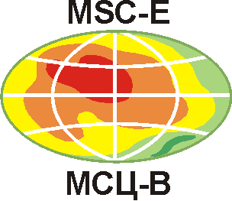
Heavy metal and POP pollution assessment: Progress and plans
Oleg Travnikov on behalf of MSC-E

Slide 2
PAH pollution and population exposure
Contribution to analysis of POP Protocol effectiveness (workplan item 1.1.1.1)
Motivation:
Emissions of B(a)P/PAHs from the largest sector “Residential combustion” does not change over past 20 years (similar to PM)
B(a)P and PM_{2.5} emissions from “Residential combustion” sector
B(a)P
PM_{2.5}

Slide 3
PAH pollution and population exposure
Contribution to analysis of POP Protocol effectiveness (workplan item 1.1.1.1)
Motivation:
Emissions of B(a)P/PAHs from the largest sector “Residential combustion” does not change over past 20 years (similar to PM)
No significant reduction in observed B(a)P concentrations and continuous exceedance of EU/WHO limits
B(a)P concentration, Italy
B(a)P concentration, Poland
EU target limit

Slide 4
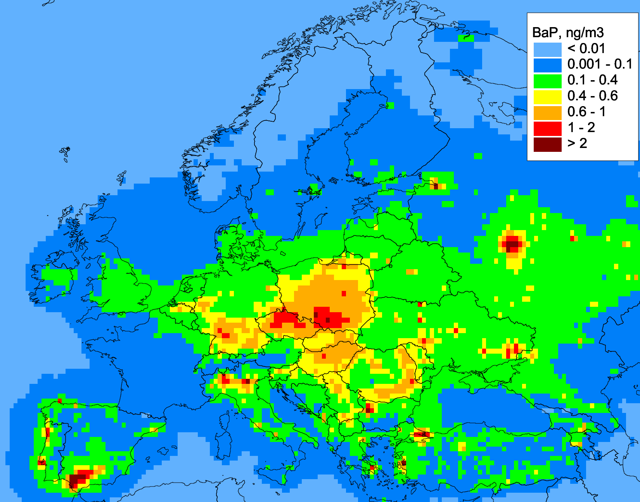
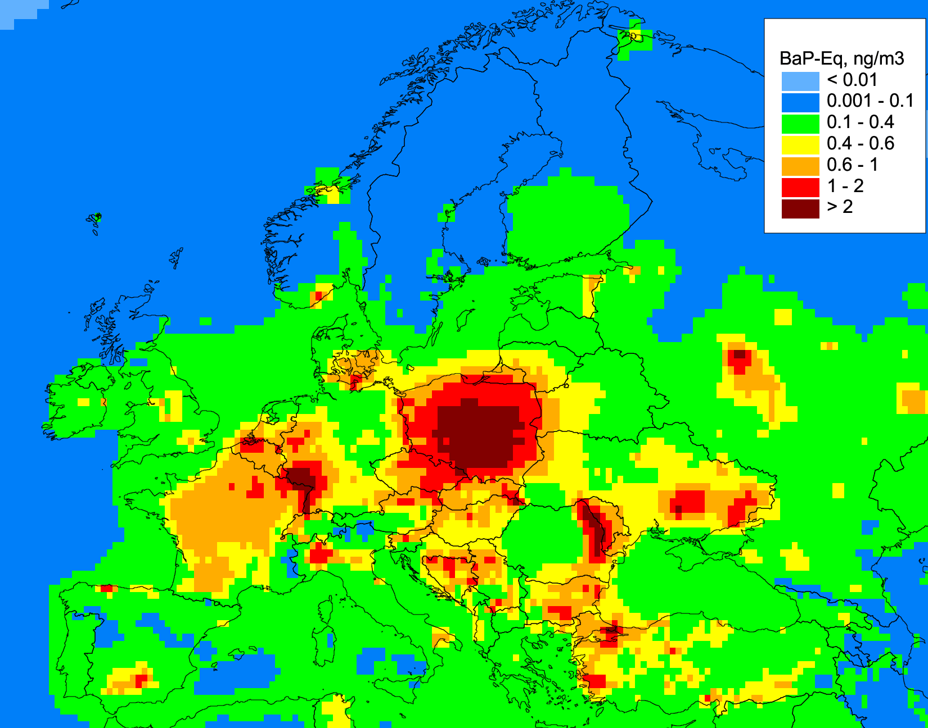
PAH pollution and population exposure
Contribution to analysis of POP Protocol effectiveness (workplan item 1.1.1.1)
Motivation:
Emissions of B(a)P/PAHs from the largest sector “Residential combustion” does not change over past 20 years (similar to PM)
No significant reduction in observed B(a)P concentrations and continuous exceedance of EU/WHO limits
Methodology of PAH mixture toxicity differs in various international organizations and countries
B(a)P concentration (ng TEF m⁻³)
16 PAHs mixture concentration (ng TEF m⁻³)
Number of PAHs:
CLRTAP – 4 PAHs
EU POP Regulation – 8 PAHs
US EPA – 16 PAHs
PAH mixture toxicity -
B(a)P toxic equivalent factors (TEF)

Slide 5
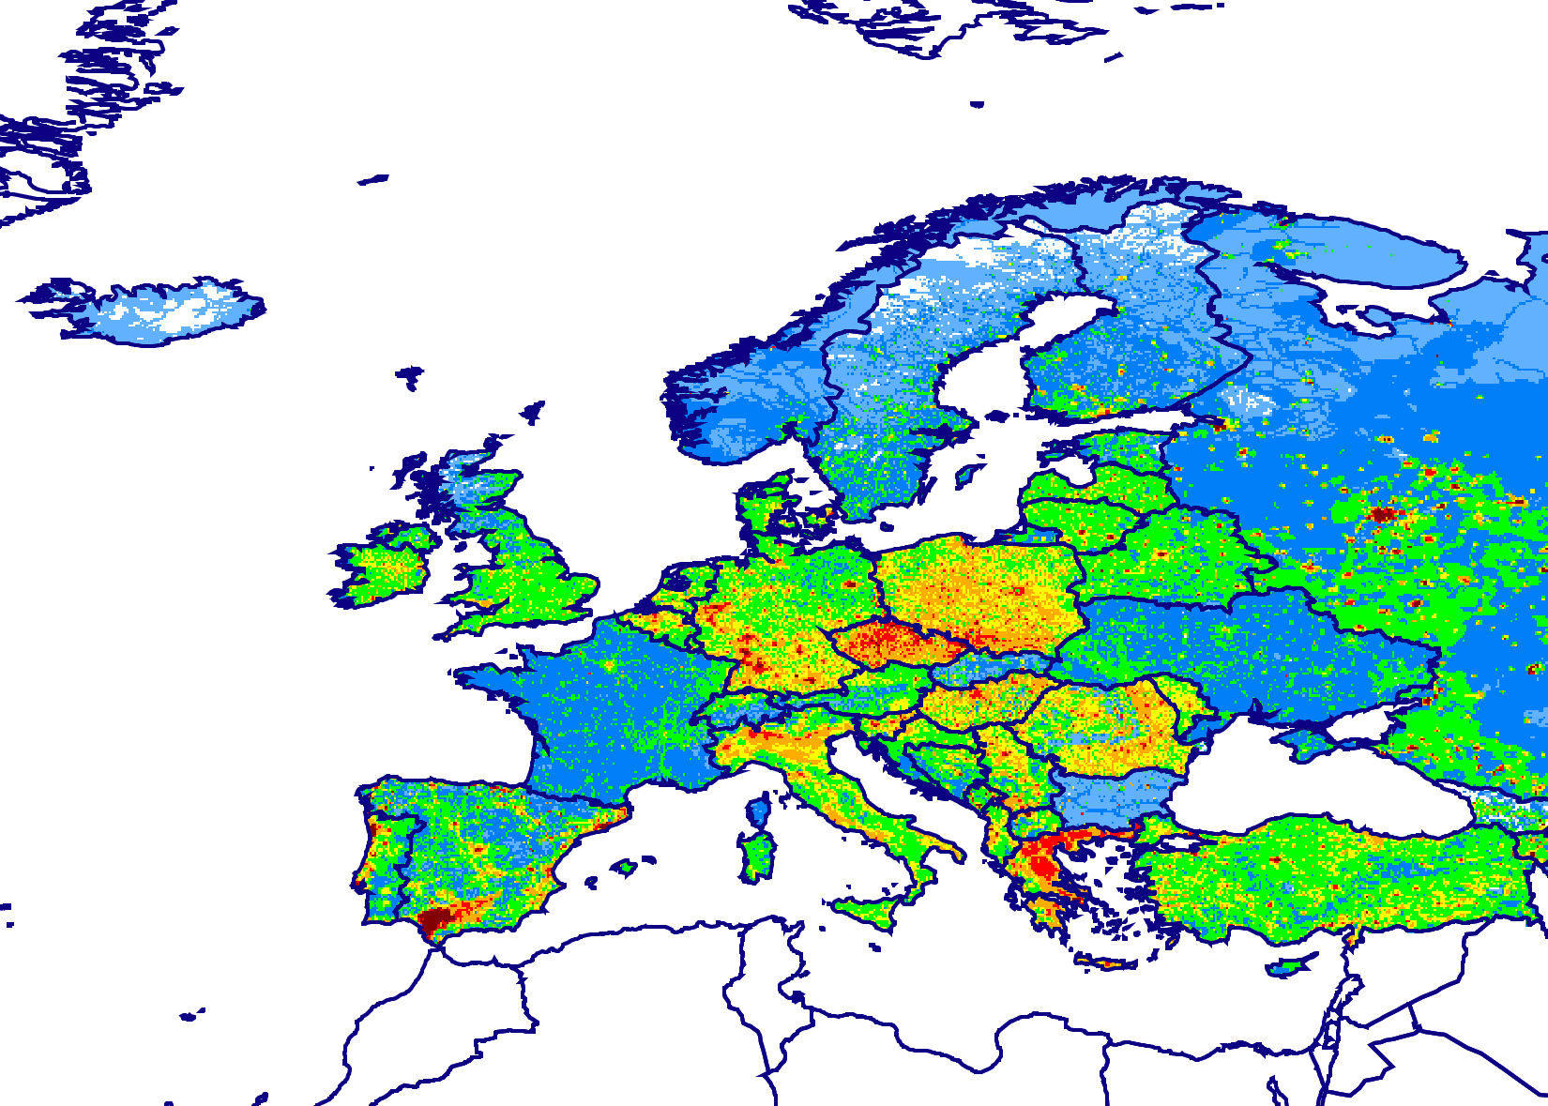
Workplan item 1.1.1.1
Multi-model study of B(a)P pollution
Contribution to EuroDelta-Carb model intercomparison project (TFMM)
Objectives :
Multi-model assessment of B(a)P pollution levels within EMEP
Analyzing interaction between PM and B(a)P transport and pollution levels
Improving consistency of residential wood burning emission
Model domain and B(a)P emissions (2017)
Modeling groups:
Institution | Model
EMEP/MSC-E | GLEMOS
INERIS (France) | CHIMERE
IEP-NRI (Poland) | GEM-AQ
ENEA (Italy) | MINNI

Slide 6
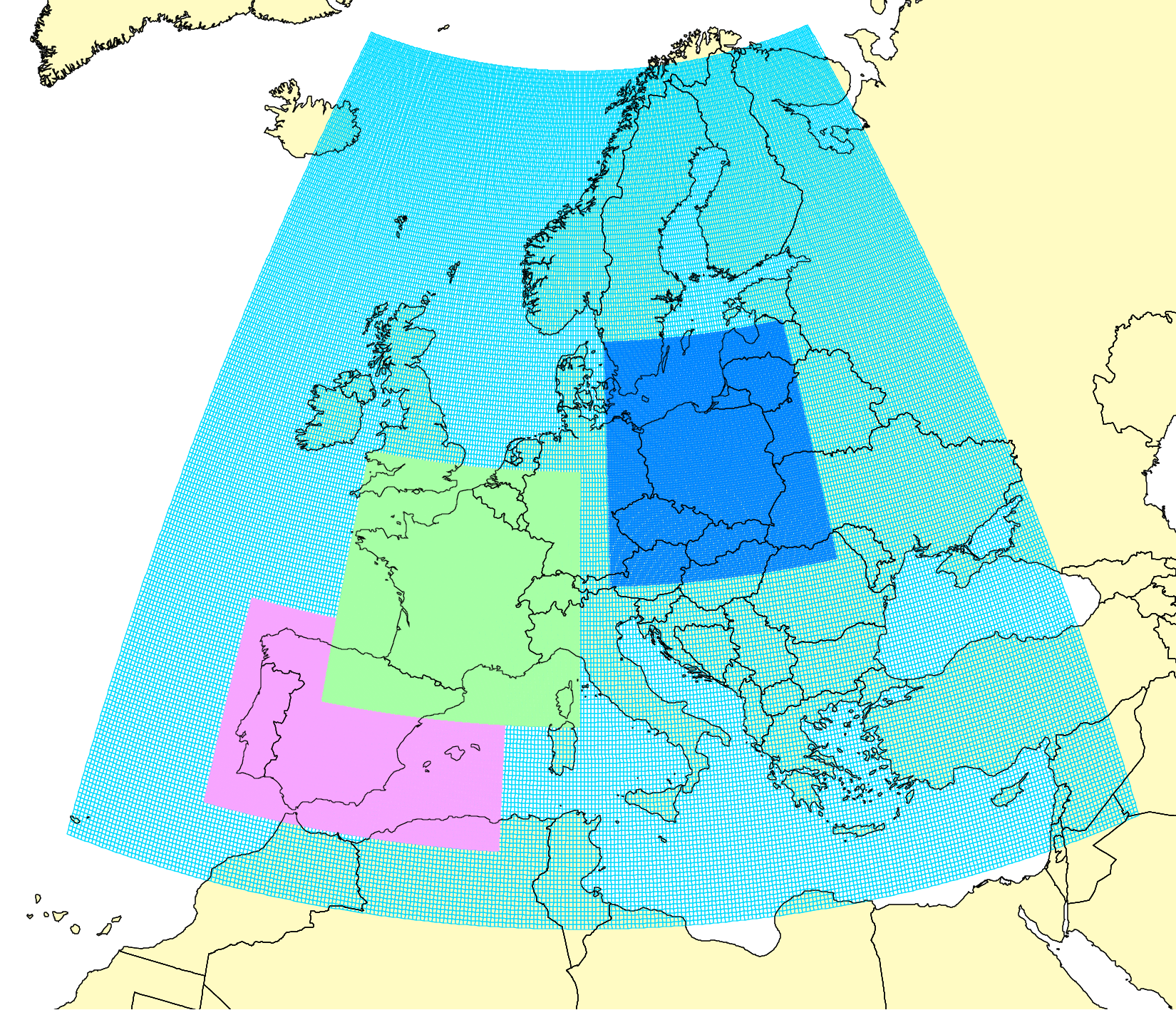
Workplan item 1.1.1.1
National scale studies on B(a)P
Joint research to improve B(a)P pollution assessment (Spain, France, Poland)
Project domains
Past and on-going studies (2017-2021):
Multi-model study of B(a)P pollution in Spain and France
Analysis and improvement of PAH emissions from key sectors (agriculture, domestic heating)
Initiation of a new case study on B(a)P for Poland (2020-2021)
Poland
France
Spain
B(a)P emissions in Spain
Refinement of B(a)P emissions (Spain):
Updated total emission is 30-60% lower
The dominating sector changed from “Agriculture” to “Residential combustion”
Previous estimates
Refined estimates

Slide 7
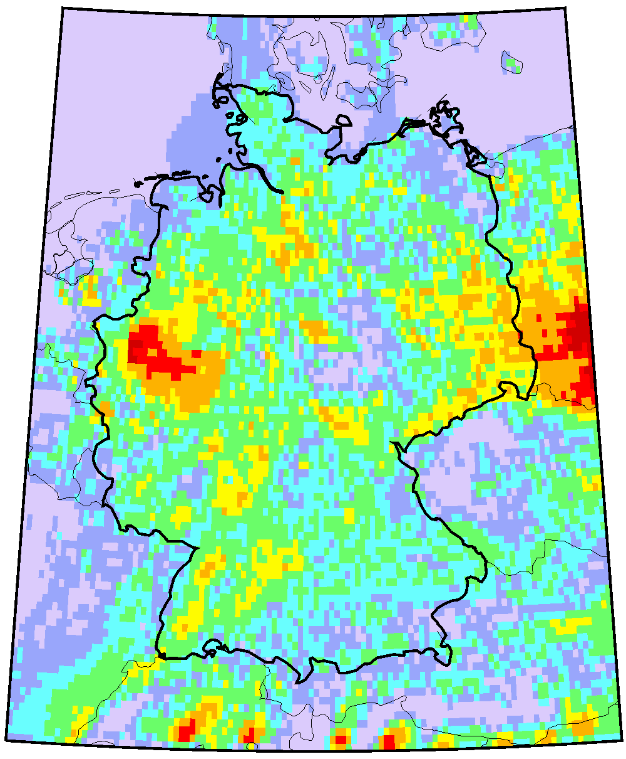
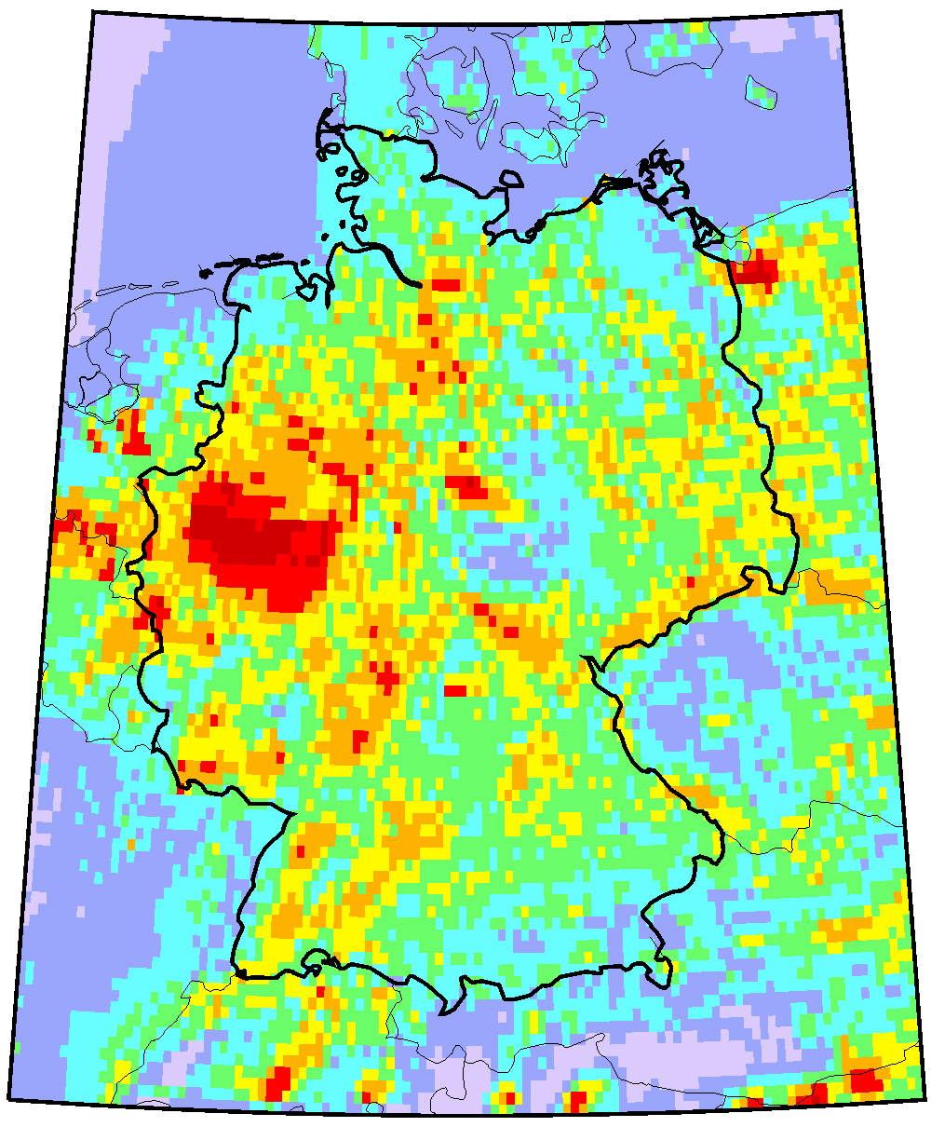
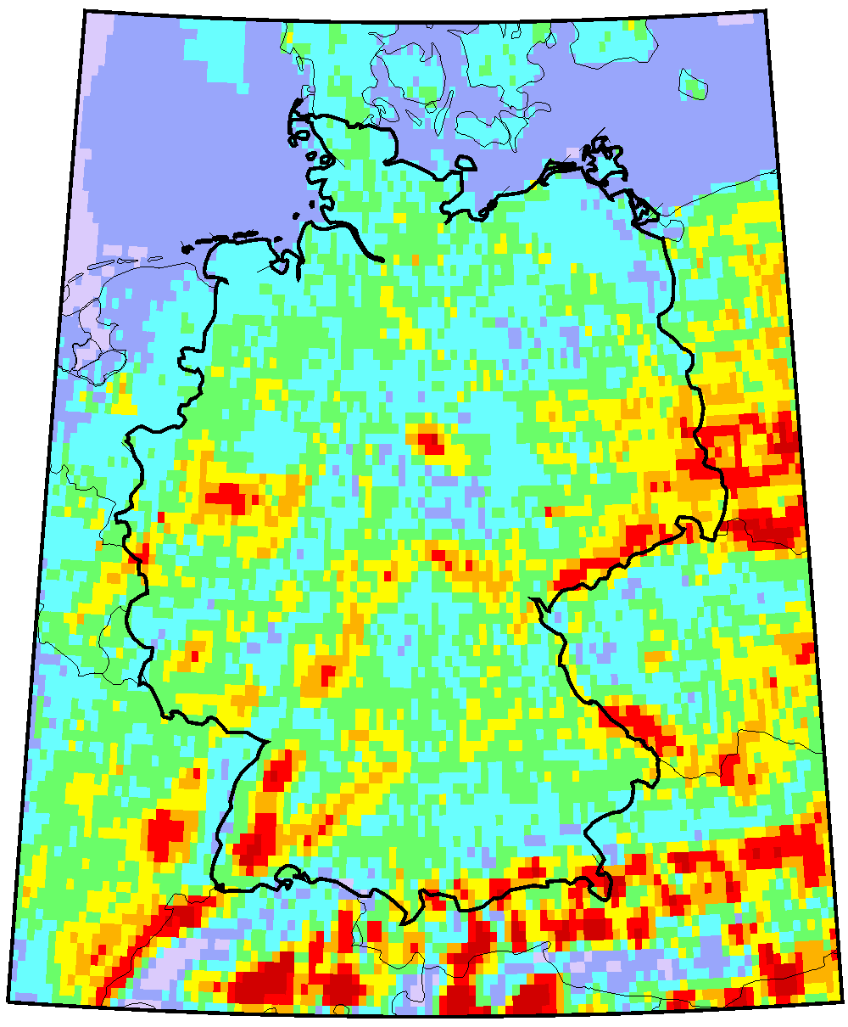
Workplan item 1.2.1
National scale study on heavy metals
Downscaling of HM pollution assessment for Germany
HM deposition (2016)
Main output of the study (2019-2020):
Air concentration and deposition maps of Pb, Cd and Hg to Germany in 2014-2016
Ecosystem-specific deposition to various LC types (arable lands, forests etc.)
Contribution of local/regional/global sources
Evaluation of modelling results vs. observations
Pb
Cd
Hg
The project is jointly funded by EMEP and the country (UBA, Germany)

Slide 8
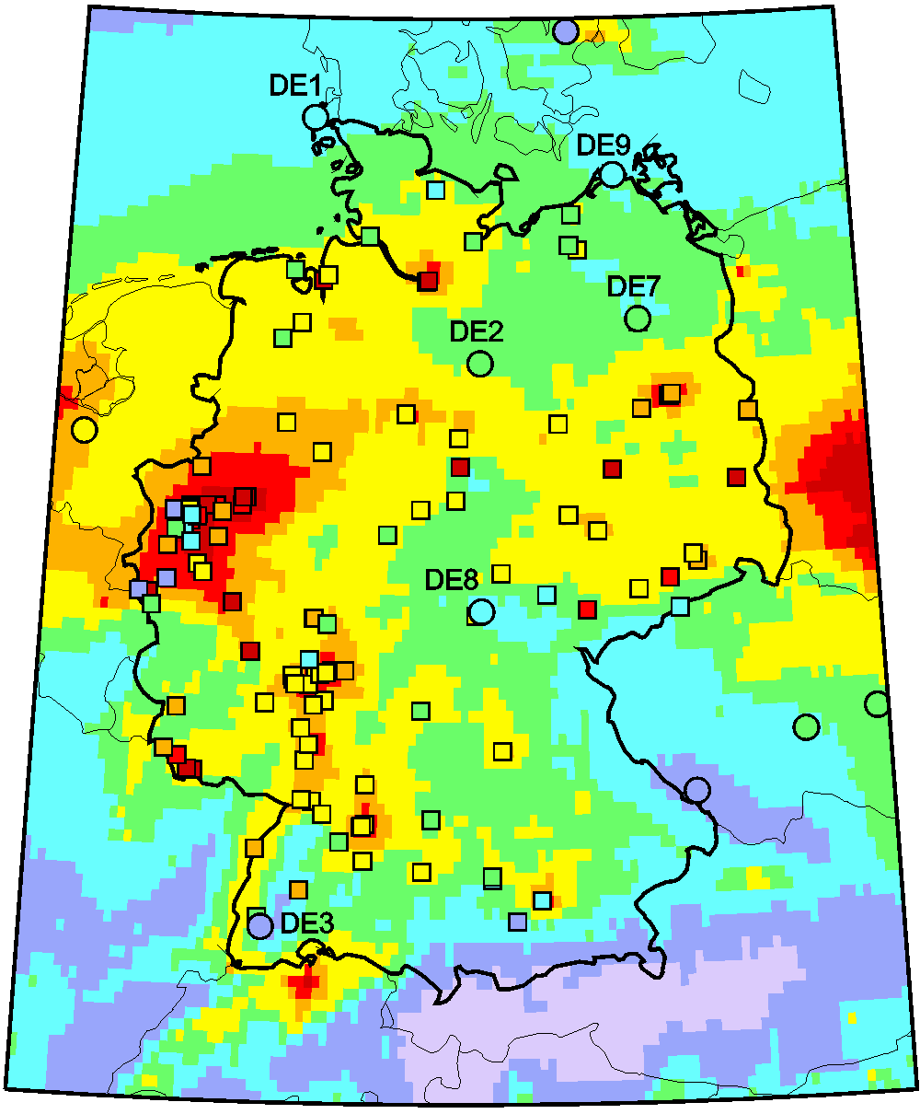
Workplan item 1.2.1
National scale study on heavy metals
Contribution of local/regional/global sources to HM pollution (Germany)
Pb concentration, 2015
DE01 (Westerland)
- Measured
- Secondary
- Germany
- EMEP
- Global
DEHE057 (Wetzlar-Hermanstein)
DENW053 (Köln-Chorweiler)

Slide 9
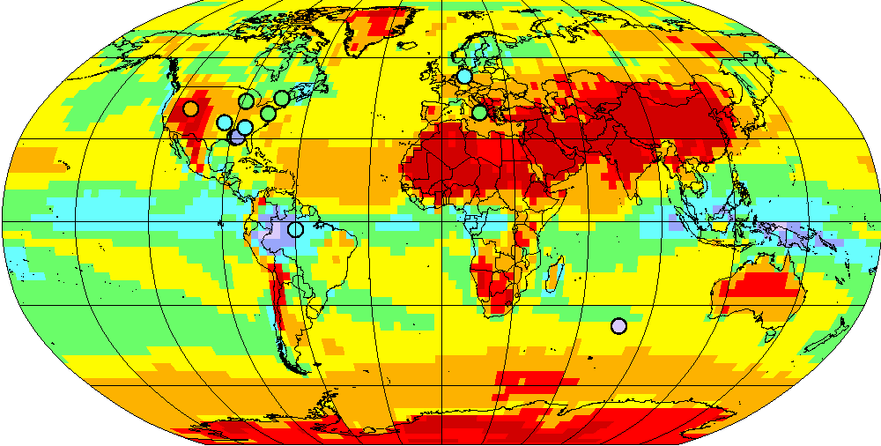
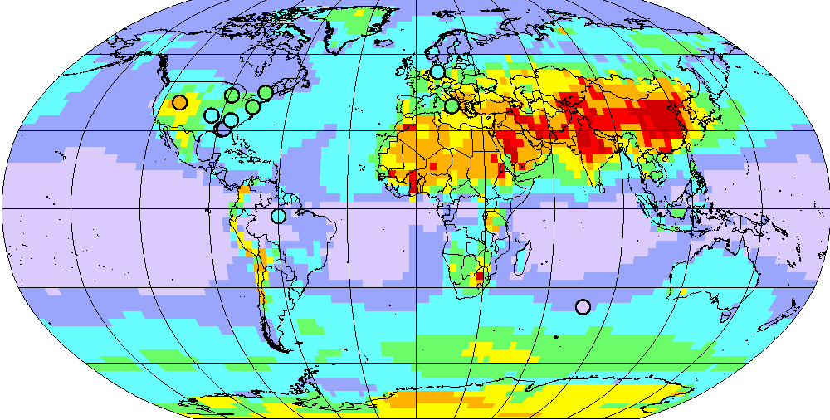
Study of Hg atmospheric chemistry
Research and development
Model evaluation of Hg oxidation and reduction mechanisms
Motivation of the study:
Importance of Br-initiated oxidation of Hg in the atmosphere
Poor understanding of the mechanisms and exploring new photo-reduction pathways
General scheme of Hg chemistry
hν
Br, OH, HO₂, NO₂, …
Hg⁰
Br
Hg^{I}Br
Hg^{II}
hν
Simulated vs. observed Hg^{II} concentration
No reduction
Current activities:
Collaborative study by international research group (EMEP/MSC-E, Spain, France, USA, Canada, UK, Germany)
MSC-E contributes with model evaluation of the new mechanisms
Photo-reduction of Hg^{I} and Hg^{II}
New results were submitted for publication (PNAS)
No reduction
Photo-reduct.

Slide 10
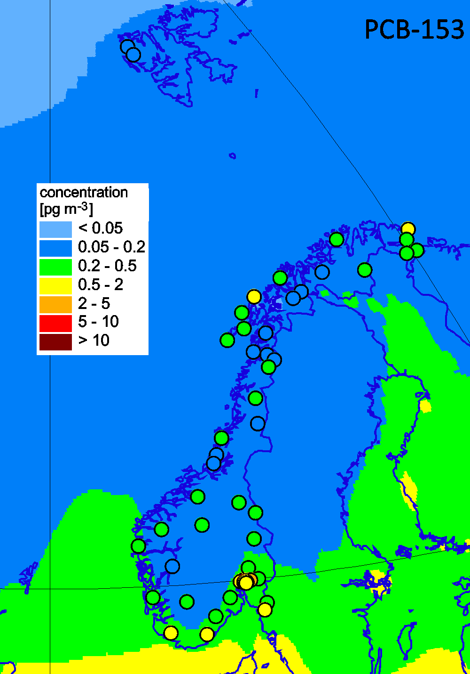
Research and development
Research project on HCB and PCBs
Study of main sources controling HCB and PCBs pollution (Norway, CCC/NILU)
Main activities:
Analysis of “multi-media” POPs with large contribution of secondary emissions (PCBs, HCB)
Use of EMEP POP passive sampling campaigns for 2006/2016
Spatial mapping of POP levels using two models (GLEMOS and FLEXPART)
Comparison of contributions of primary and secondary emissions to POP pollution
Observed vs modelled PCB-153 air concentrations (GLEMOS, 2016)
Results of the study are prepared of a peer-review publication

Slide 11
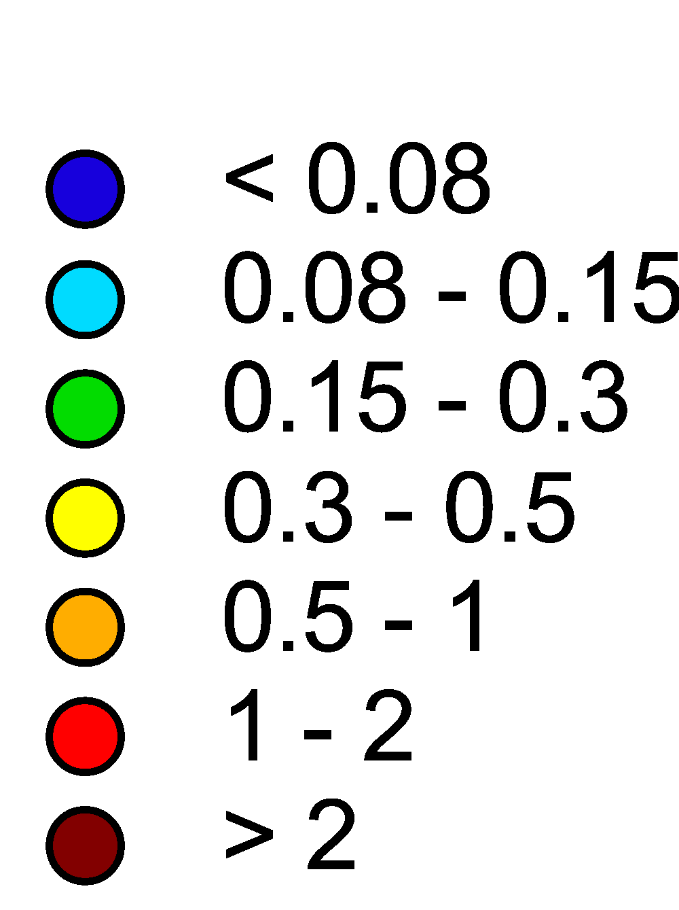
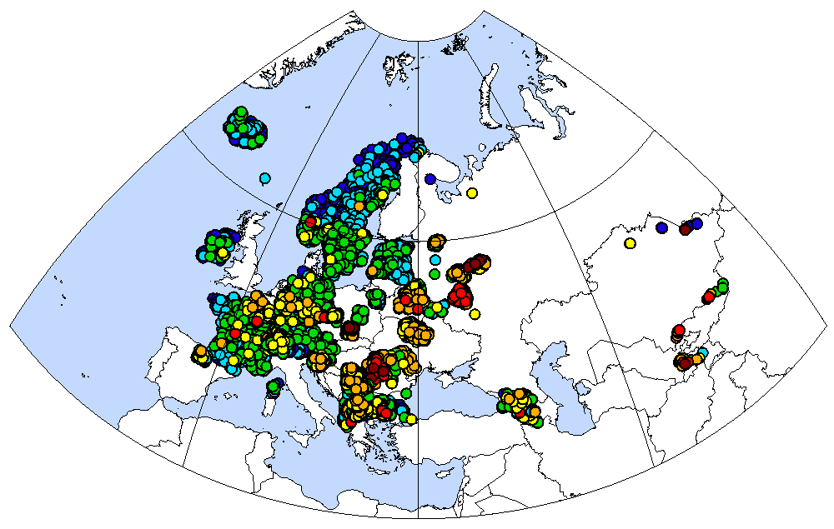
Co-operation with WGE (ICP-Vegetation)
Use of modeling and moss measurements for source attribution of HM deposition
Cd concentration in moss (2015)
Contribution of wind re-suspension to Cd deposition
Central Asia and Caucasus
- Model
- Moss (Al/Cd)
Europe
Results were discussed at the ICP-vegetation Task Force meeting (Riga, Latvia, January 2020)

Slide 12
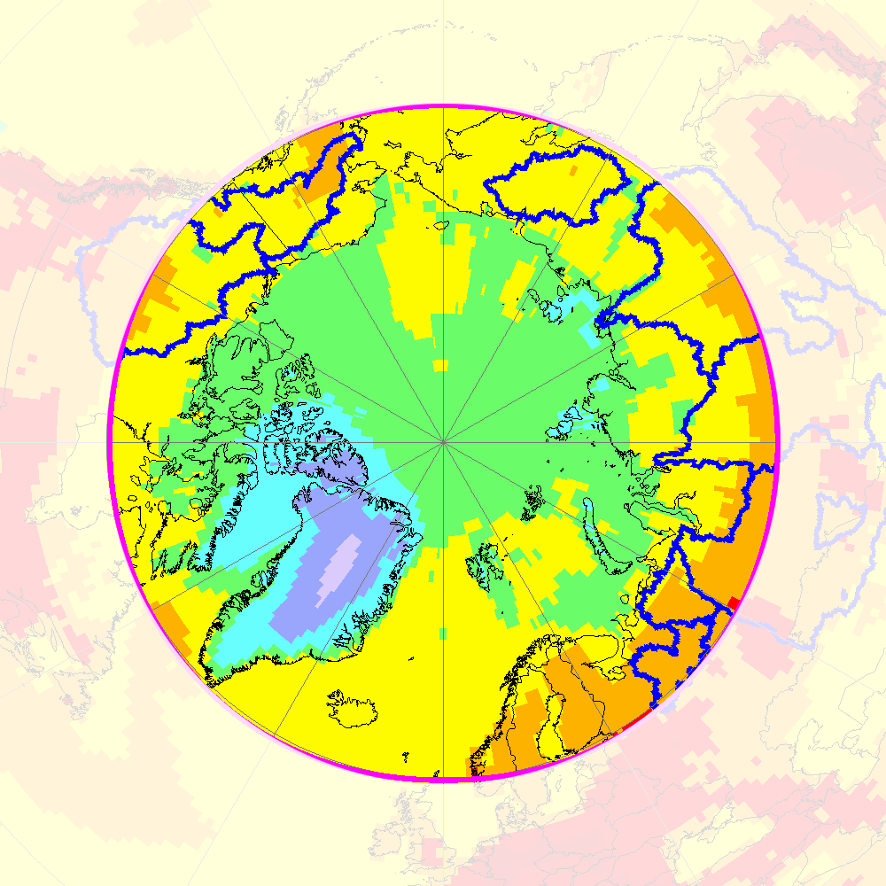
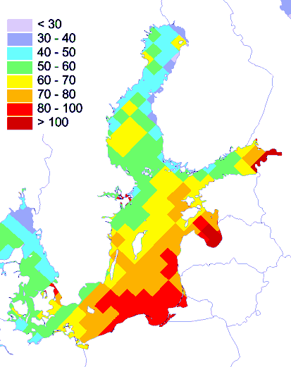



On-going international co-operation
Hg deposition to the Arctic (2015)
Arctic Monitoring and Assessment Programme (AMAP)
  Participation in AMAP Hg Assessment 2021 and AMAP POP Assessment
  Multi-model simulations and source apportionment of Hg deposition to the Arctic
Helsinki Commission (HELCOM)
  Assessment of atmospheric load of HMs and POPs to the Baltic Sea
OSPAR Commission
  Initial discussion of potential co-operation
  Simulations of long-term trends of HM deposition to OSPAR Convention Sea Area
PCDD/F deposition to the Baltic sea
ng TEQ/m²/y
OSPAR
COMMISSION

Slide 13
Future directions
(in accordance with bi-annual workplan 2020-2021)
Contribution to analysis of effectiveness of POP Protocol (PAH pollution and population exposure)
Continue national scale studies of HM and POP pollution (co-operation with countries)
Attribution of long-term changes of Hg and POP pollution to regional/global sources and factors
Research and model development (Hg chemistry, POP degradation and exchange)
  Co-operation with international organizations and national experts

