Slide 1


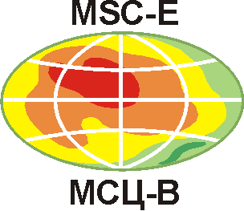
Heavy metal and POP pollution assessment: Progress in 2022-2023 work plan
O. Travnikov, A. Gusev, I. Ilyin, M. Kleimenov, N. Batrakova, N. Vulykh, V. Shatalov, O. Rozovskaya, I. Strizhkina

Slide 2
Topics of research and co-operation
  EuroDelta-Carb: Assessment of BaP and PM pollution (TFMM)
  (items 1.1.1.1, 1.1.1.5)
  Country-scale studies: Poland, Norway (TFMM, national experts)
  (item 1.2.1)
  Scientific co-operation on Hg and POPs (TF HTAP, AMAP, national experts)
  (items 1.1.4.3, 1.1.4.5, 1.1.4.6)
  Co-operation with the effect community (WGE, ICP-Vegetation)
  (item 1.1.1.13)
  Outreach: Marine pollution assessment (OSPAR, HELCOM)
  (item 1.3.1)
  Contaminants of Emerging Concern (TF HTAP, TFMM, HELCOM)
  (item 1.1.1.6)

Slide 3
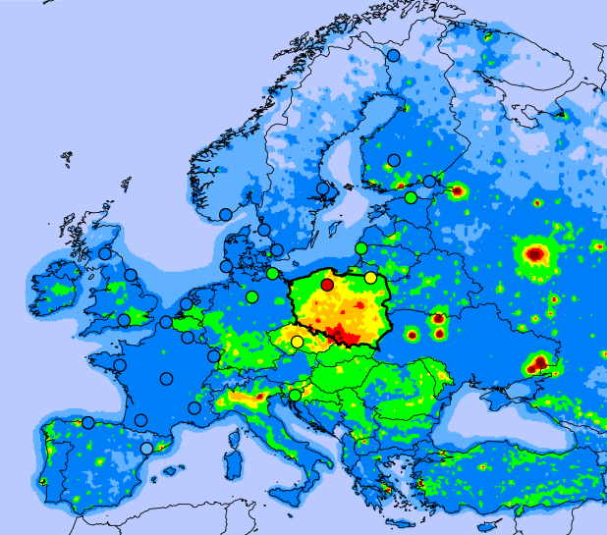
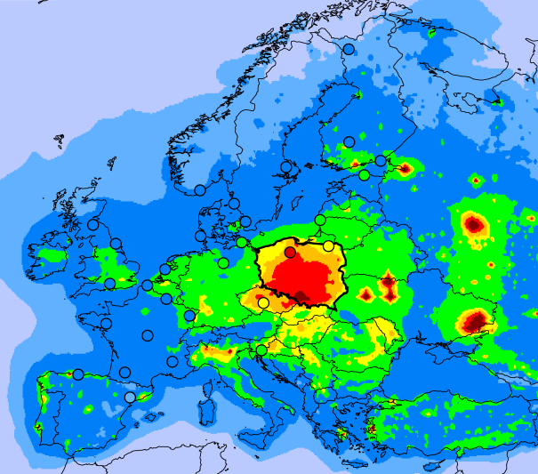
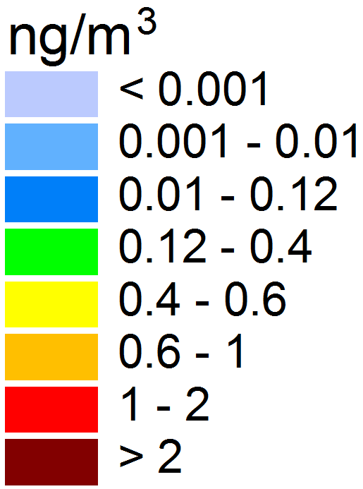
Co-operation with TFMM workplan items 1.1.1.1, 1.1.1.5
Assessment of BaP and PM pollution
EuroDelta-Carb multi-model intercomparison study (TFMM)
Objectives:
Assessment of BaP pollution levels and exceedances of air quality guidelines
Evaluation of PAH/PM emissions from ‘residential combustion’ sector
Interlinking transport and fate of BaP and PM components (OC, EC)
BaP concentration (2018)
MINNI
GLEMOS
Institution | Model
EMEP/MSC-E | GLEMOS
INERIS (France), CIEMAT (Spain) | CHIMERE
FMI (France) | SILAM
ENEA (Italy) | MINNI
Kosetice (CZ0003R)

Slide 4
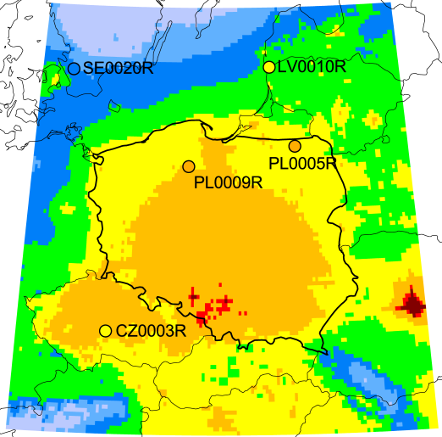
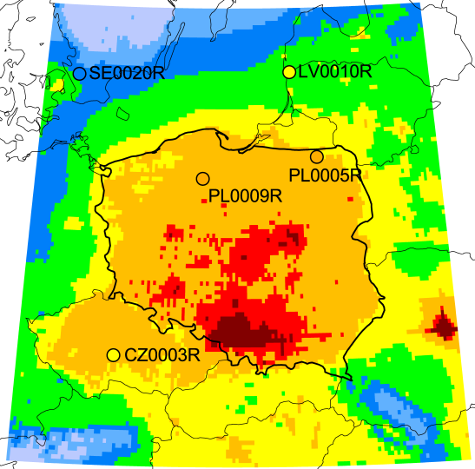
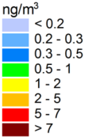
Co-operation with TFMM workplan item 1.2.1
Country-scale study: PAH pollution in Poland
Air concentration of 4 PAHs (2018)
Phase II program (2022-2023):
Model assessment of 4 PAHs (BaP, BbF, BkF, IcdP) in Poland
Evaluation of updated national PAH emissions inventory for EMEP
Model intercomparison (GLEMOS, GEM-AQ) to support further improvement of emissions data and analysis of pollution trends
Original
Updated
Evaluation vs. observations (2018)
Progress of the study will be reported at forthcoming TFMM meeting (May 2022)

Slide 5
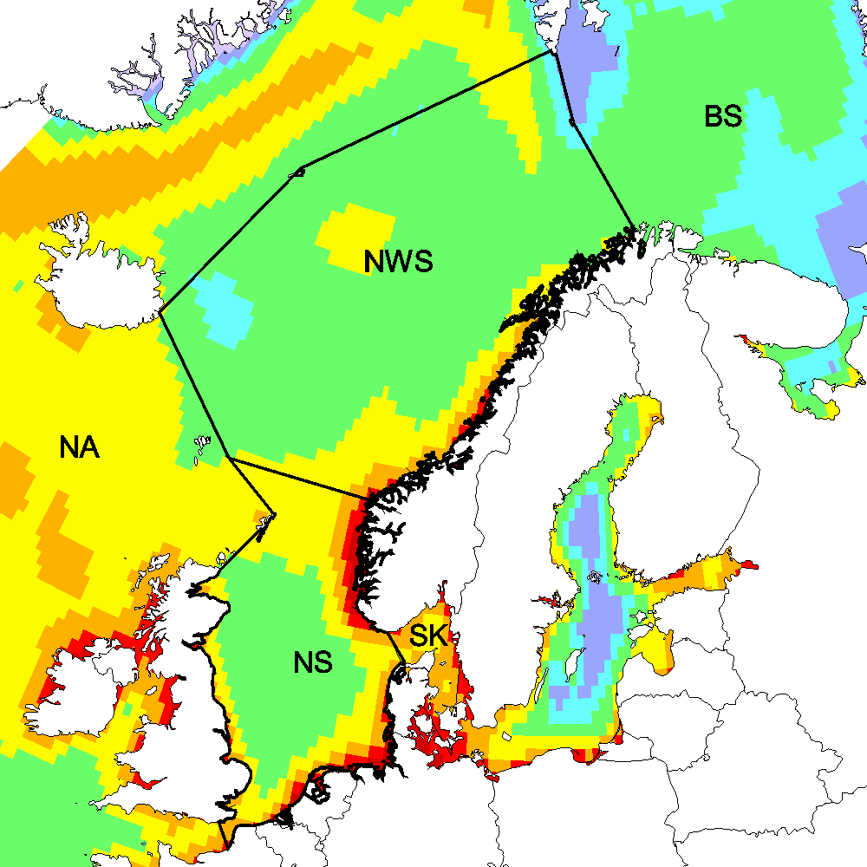
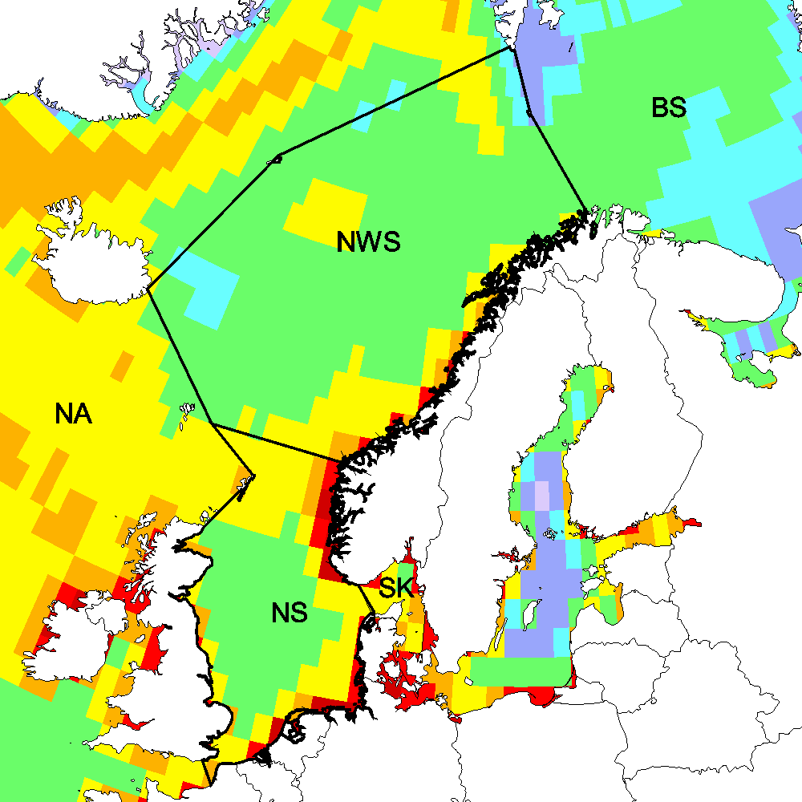
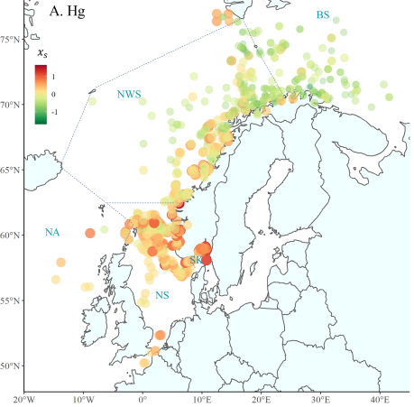
Co-operation with TFMM workplan item 1.2.1
Country-scale study: Hg pollution in Norway
EMEP/MSC-E contribution to the Norwegian Mercury Assessment 2022
Contributors:
Norway: NILU, NIVA, NP, IMR, NEA, NIPH EMEP: MSC-E
Simulated Hg deposition to the NE Atlantic
Hg concentration in fish (2006-2019)
Provided data and analysis:
Long-term trends of Hg emissions, air concentration and deposition
Modelling data for analysis of factors affecting Hg changes in Norway
Contribution to study of Hg levels and trends in biota (fish, bears, foxes)
Ho et al. (2021)

Slide 6
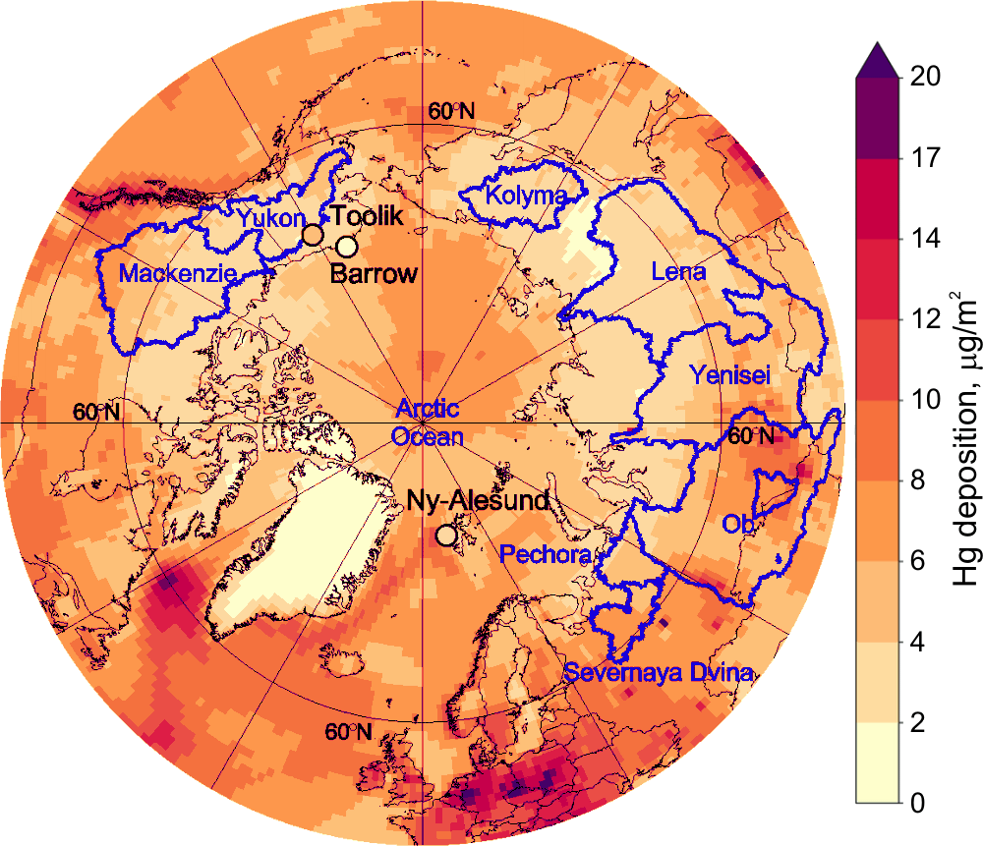
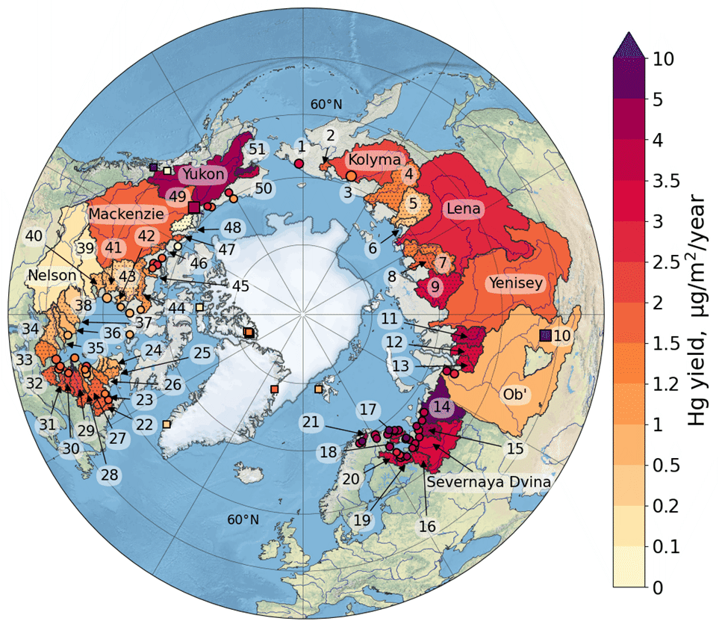
Co-operation with national experts
Assessment of Hg pollution in the Arctic
EMEP/MSC-E contribution to the co-operative follow-up studies based on AMAP Hg Assessment
Annual river Hg yield for pan-Arctic watersheds
Wintertime Hg deposition
Main topics:
Literature review of Hg sources, transport and fate in the Arctic
Estimates of the present-day total Hg mass balance in the Arctic
Update and evaluation of global Hg emissions inventory
Analysis of factors affecting changes of Hg pollution in the Arctic
Publications:
Dastoor et al. (2022) Nature Reviews Earth & Environment, in press
Dastoor et al. (2022) Science of the Total Environment, submitted

Slide 7
Co-operation with TF HTAP workplan item 1.1.4.3, 1.1.4.5, 1.1.4.6
Scientific co-operation on Hg and POPs (TF HTAP)
Research activities following decisions of TF HTAP Workshops on Hg and POPs (April 2021)
On-going and future activities :
Incorporation of Hg and POP emissions into HTAPv3 Global Emissions Mosaic
  Model evaluation of new JRC/EDGAR emission inventory for POPs
  Initiation of review and comparison of global Hg emission inventories
Multi-model experiments focused on Hg and POP processes and fate
  Planning model study of Hg air-surface exchange and secondary emissions
  Elaborating global source-receptor relationships of combustion-related POPs and PM (in connection with TFMM EuroDelta-Carb)
These research topics will be further discussed at the forthcoming TF HTAP thematic meetings on Hg and POP emissions and modelling (May 2022)

Slide 8
Co-operation with national experts
Co-operative study of Hg atmospheric chemistry
Further development of Hg chemical scheme in co-operation with other research groups
Motivation:
Current understanding of Hg atmospheric chemistry is still incomplete
Analysis and evaluation of new Hg redox mechanisms are needed
Updated scheme of Hg redox chemistry
O₃, Br, OH, HO₂, NO₂, …
Br
Hg^{I}Br
hν
PM
hν
Hg^{II}
Hg^{II}
Hg⁰
part
OH
hν
Cl
O₃, Br, OH, HO₂, NO₂, …
Research activities:
Development of a new Hg chemical scheme for experimental version of GLEMOS model
Numerical experiments with new proposed Hg redox pathways (Br, OH, Cl) and gas-particle partitioning
Hg^{I}OH
Hg^{I}Cl
Collaborators:
Institute of Physical Chemistry Rocasolano, Spanish National Research Council (CSIC), Spain

Slide 9
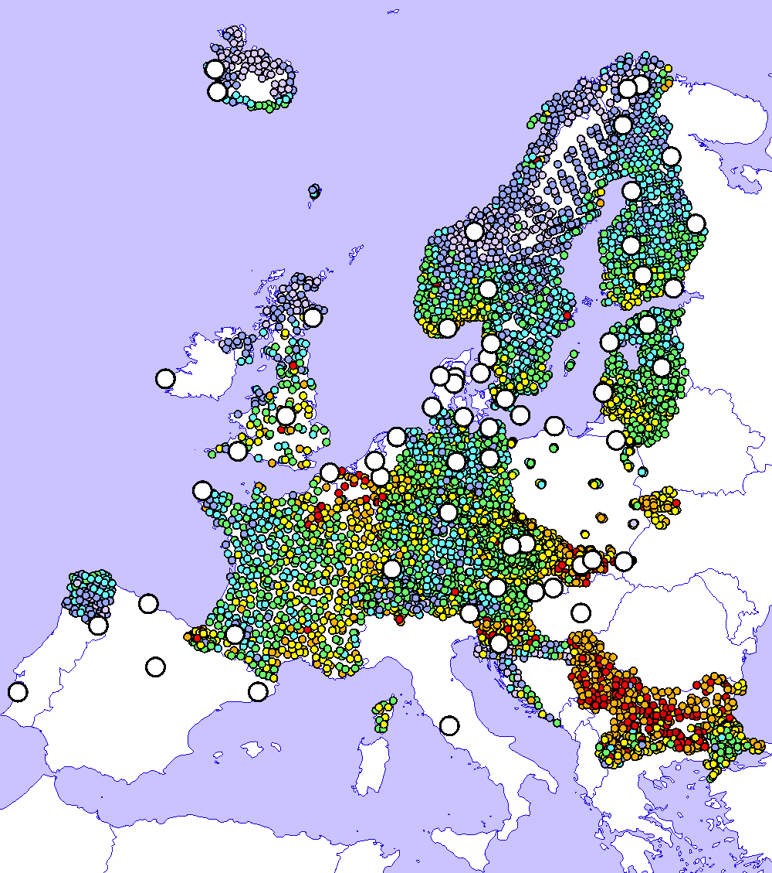

Co-operation with WGE workplan item 1.1.1.13
Co-operation with effect community
Use of EMEP observations, modelling, and moss measurements (ICP-Vegetation) for trend analysis
Pb concentration in moss
Key features:
Combination of different data types provides more reliable estimates of pollution changes on local and regional scales
Analysis of discrepancies allows revealing assessment uncertainties (e.g. emission estimates, model parameterizations etc.)
Conc. in moss (obs.)
Wet deposition (obs.)
Deposition (model)

Slide 10
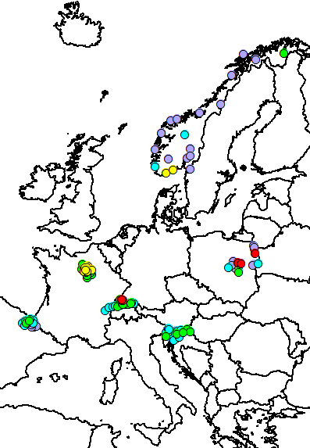
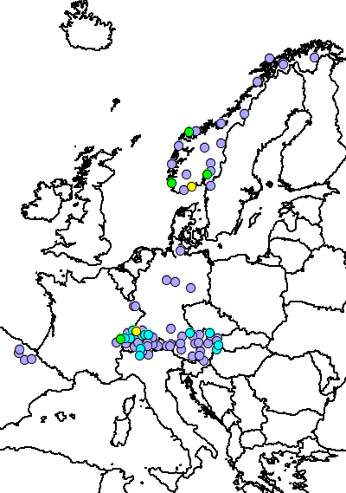
Co-operation with WGE workplan item 1.1.1.13
Co-operation with effect community
Use of EMEP observations, modelling, and moss measurements (ICP-Vegetation) for trend analysis
Measured BaP concentrations in moss
Changes between 2010 and 2015 (%)
NEW!
POP in mosses:
B(a)P
PCB-153
HCB
BDE-99
2010
2015
Moss
Model
< 3
3-5
5-10
10-20
> 20
ng/g
- Concentrations in mosses
- Modelled deposition flux
Note: POP measurements in moss need to be continued

Slide 11
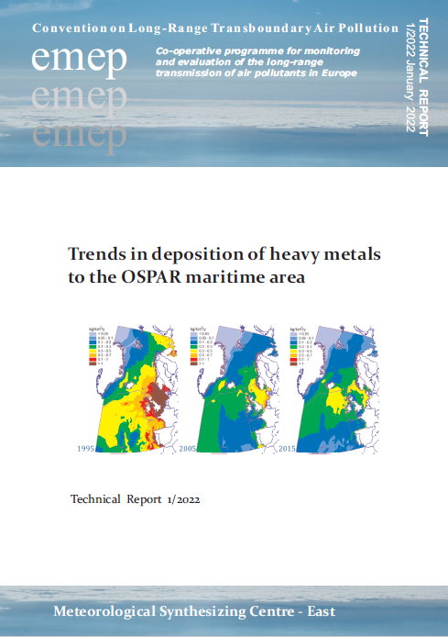
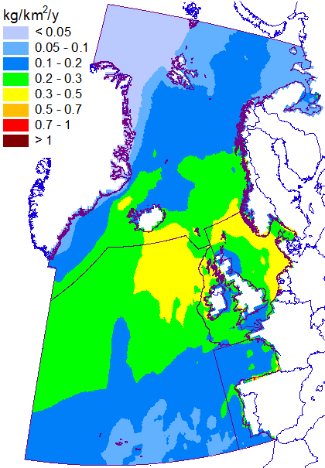

Co-operation with marine conventions workplan item 1.3.1
Contribution to marine pollution assessment
Model assessment of heavy metal loads to the Northern Atlantic (co-operation with OSPAR)
Assessment items:
Considered pollutants – Cd, Pb, Hg
Long-term trends of HM deposition to the OSPAR maritime regions
Source apportionment of HM deposition
Evaluation of modeling results vs. observations (EMEP/CAMP)
Pb deposition (2015)
HM deposition trends
Arctic waters
Greater North Sea
Wider Atrlantic
Celtic Seas
Bay of Biscay
DRAFT
The project was funded by OSPAR
OSPAR
COMMISSION

Slide 12
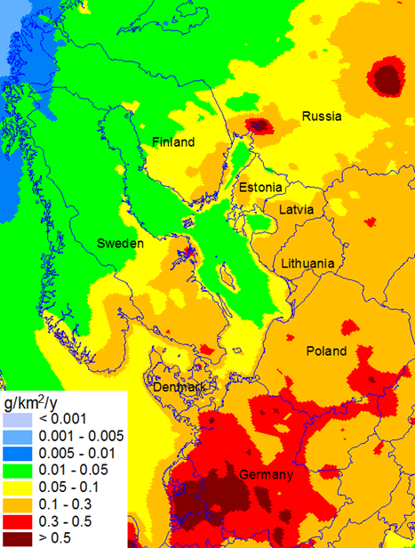
workplan item 1.1.1.6
Contaminants of emerging concern (CECs)
Motivation:
CECs have confirmed toxicity for humans and ecosystems
Some CECs (HCBD, PeCBz, PBDEs, PFAS, PCNs and SCCPs) are added to the POP Protocol (2009)
CECs are of high interest of other international bodies (Stockholm Convention, AMAP, HELCOM, OSPAR)
Monitoring of BDE-99 within EMEP
Modelled deposition of BDE-99
Ongoing and future EMEP activities:
Monitoring of CECs at EMEP stations (CCC, countries)
Review of information (emissions, properties) and pilot model assessment (MSC-E in co-operation with HELCOM)
Workshop on CECs measurements and modelling (2023, TFMM, TF HTAP, CCC, MSC-E)

Slide 13
Future research directions
  Contribution to multi-model intercomparison study of BaP/PM pollution as a part of EuroDelta-Carb (TFMM) (item 1.1.1.5)
  Collaboration with TF HTAP on development of global Hg and POP emissions inventories and model intercomparison studies (TF HTAP meetings, May 2022) (items 1.1.4.3, 1.1.4.5, 1.1.4.6)
  Co-operation with the effect community on assessment of heavy metal and POP pollution and trends (WGE, ICP Vegetation, ICP Forests) (items 1.1.1.13, 1.1.1.18)
  Research of atmospheric pollution of the marine environment (co-operation with HELCOM and OSPAR) including HMs of second priority (item 1.3.1)
  Preparatory work for assessment of Contaminants of Emerging Concern (CECs) (item 1.1.1.6)

