Slide 1
24th meeting of the Joint Convention/WHO Task Force on the Health Aspects of Long-range Transboundary Air Pollution, Bonn, Germany (virtual meeting)
10–11 May 2021
Assessment of PAH pollution levels, key sources and trends
A. Gusev, N. Batrakova, V. Shatalov, O. Rozovskaya

Slide 2
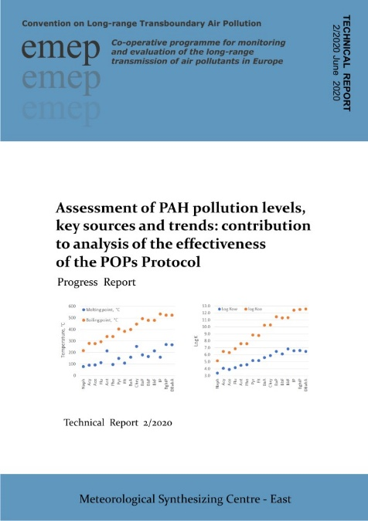
PAH pollution and population exposure
Contribution to analysis of POP Protocol effectiveness in co-operation with TFTEI, TFH (workplan 1.1.1.1)
Long-Term Strategy for the Convention (2020-2030):
“Unintentional releases of PAHs are still a concern”
“Continue scientific research on POP transport and trends with a focus on PAHs”
Progress Report on PAHs (2020)
Main issues considered in the MSC-E report on PAHs:
Trends in B(a)P pollution and exceedances of limit values
Key emission sectors and temporal changes of their contributions
Exposure to mixture of 16 toxic PAHs
Contribution of PAHs to PM adverse effects

Slide 3
PAH emissions: key sectors and temporal changes
PAH emissions:
Biomass/fossil fuels combustion is the main source of PAHs emission
The largest contribution is made by Residential combustion sector
PAHs are co-emitted with PM from sectors related to combustion
PAH emissions do not change significantly over the past ~20 years
4 PAHs and PM_{2.5} sectoral emissions (CEIP)
4 PAHs
PM_{2.5}

Slide 4
Long-term changes of B(a)P pollution in the EMEP region
Modelled vs measured B(a)P air concentrations at EMEP sites
Modelled B(a)P concentrations generally correspond EMEP measurements
No significant decrease of B(a)P concentrations in modelling results and measurements
B(a)P concentrations (2018)
EMEP sites with long-term measurements of B(a)P

Slide 5
Long-term changes of B(a)P pollution in the EMEP region
Observed B(a)P concentrations in period 2007-2018 (EU EEA AIRBASE)
Poland
EU target limit
Italy
High concentrations near or above air quality guidelines (2018)
Implications to the analysis of POP Protocol effectiveness:
Lack of decrease in B(a)P pollution levels and emission during recent ~10-20 years
Exceedances of air quality guidelines are still existed in some of EMEP countries

Slide 6
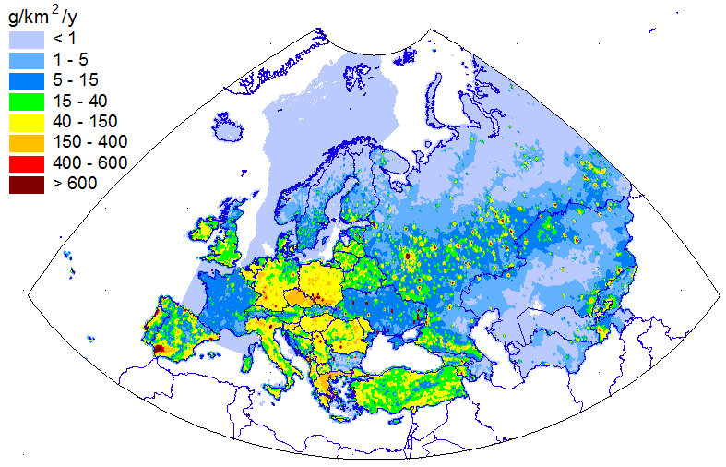
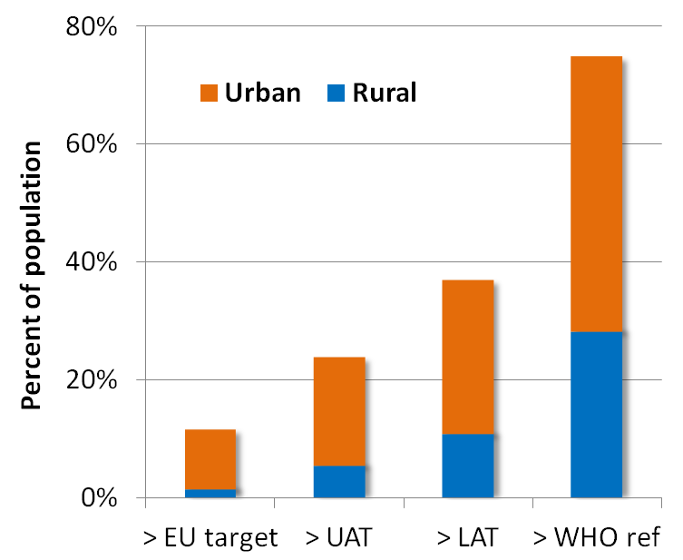
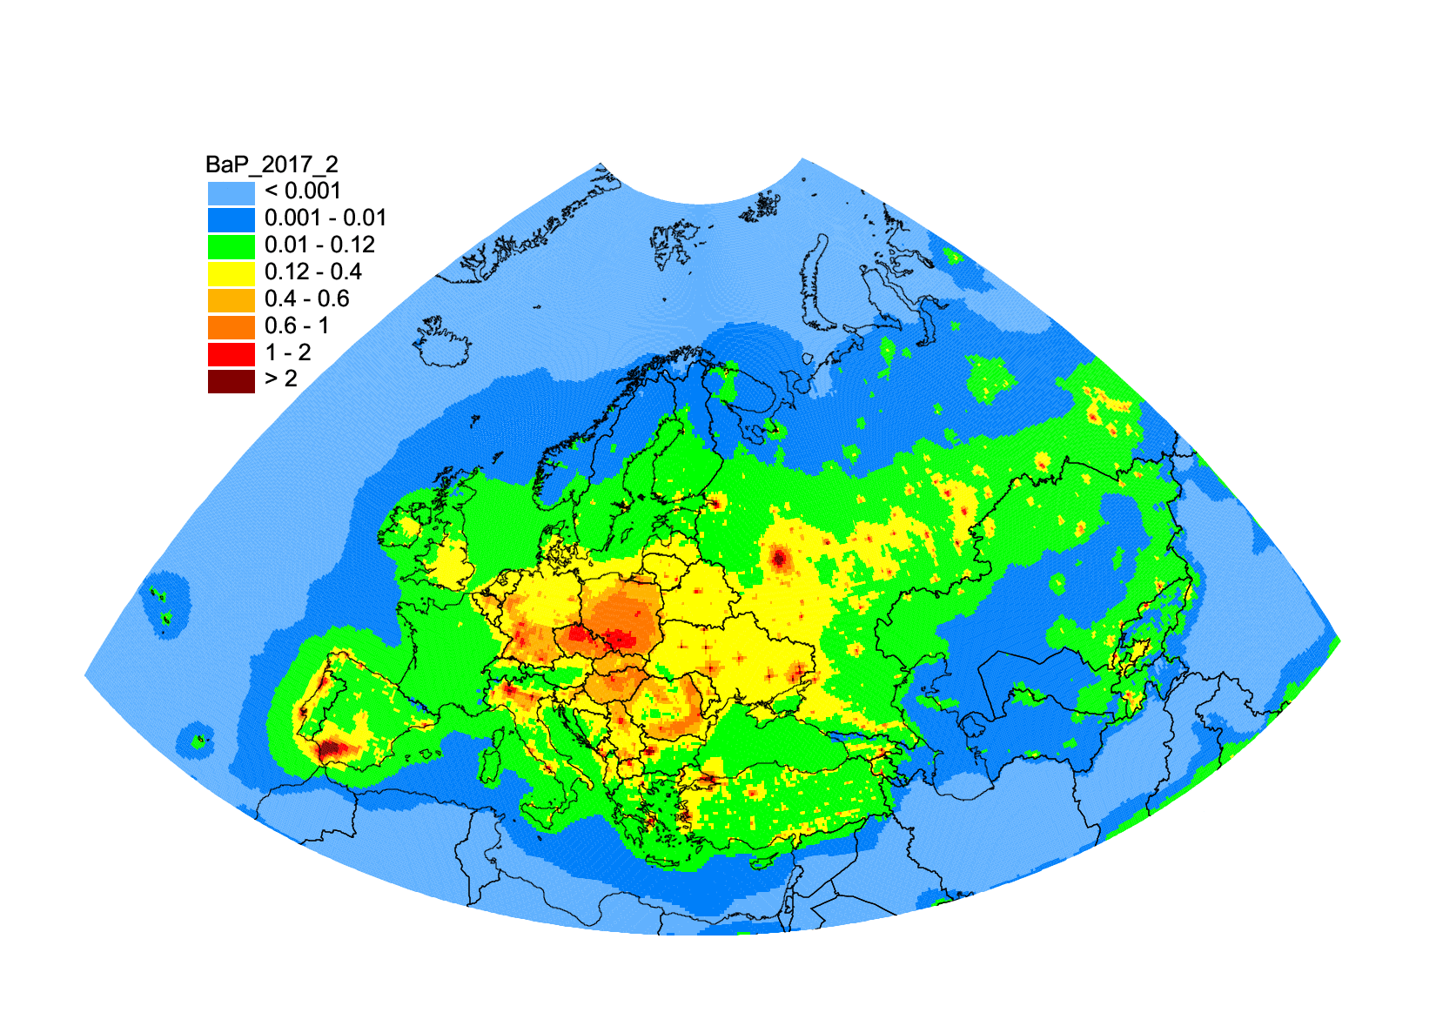
Human exposure to high B(a)P levels
Contribution to analysis of the effectiveness of POP Protocol (TFTEI)
B(a)P emissions (2017)
Population in areas with exceeded EU/WHO limits for B(a)P
B(a)P air concentration (2017)
1 ng/m³
0.12 ng/m³
~10% of population
~70% of population
Information on exceedances can be delivered to TF Health/WHO PAH group

Slide 7
Evaluation of exposure to mixture of toxic PAHs
PAHs are emitted to the atmosphere as a mixture of different compounds
Number of considered PAHs differs in various international organizations and countries
Carcinogenic (CEQ), mutagenic (MEQ), and dioxin-related toxicity (TEQ) equivalents can be estimated for PAH mixture
POP Protocol
EU Air Directive/ECHA*
US EPA Priority list
4 PAHs
BaP, BbF,
BkF, IND
8 PAHs
BaP, BeP, BaA, DahA, BbF, BjF, BkF, Chry
16 PAHs
BaP, BaA, BbF, BkF, DahA, Chry, IND, Acy, Flth, Pyr, Nap, Flu, Ace, BghiP, Ant, Phen
* ECHA – European Chemical Agency

Slide 8
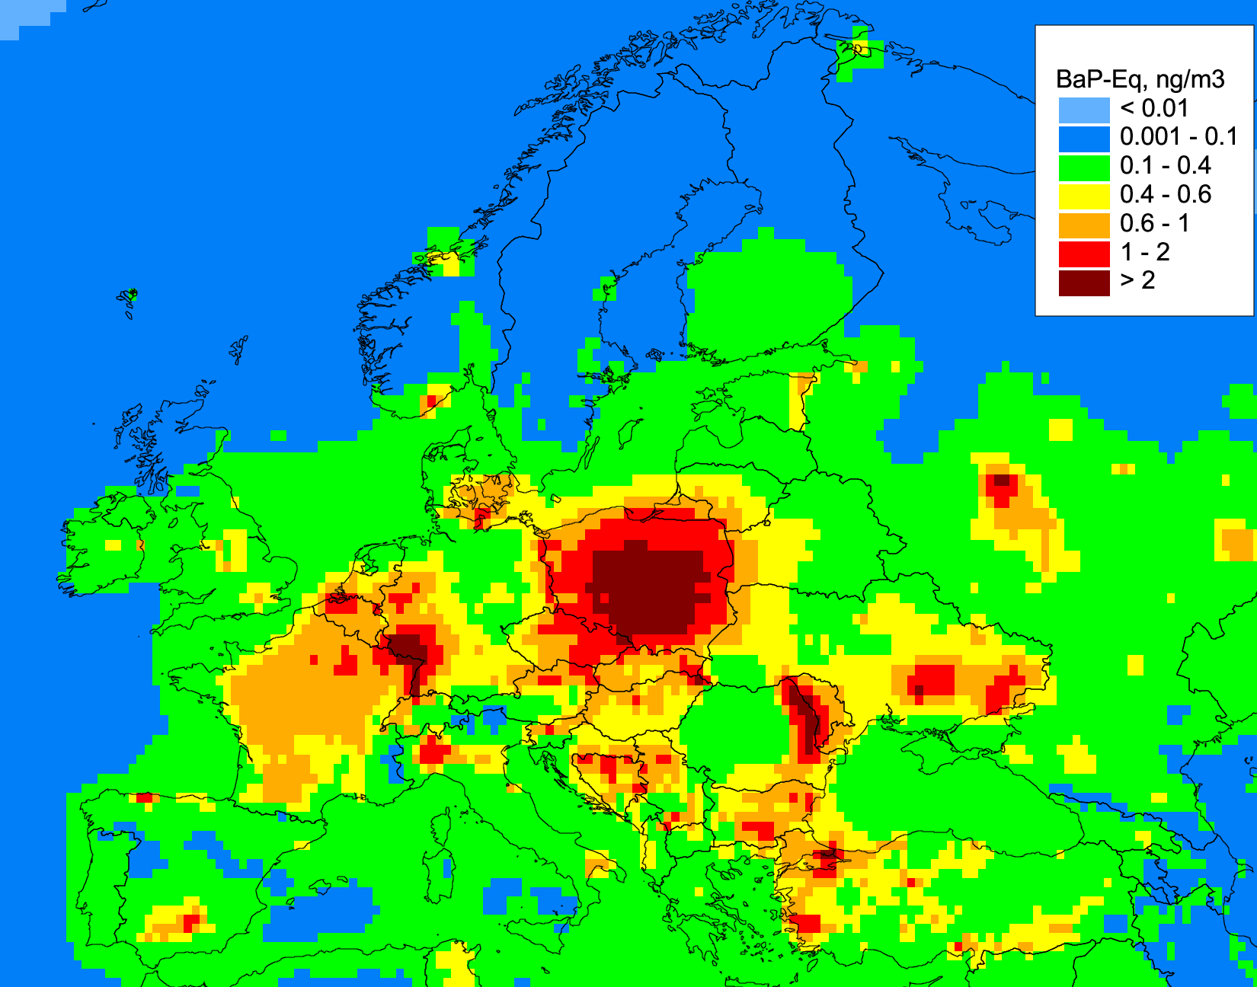
Evaluation of exposure to mixture of toxic PAHs
Experimental model simulations of 16 PAHs based on expert estimates of emissions (Pekin University project PKU-FUEL, 2015)
B(a)P-equivalent concentrations of 16 PAHs exceed EU target value in many countries
B(a)P equivalent concentrations of 4 PAHs (ng TEQ m⁻³)
Contributions of 16 PAHs to total B(a)P equivalent concentrations
B(a)P_{eq} = Σ (C_{PAHi} * TEF_{i})
B(a)P equivalent concentrations of 16 PAHs (ng TEQ m⁻³)
Inclusion of additional PAH compounds into the assessment may help to characterize population exposure to toxic PAHs more accurately

Slide 9
Contribution of PAHs to PM adverse effects
Air quality assessment for PM is often based on PM mass concentration without considering sources and chemical composition of particles
Impact of PM on human health may be more significant due to the presence of toxic constituents (e.g. PAHs, PCDD/Fs,…)
Analysis of PAH toxicity can contribute to evaluation of adverse effects of PM on human health
PM chemical composition may include:
Health effects of PM and PAHs/HMs
Respiratory diseases
Cardiovascular and cardiopulmonary diseases
Carcinogenic and mutagenic effects
…
Organic components (e.g. PAHs, PCDD/Fs, …)
PM
Heavy metals (e.g. Cd, Pb, …)
Other components

Slide 10
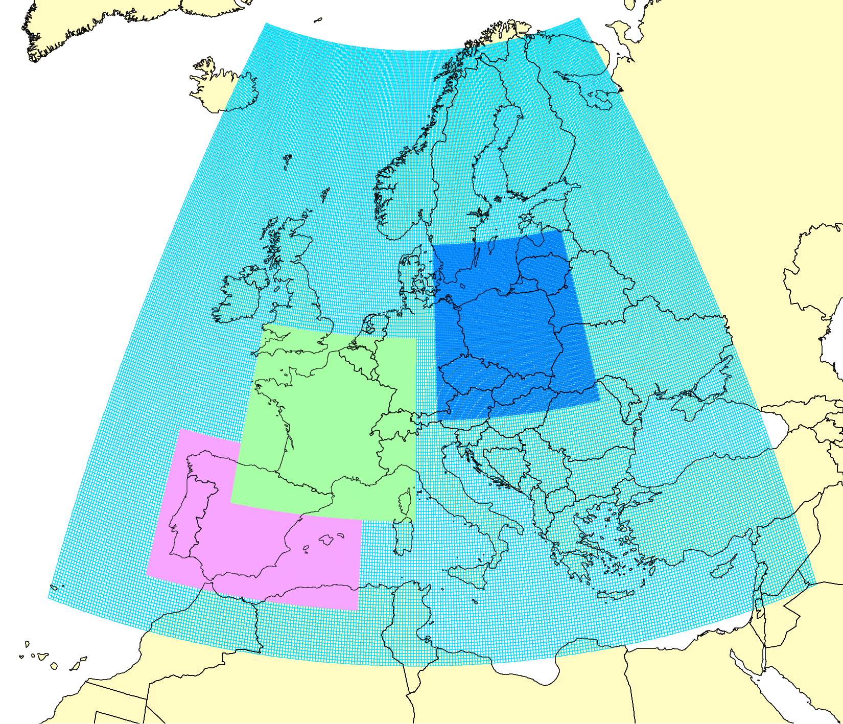
Research to improve PAH pollution assessment
National scale studies on B(a)P (Spain, France, Poland)
Project domains
Past and on-going studies (2017-2021):
Multi-model study of B(a)P pollution in Spain and France
Analysis and improvement of B(a)P emissions from key sectors (agriculture, domestic heating)
Analysis of model parameterizations for B(a)P
Initiation of a new case study for Poland (2020-2021)
Poland
France
Spain
B(a)P emissions in Spain
Refinement of B(a)P emissions (Spain):
Updated total emission is 30-60% lower
The dominating sector changed from “Agriculture” to “Residential combustion”
Previous estimates
Refined estimates

Slide 11
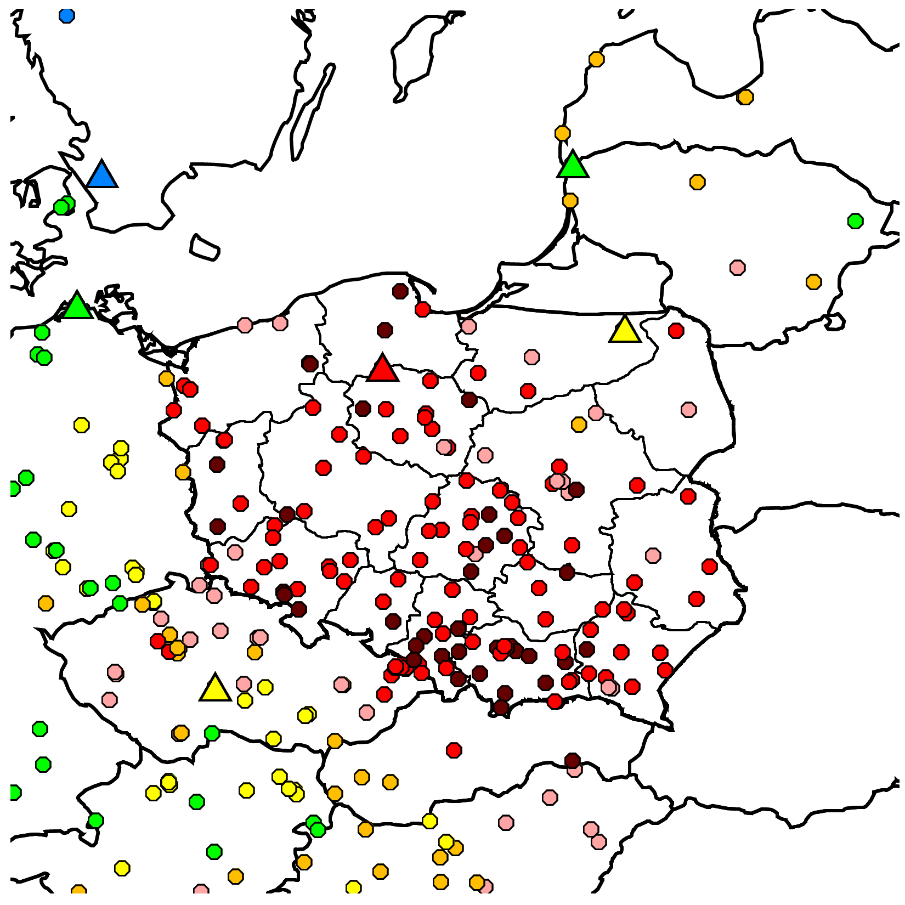
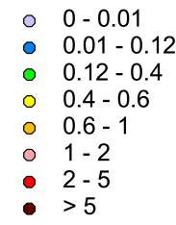
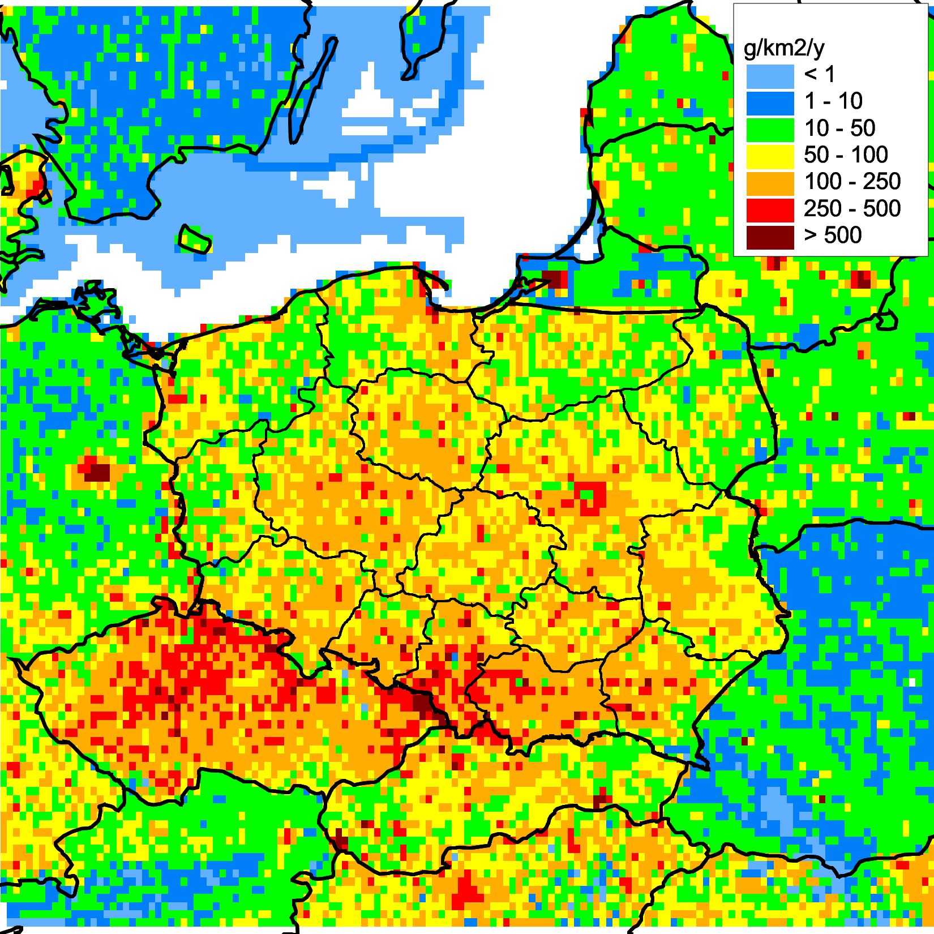
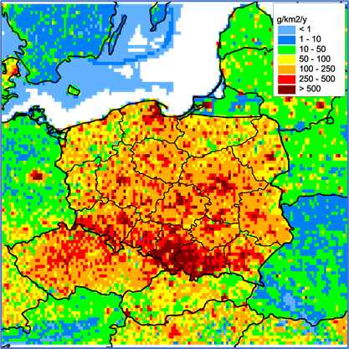
Research to improve B(a)P pollution assessment
National scale studies on B(a)P/PAH pollution (Poland)
Program of the study (2020-2021):
Simulations of B(a)P and other PAH levels in the country involving detailed national data
Model evaluation of updated national PAH emissions inventory and scenarios
Analysis of residential combustion contribution to PAH levels in the country
Estimates of exceedances of the EU and WHO air quality guidelines for PAHs
Inter-comparison of GLEMOS and GEM-AQ model results for B(a)P
Observed B(a)P conc (2018) EMEP+AIRBASE
B(a)P, ng m⁻³
Long-term changes of B(a)P emissions
Spatial distribution of B(a)P emissions
Previous inventory
Updated inventory
Updated inventory
Previous inventory

Slide 12
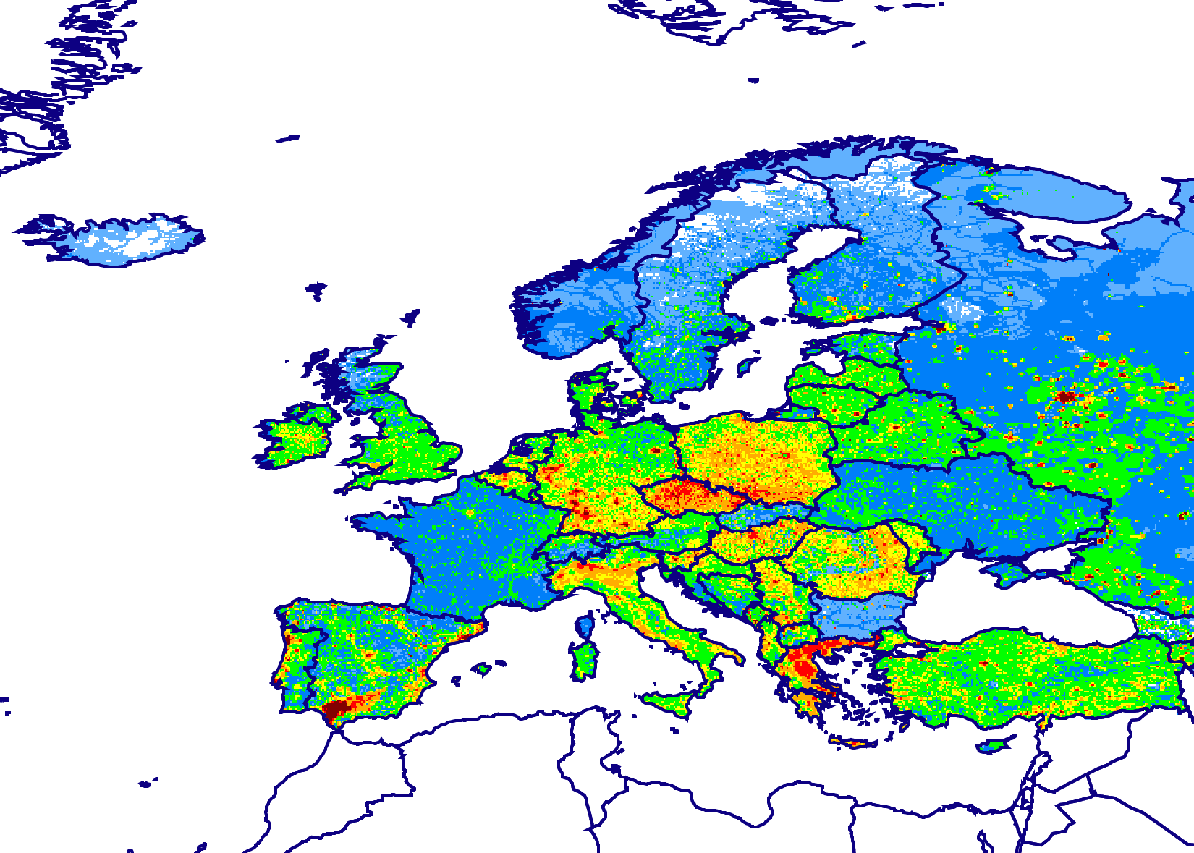
Multi-model study of B(a)P pollution
Contribution to EuroDelta-Carb model intercomparison project (TFMM)
Objectives :
Multi-model assessment of B(a)P pollution levels and exceedances of air quality guidelines
Analyzing relationship between B(a)P and PM transport and fate (including PM components – OC, EC)
Contribute to analysis of consistency of residential wood burning emissions
Model domain and B(a)P emissions
Modeling groups:
Institution | Model | Participants
EMEP/MSC-E | GLEMOS | Alexey Gusev
INERIS (France) | CHIMERE | Augustin Colette
FMI (Finland) | SILAM | Rostislav Kouznetsov, Evegeny Kadantsev
CIEMAT (Spain) | CHIMERE | Marta Garcia Vivanco
ENEA (Italy) | MINNI | Mihaela Mircea, Ilaria Delia, Mario Adani

Slide 13
Ongoing and further EMEP activities on PAHs
Research activities
Analysis of trends and key sources of PAH pollution in the EMEP region
Multi-model analysis of B(a)P pollution in 2017/2018 using data of intensive winter monitoring campaign (EuroDelta-Carb)
Case study on B(a)P pollution in Poland
Analysis and attribution of long-term changes of PAH pollution on global/regional scale (in co-operation with TF HTAP)
Co-operation
Data exchange with TF Health on B(a)P/PAH concentration and exceedances of target values to assess population exposure
Co-operation with international organizations (HELCOM, …)

