Slide 1

Analysis and source attribution of long-term Hg pollution trends:
Proposal for multi-model assessment
Oleg Travnikov, EMEP/MSC-E

Slide 2
HTAP assessment of Hg trends
Objectives (based on the policy-relevant questions):
Retrospective analysis of Hg pollution trends in various regions of the globe based on model estimates and measurement data
Attribution of Hg concentration and deposition trends to changes in regional and extra-regional anthropogenic emissions
Analysis of other factors affecting long-term Hg pollution changes (secondary emissions, meteorology, chemistry, land cover, sea ice extent etc.)
Projection of future levels of Hg atmospheric pollution based emission scenarios

Slide 3
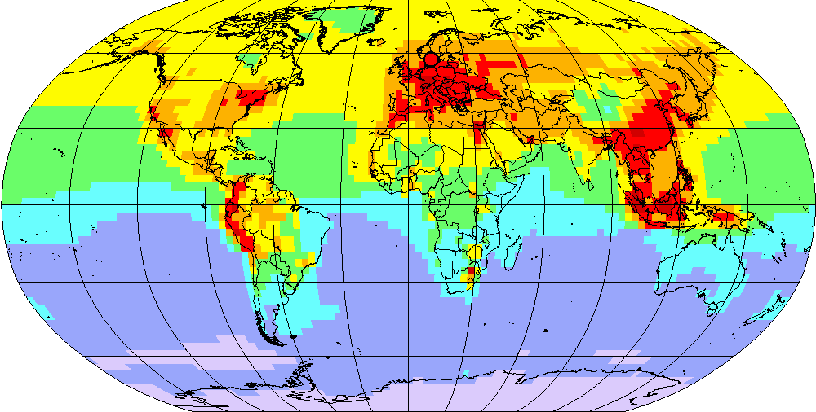
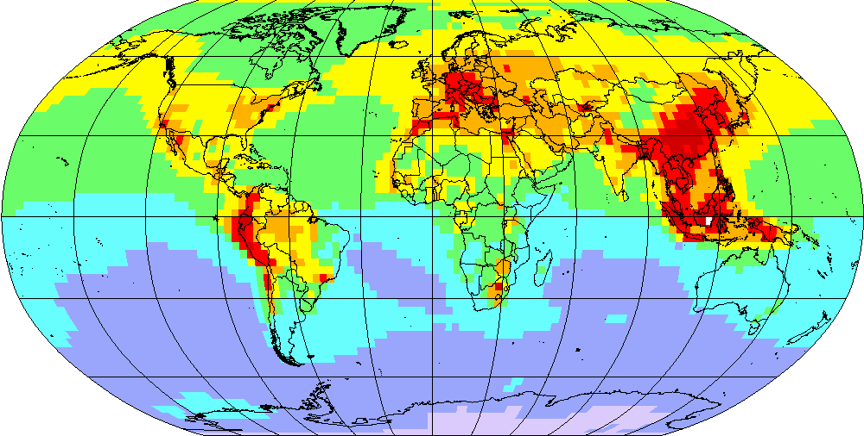
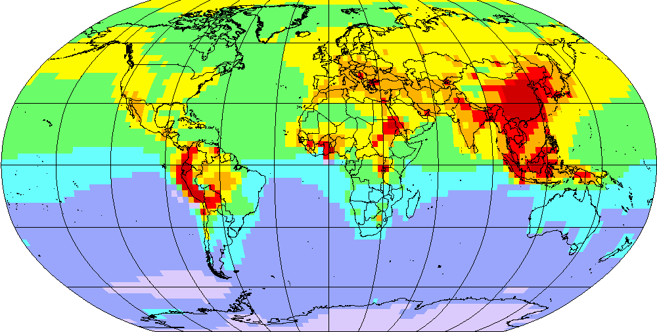
Pilot simulations (testing the approach)
Hg⁰ concentration
Model set-up:
Model: GLEMOS (v2.2.2)
Simulations period: 1990-2018
Emissions: Streets et al. (2019), UNEP/AMAP (GMA 2013, GMA 2018)
Meteorology: ECMWF reanalysis, WRF pre-processing
Chemical reactants: GEOS-Chem (v12.8.2)
1990
2000
2018

Slide 4
1. Model/measurement analysis of Hg trends
Evaluation of modelled trends vs. long-term measurements
Europe (Hg⁰ concentration)
Arctic (Hg⁰ concentration)
n = 22
n = 5
Europe (Hg wet deposition)
n = 19
Measurements
Model
The measurements dataset needs to be extended

Slide 5
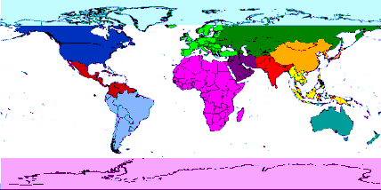
2. Hg trends attribution: Source regions
Contribution of emission source regions to Hg⁰ concentration trends
Source regions
Europe
North America
South Asia
East Asia
Other
Natural & legacy

Slide 6
3. Hg trends attribution: Other factors
Contribution of various factors to relative change of Hg⁰ concentration
Total reduction
Anthropogenic emissions
Meteorology / climate
Chemical reactants
Others

Slide 7
3. Hg trends attribution: Other factors
Contribution of various factors to relative change of Hg deposition
Total reduction
Anthropogenic emissions
Meteorology / climate
Chemical reactants
Others
The analysis results are sensitive to consistency of the emissions dataset

Slide 8
4. Projection of future Hg pollution levels
Long-term changes of Hg deposition based on emission scenarios (1990-2035)
Emission scenarios (2035)
(Pacyna et al., 2016)
Current policy
New policy
Maximum Feasible Reduction
The emission scenarios need to be updated

Slide 9
Proposal for multi-model experiments
Experiments set-up (to be further discussed)
1. Base case simulation (1990-2019):
Standard model configuration and input data
2. Evaluation vs. long-term measurements
3. Model experiments (trends sensitivity to changes in):
Anthropogenic emissions (in various regions)
Meteorological conditions
Atmospheric chemical reactants
Surface conditions (land cover, sea ice extent)
…
4. Simulation of future scenarios (if available)

Slide 10
Participating Hg transport models
Model | Institution (user) | Type
ECHMERIT | CNR-IIA (Italy) | Atmospheric
GEM-MACH-Hg | Environment and Climate Change Canada (Canada) | Atmospheric
GEOS-Chem | Harvard University (USA) | Atmosphere/land/ocean coupled
GEOS-Chem | MIT (USA) | Atmosphere/land/ocean coupled
GLEMOS | EMEP/MSC-E | Atmospheric
GBC-boxmodel | Harvard University (USA) | Box, multi-media
MECOSMO | HZG (Germany) | Oceanic

Slide 11
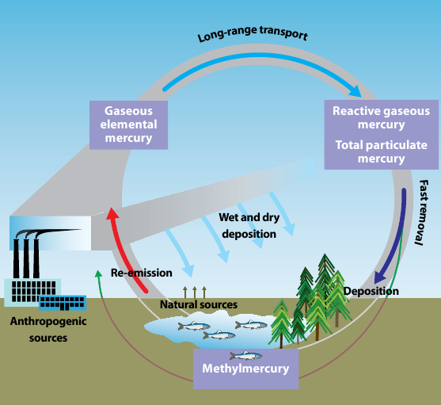
Modelling: Limitations and uncertainties
Atmospheric transport models do not account for long-term changes in secondary/legacy emissions
Solutions: (1) Top-down estimates of secondary emission changes based on long-term measurements; (2) Coupling to multi-media box models; (3) Application of simplified metrics (e.g. EAMD, Selin 2018)
Uncertainties of Hg atmospheric chemistry
No direct link to human and ecosystem exposure changes
Solution: Coupling to aquatic and terrestrial biogeochemical models
Hg cycling in the environment
© UNEP/AMAP, 2008

Slide 12
Data needs: Anthropogenic emissions
Global Hg emission inventories
Requirements:
Global coverage, spatially distributed
Consistent time series (1990-2019) in different source regions
Speciated emissions (Hg⁰, Hg²⁺, Hg_{part})
Vertical distribution
Seasonal variation
Emission projections
GMA 2013 / GMA 2018
EDGARv4.tox2
Streets et al. (2019)

Slide 13
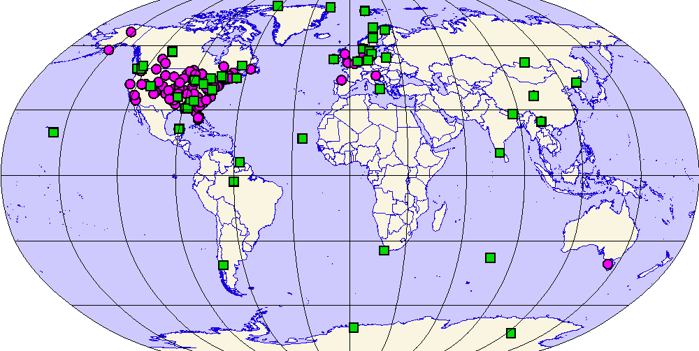
Data needs: Measurements
Requirements:
Air concentration (Hg⁰/TGM), wet deposition
Long time series or different time periods
Hg monitoring networks
AMAP
NAtChem
EMEP
AMNet
NADP/MDN
GMOS
GMOS
Hg networks / campaigns
Network | Region | Data type
EMEP | Europe | air conc / wet dep
GMOS | Global | air conc / wet dep
NADP/MDN | North America | wet dep
AMNet | North America | air conc
NAtChem | North America | air conc
AMAP | Arctic | air conc
CARIBIC | Global | air conc
Ship cruises | Oceans | air conc
… | … | …
Hg⁰ / TGM concentration
Hg wet deposition

Slide 14
Following discussion sessions
Session 1. Modelling needs and opportunities
Session 2. Emissions needs and opportunities
Session 3. Observational needs and opportunities

